Slide 1
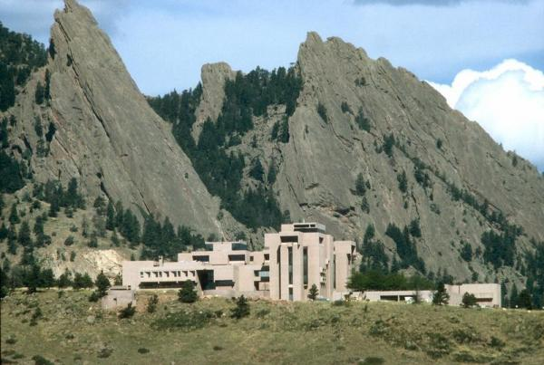
National Center for Atmospheric Research
John Clyne
4/27/11

Slide 2
NCAR Mission
NCAR is a federally funded research and development center devoted to service, research and education in the atmospheric and related sciences.
NCAR’s mission is to understand the behavior of the atmosphere and related physical, biological and social systems; to support, enhance and extend the capabilities of the university community and the broader scientific community – nationally and internationally; and to foster transfer of knowledge and technology for the betterment of life on Earth.
The National Science Foundation is NCAR's primary sponsor, with significant additional support provided by other U.S. government agencies, other national governments and the private sector.

Slide 3
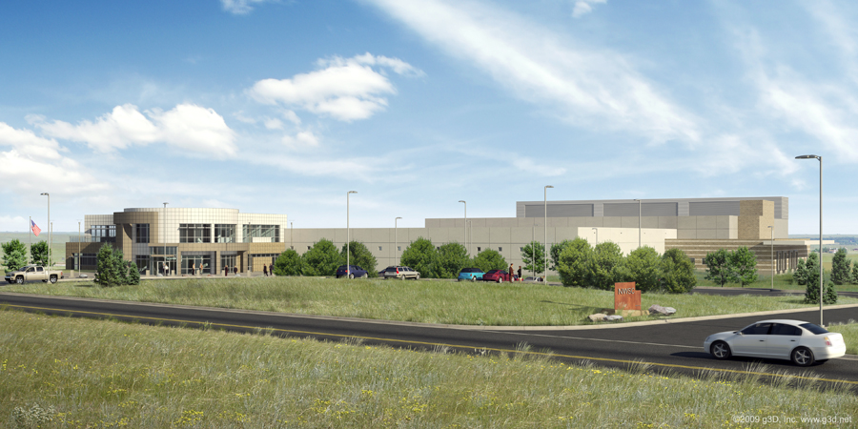
NCAR-Wyoming Supercomputer Center (NWSC)

Slide 4
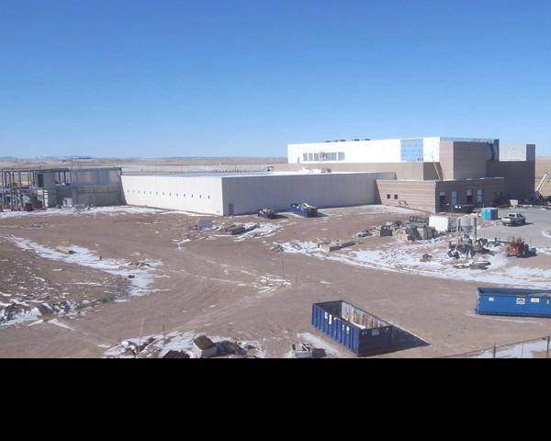
NCAR-Wyoming Supercomputer Center (NWSC)

Slide 5
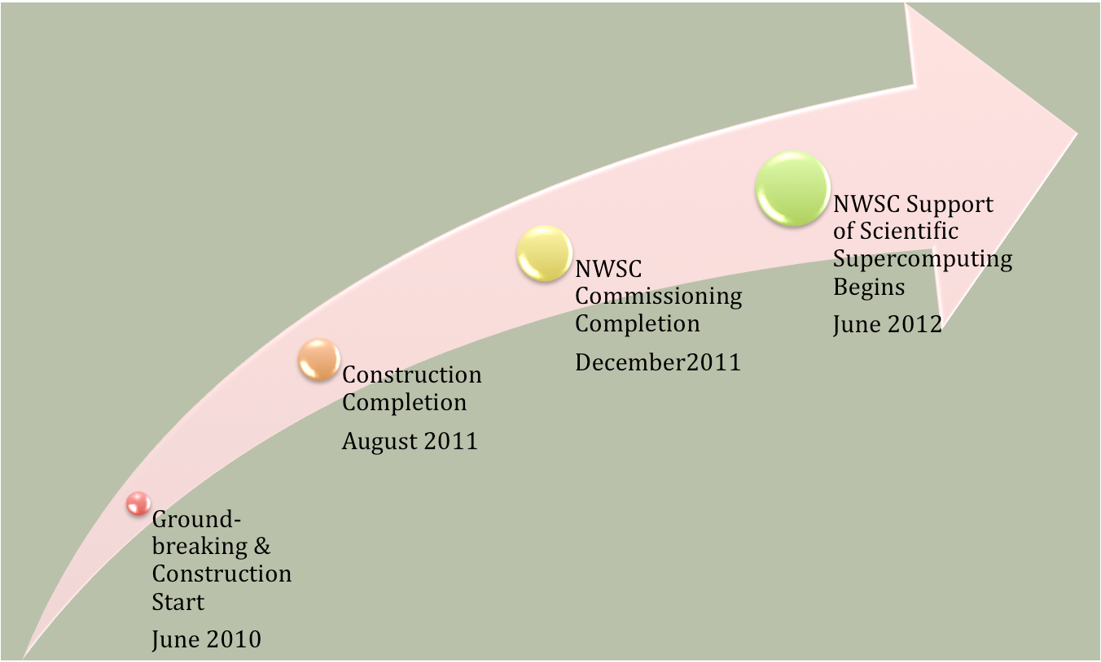
NWSC timeline

Slide 6
NWSC Fun Facts
$70M facility (state of Wyoming put up ~$25M)
Located in Cheyenne, Wy (~2 hours north of Boulder)
Minimal staff on site (~20 technicians)
NCAR is pursuing LEED Gold certification for the facility (90% more efficient than typical data centers)
92% of power will go directly to supercomputing (not cooling, etc)
10% of power from wind
~5 Mwatts first phase, with room for expansion

Slide 7
NWSC SuperComputer RFP
Bids currently under review
Award in June/July
Delivery Q1CY12 (we go production in June)
RFP components:
Batch compute
Data Analysis and Visualization
Shared storage
Vendors can bid on any combination of 3 components

Slide 8
RFP – HPC
>1 PFlop peak
Primary evaluation metric is performance on NCAR benchmark application suite

Slide 9
RFP - DAV Fat Node Cluster
Applications:
Large shared memory, limited parallelism
E.g. matlab, IDL, numpy, VAPOR
~10 nodes
30GB/sec IO bandwidth (aggregate)
10 TB RAM
~512 cores
10GigE interconnect
Nodes:
1TB RAM
1 GPU (CUDA compliant)
~64 cores
4GB/sec IO

Slide 10
RFP - DAV Vis and GPGPU Cluster
Applications:
Distributed memory viz
Experimental GPGPU
Tiled display (remotely driven)
16 nodes
40 GB/sec IO bandwidth (aggregate)
QDR IB Interconnect
Nodes:
64 GBs RAM
1 GPU (CUDA compliant)
16 cores
4GB/sec IO

Slide 11
RFP - Shared Storage
15 PBs capacity
150 GB/sec “burst” write
I/O burst: 20% of the aggregate memory of the batch-computing portion of the NWSC-1 HPC Production resource
60 GB/sec sustained read and write

Slide 12
VAPOR
New staff:
Yannick Polius (Rose Hulman Institute of Technology)
Recent focus areas:
Re-factoring architecture for extensibility (on-going)
A new, more aggressive progressive access data model (VAPOR 2.0)
Numpy calculation engine (VAPOR 2.0)
Global ocean circulation model data (on-going)
More on VAPOR, Wednesday at 2pm

