Slide 1



UltraVis Research Overview
DOECGF
April 29, 2011
Kenneth Moreland
Sandia National Laboratories
With contributions from:
Jian Huang, Kwan-Liu Ma, Nelson Max, John Owens, Tom Peterka, Rob Ross, Han-Wei Shen, Debora Silver, Shi Yan
SAND 2011-2710P
Sandia National Laboratories is a multi-program laboratory managed and operated by Sandia Corporation,
a wholly owned subsidiary of Lockheed Martin Corporation, for the U.S. Department of Energy’s National
Nuclear Security Administration under contract DE-AC04-94AL85000.

Slide 2
Breadth of UltraVis Research
Simulation
Resource
Visualization
Resource
In Situ Visualization
Parallel Rendering
Feature Tracking
Parallel File I/O
Polygon Surface Advection
Particle Tracking
Building Blocks
GPGPU
Query Interfaces

Slide 3
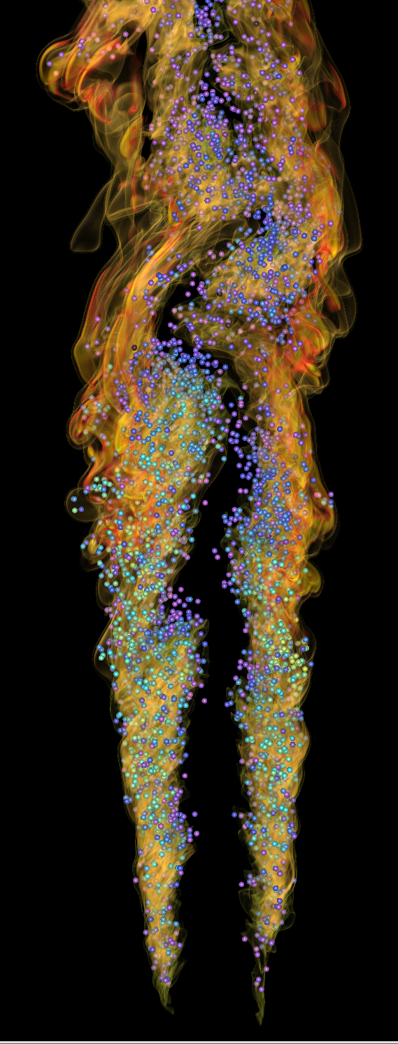
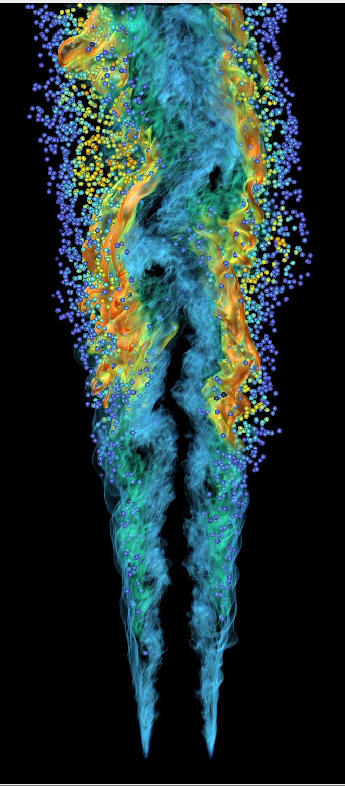
In Situ Visualization of
Ultra-Scale Simulations
When scientific supercomputing reaches exascale, new discoveries will become possible. However, scientists would not be able to study the full extent of the data generated by the high-resolution simulations with conventional post-processing data analysis methods.
Computer scientists at the SciDAC Institute for Ultrascale Visualization have pioneered in situ data analysis and visualization of very large scale simulations.
They have demonstrated in situ visualization of turbulent combustion simulations at the largest scale ever using the DOE Leadership Computing Facilities at ORNL, promising a solution to the upcoming exascale data analysis problems.
Turbulent Combustion Simulation of Lifted Flame
Notes:
Simulation
Jackie Chen, Sandia National Laboratories, CA
Visualization:
Hongfeng Yu, Sandia National Laboratories, CA
Kwan-Liu Ma, SciDAC Institute for Ultrascale Visualization

Slide 4
Parallel Image Composition With Radix-k
Problem
  Large-scale computational science requires parallel visualization to analyze data effectively. Image composition merges parallel results into one final image.
  Composition algorithms were developed in the mid ‘90s when supercomputing architectures were very different than current and future ones.
Solution
  Take advantage of modern supercomputer network architectures with a better algorithm that adapts to largest HPC leadership machines and smaller graphics clusters alike
  Implement in a popular image composition library called IceT
5X
Impact
  Enables science results sooner; wall-size images can be composed in less than one millisecond.
  Up to 5X faster than existing algorithms at full leadership scale
  ParaView and VisIt can now take advantage of Radix-k via IceT
A Configurable Algorithm for Parallel Image-Compositing Applications. Peterka et al., SC’09
Notes:
Problem
- Efficient data movement is essential for extreme-scale parallel visualization and analysis algorithms. Existing image composition algorithms, however, were developed in the mid 1990’s, and algorithms such as direct-send and binary-swap underutilize modern supercomputer networks.
Solution
We improved the performance of collective communication for data-parallel visualization with a new image composition algorithm called Radix-k that in many cases performs better than existing algorithms.
It does so through a set of configurable parameters that determine the number of communication partners in each message round. The algorithm is not tied to a particular computing architecture or network topology, and the selection of parameters allows Radix-k to take advantage of new supercomputer interconnect features such as multiple 3D torus links and DMA engines.
Impact
Proven scalability on Argonne Blue Gene/P and Oak Ridge Cray XT systems
Optimized performance for both HPC machines (Argonne’s Intrepid and Oak Ridge’s Jaguar) and graphics clusters (Argonne’s Eureka and Oak Ridge’s Lens), for process counts up to 32 K processes and image sizes to 64 megapixels. We demonstrated that 32 megapixels generated from parallel volume rendering at 32 K processes can be composited at interactive rates of .04 seconds, or 25 frames per second, and 64 megapixel images can be composited at 12.5 frames per second.
We implemented Radix-K in the IceT image compositing library that is used by VisIt and ParaView. It is now part of the IceT distribution, so that in future versions of these tools, visualization researchers and computational scientists can benefit from its advantages.
Images: (From top to bottom)
An example of eight processes’ images being composed into one final image
Radix-k outperforms binary swap by 3X to 5X across a range of system scales
Core-collapse supernova simulation rendered in parallel across 32K processes and composed using the Radix-k algorithm
A timeline of image composition algorithm developments. The three items in red are our contributions to the state of the art.

Slide 5
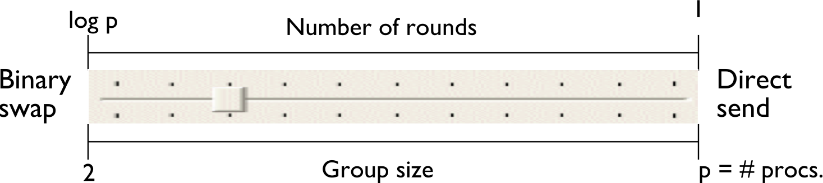
How the Radix-k Algorithm Works
Benefits
Increase concurrency while managing contention
2 <= k <= p
Overlap communication with computation by nonblocking and careful ordering of operations
No penalty for non-powers-of two numbers of processes is inherent in the algorithm design
Example of 8 process compositing in 2 rounds of k=4 followed by k=2
Accelerating and Benchmarking Radix-k Image Compositing at Large Scale. Kendall et al., EGPGV’10
Radix-k covers binary swap, direct send, and many other configurations between these two extremes

Slide 6
Activity Recognition in Scientific Visualization
    MOTIVATION: It is infeasible to visualize and search for events manually in ultrascale data → automated techniques to search and find features and events are necessary.
  Activity recognition is the process that extracts specific temporal patterns (events) from a set of time varying datasets. It includes defining primitive events (actions) through tracking and complex events (activities) that are a specified sequence of primitive events.
      Activity recognition deals with the inference problem therefore it can answer a new set of questions for the scientists. (Such as how features evolve, whether particular events take place, etc.)
      Defining scientific events and cataloguing features is part of activity recognition
The logical relations between activity recognition, feature tracking and segmentation
Activity Recognition
Feature Tracking
segmentation

Slide 7
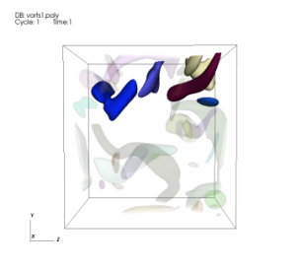
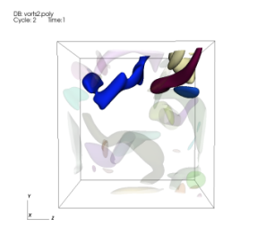
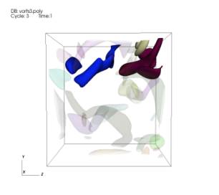
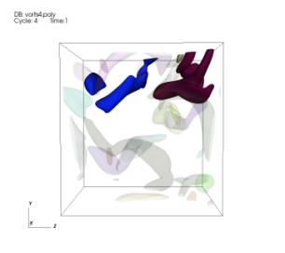
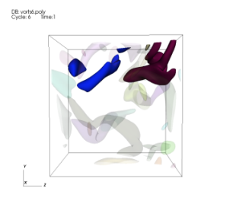

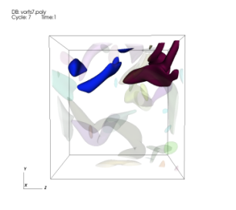
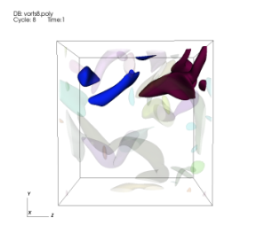
Activity Recognition
An activity can be modeled as a sequence of atomic events (actions).
Petri Nets can be used to define this activity
    5 tuple: {P,T,M,I,O}, where P=Place, T=Transition, M=Initial Marking (state),I defines the arcs and their weights from Places to transitions and O defines the arcs from transitions to Places. (where I and O can be defined as Matrices).
    Places are the object states and transitions are the actions. Markings can be object IDs or the number of objects in each state.
    This can then be used to search for activity within large datasets
k₀
Amalgamation
Continuation
2
p₃
p₂
2
Split
p₁
Bifurcation
Merge
k₀
Frame 1
Frame 2
Frame 3
Frame 4
Example:
Petri Net for searching for
a “Merge Split” activity
Frame 5
Frame 6
Frame 7
Frame 8

Slide 8
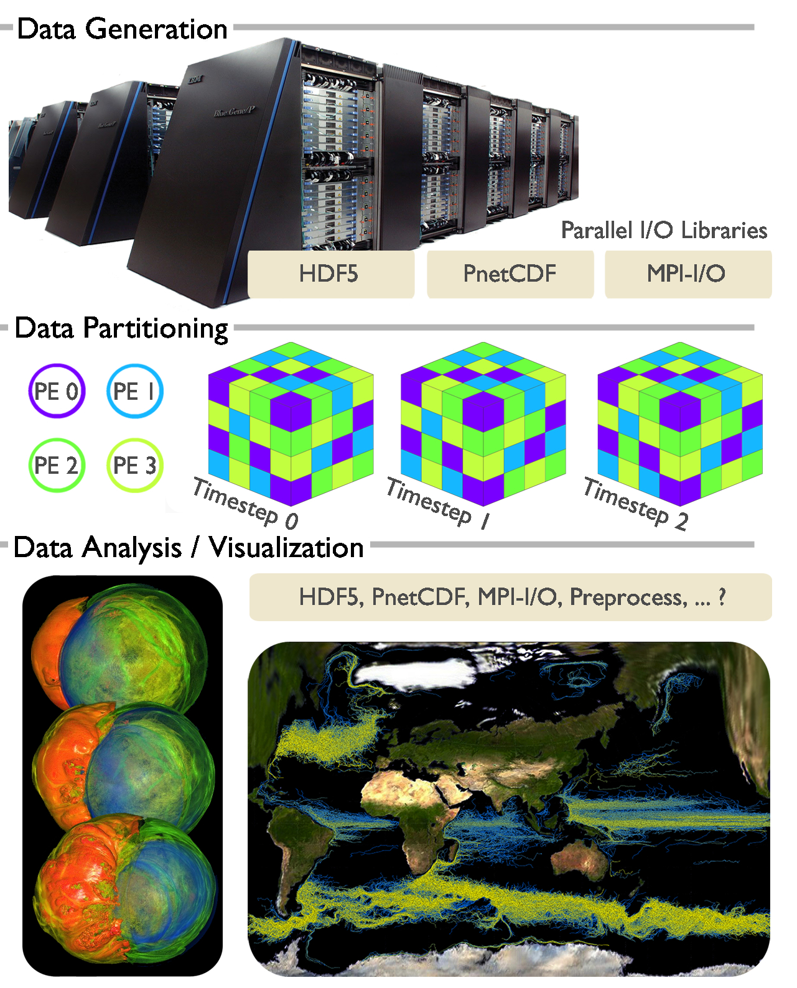
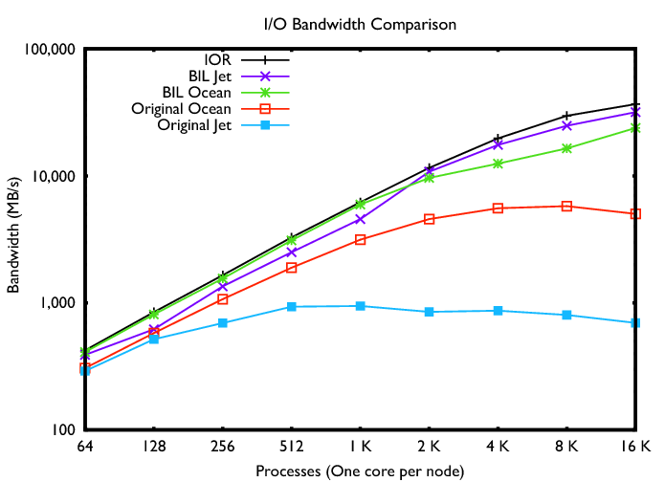
BIL - Block I/O Layer for Ultrascale Visualization and everything else!
Problem
  I/O is the generally agreed villain to performance
  Critical to visualization codes
  Yet few in visualization implement leading edge I/O practices in code
  Gap: too much I/O decisions in vis codes are due to file formats, too little are based on partitioning strategy
Solution
  Many visualization codes manages data on the granularity of blocks, including scalar vs. vector, static time vs. time-varying, single vs. multi/many-variable, single vs. ensemble output
  For this parallel visualization design pattern, we created a BIL library (already under public release) where IOR benchmark performance can be consistently achieved in application code
Impact
  Happy users!
Notes:
- What's the connection between BIL and the three libraries mentioned
on the slide?
Ans: BIL is an application level library that abstracts away the file save layer. It uses MPI-IO directly and
indirectly via PnetCDF (already implemented) or HDF5 (to be released).
- What does BIL *do* to deliver these results? A hint as to the
technique(s) involved would be helpful for uninformed audience members.
Ans: BIL implements two-phase collective I/O (I/O requests are
aggregated, I/O are then performed on maximized contiguous regions,
then exchange/resort data through MPI). The focus is on designing the
generic API, as well as on implementing parallel I/O practices
underneath. Multi-file capabilities are supported. On this slide 3-
timesteps are illustrated. With the test results, one test case has
2000 time steps, 375GB in total.
- Were the results from the BG/P? What are the I/O sizes?
Ans: Intrepid, BG/P. Jet: 375 GB total in 2000 files (one for each
timestep). So, small file in this case. Ocean: 82 GB, 32 files (one
for each timestep); medium sized files.
- Why are you showing three timesteps? Are we combining I/O between
timesteps or something?
Ans: Reading the whole dataset altogether, and distribute data by
block granularity to visualization processes -- as commonly done by
applications like volume rendering and flow advection. Three timesteps
are for illustration purpose.

Slide 9
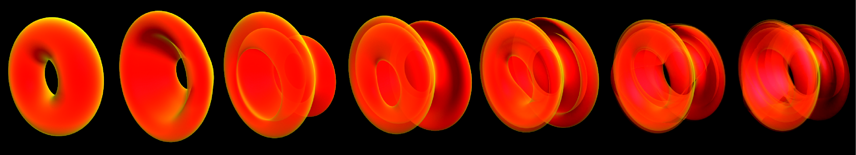
Polygon Surface Advection applied to Strange Attractors
Visualization Problem:
  Strange Attractors arise from chaotic systems with fractal structure (Infinite layers fold on top of itself).
Solution:
  A GPU accelerated polygon surface advection method:
    Adaptive subdivision phase
    Mesh decimation phase
      Re-tiling to solve self-intersection.
Result: Tested on Lorenz, Rössler, Van der Pol and Duffing Attractors.
Notes:
To start with, I’d like to introduce some basic notions of attractors and strange attractors.
Informally an attractor is a set towards which a dynamical system evolves over time. So if we put many points inside the dynamic system, the points will eventually be infinitely close to the attractor.
Strange attractors are attractor arise from chaotic systems. the chaotic behavior is the behavior of a dynamic system that is very sensitive to the initial conditions.
If the chaotic behavior takes place on an attractor, the attractor is called a strange attractor.
A Strange attractor has the characteristics of having fractal structures. In the cases we test in this paper, the fractal structure can be simply described as infinite layers on top of itself.
9

Slide 10
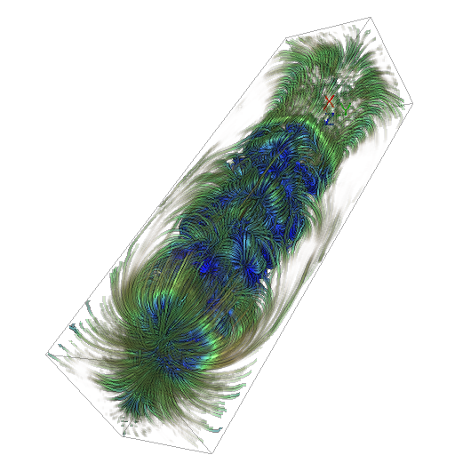
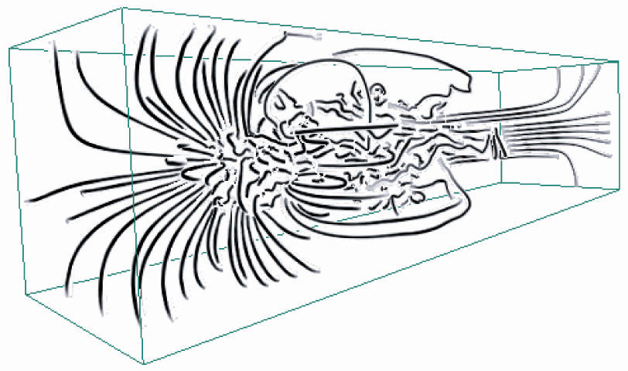
Parallel Particle Tracing for Large-scale Flow Fields
Problem
  Large-scale simulations (climate modeling, nuclear fusion, etc.) often attempt to model very complex fluid flow phenomena. Effective visualization of the resulting flow fields plays an important role in enabling validation of the simulations and scientific knowledge discovery.
  To understanding of the complex flow fields, many visualization techniques based on computing a large number of particle tracing in space and time
  Efficient parallel particle tracing is non-trivia due to irregular workload distribution and data access patterns.
Solution
  A scalable parallel flow visualization library is developed by IUSV researchers for DOE’s Leadership Computing Facility.
  The library contains optimized parallel load distribution, communication, I/O components with high quality rendering capability to support both postprocessing and in-situ visualization.
Impact
  The library exhibits strong scaling up to 16K processes.
  It has been made freely downloadable.
  IUSV is actively collaborating with scientists at Argonne National Lab (Nek5000 code) and climate scientists at PNNL to adopt this library.

Slide 11
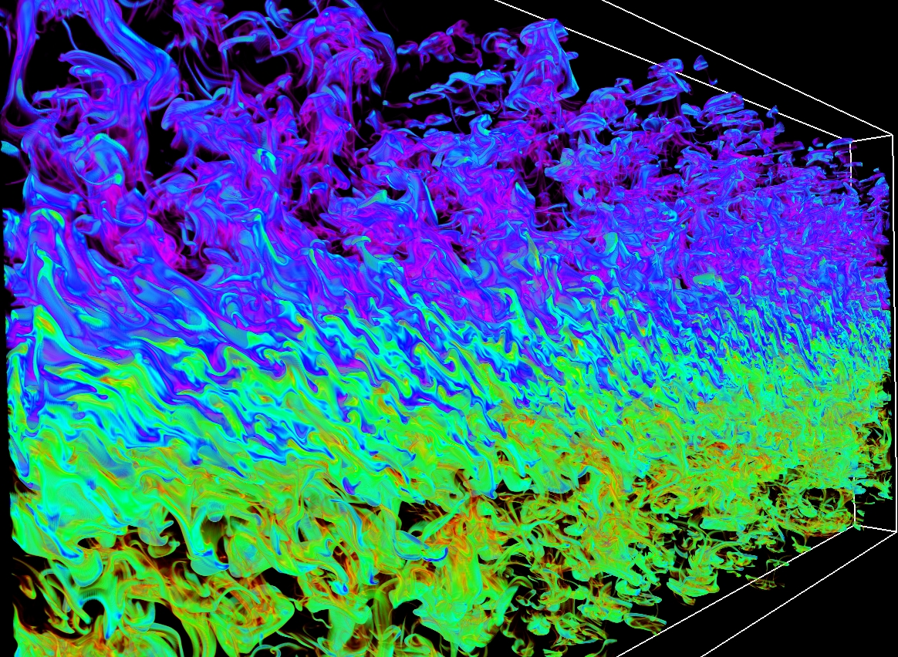
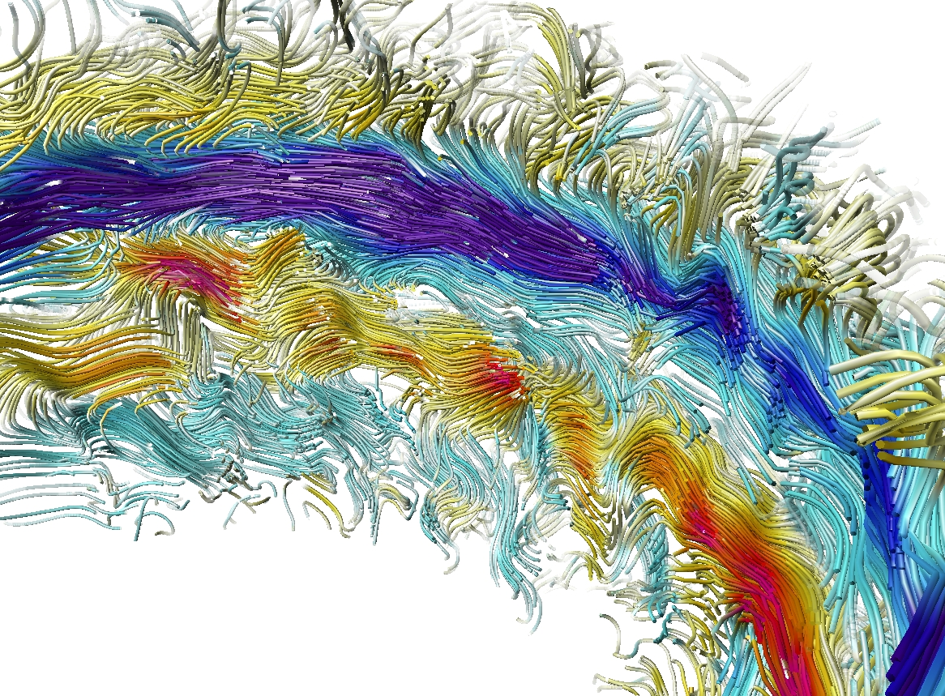

OSUFlow Library
As a result of an NSF grant, OSU began to construct a flow visualization library since 2004
In 2005, the core of OSUFlow Vis library was adopted by NCAR’s visualization software VAPOR and released to the turbulence research community via SourceForge (more than 1000 downloads so far)
In 2008, OSU and Argonne began to extend the library to run on DOE’s leadership computing facility
Currently more than 25,000 lines of code

Slide 12
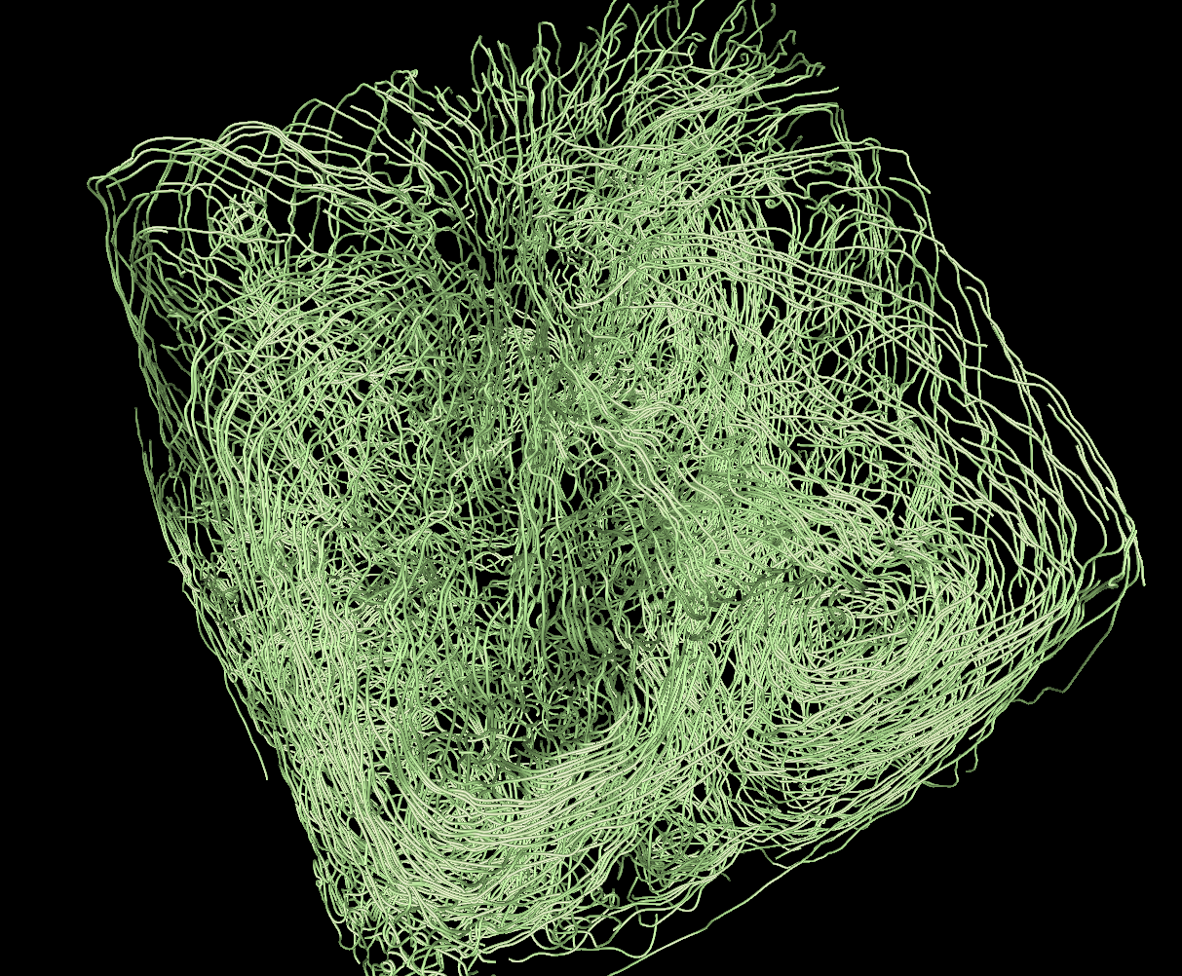
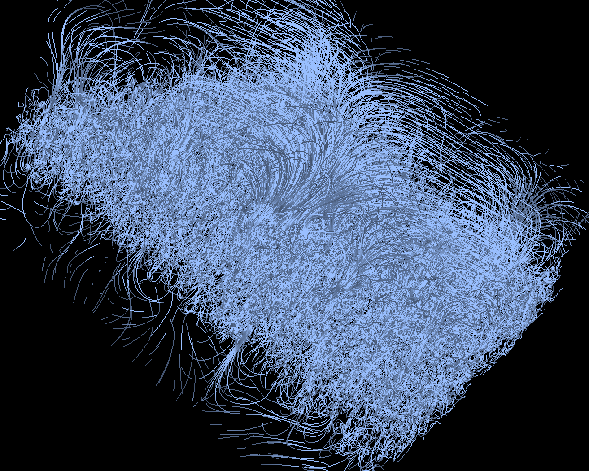
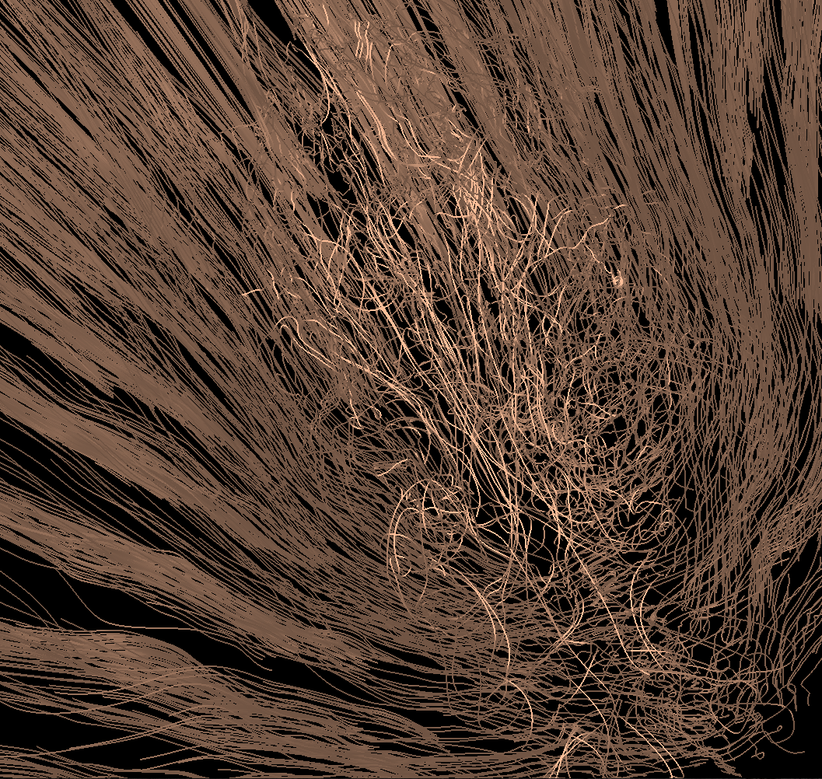
Large-Scale Parallel Particle Tracing
Benefits
Large system size, up 32K cores
Dense seeding, up to 128K particles
Static and time-varying flows
Downloadable library
https://svn.mcs.anl.gov/repos/osuflow/trunk
Strong scaling, 2048 x 2048 x 2048 data, 128K particles, 1 time-step
Weak scaling, 2304 x 4096 x 4096 data, 16K to 128K particles, 1 time-step
Weak scaling, 1408 x 1080 x 1100 data, 512 to 16K particles,1 to 32 time-steps
Thermal hydraulics data courtesy Aleks Obabko and Paul Fischer, ANL
Rayleigh-Taylor instability data courtesy Mark Petersen and Daniel Livescu, LANL
Flame stabilization data courtesy Ray Grout, NREL and Jackie Chen, SNL
A Study of Parallel Particle Tracing for Steady-State and Time-Varying Flow Fields. Peterka et al., IPDPS’11

Slide 13
Building Blocks for Scalable Parallel Analysis
Global Reduction
Goal:
Achieve scalability through a common set of core data movement components
Balance load (computation, communication)
Minimize / optimize data movement (storage and network)
Hide data movement (overlap with work)
Benefits:
Researchers can study new algorithms
Computer / computational scientists can build custom applications
Reuse core components
Examples of components for communication:
Global reduction (merging, compositing)
Local nearest-neighbor exchange (particle tracing, ghost cell exchange, connected component labeling)
We are building a prototype library of these components.
1. Round 1 exchange with k = 4, eg.
2. Round 2 exchange with k = 2, eg.
3. Repeat
Local Nearest Neighbor Exchange
1. Perform local computations on blocks
2. Exchange objects among neighbors
3. Repeat

Slide 14
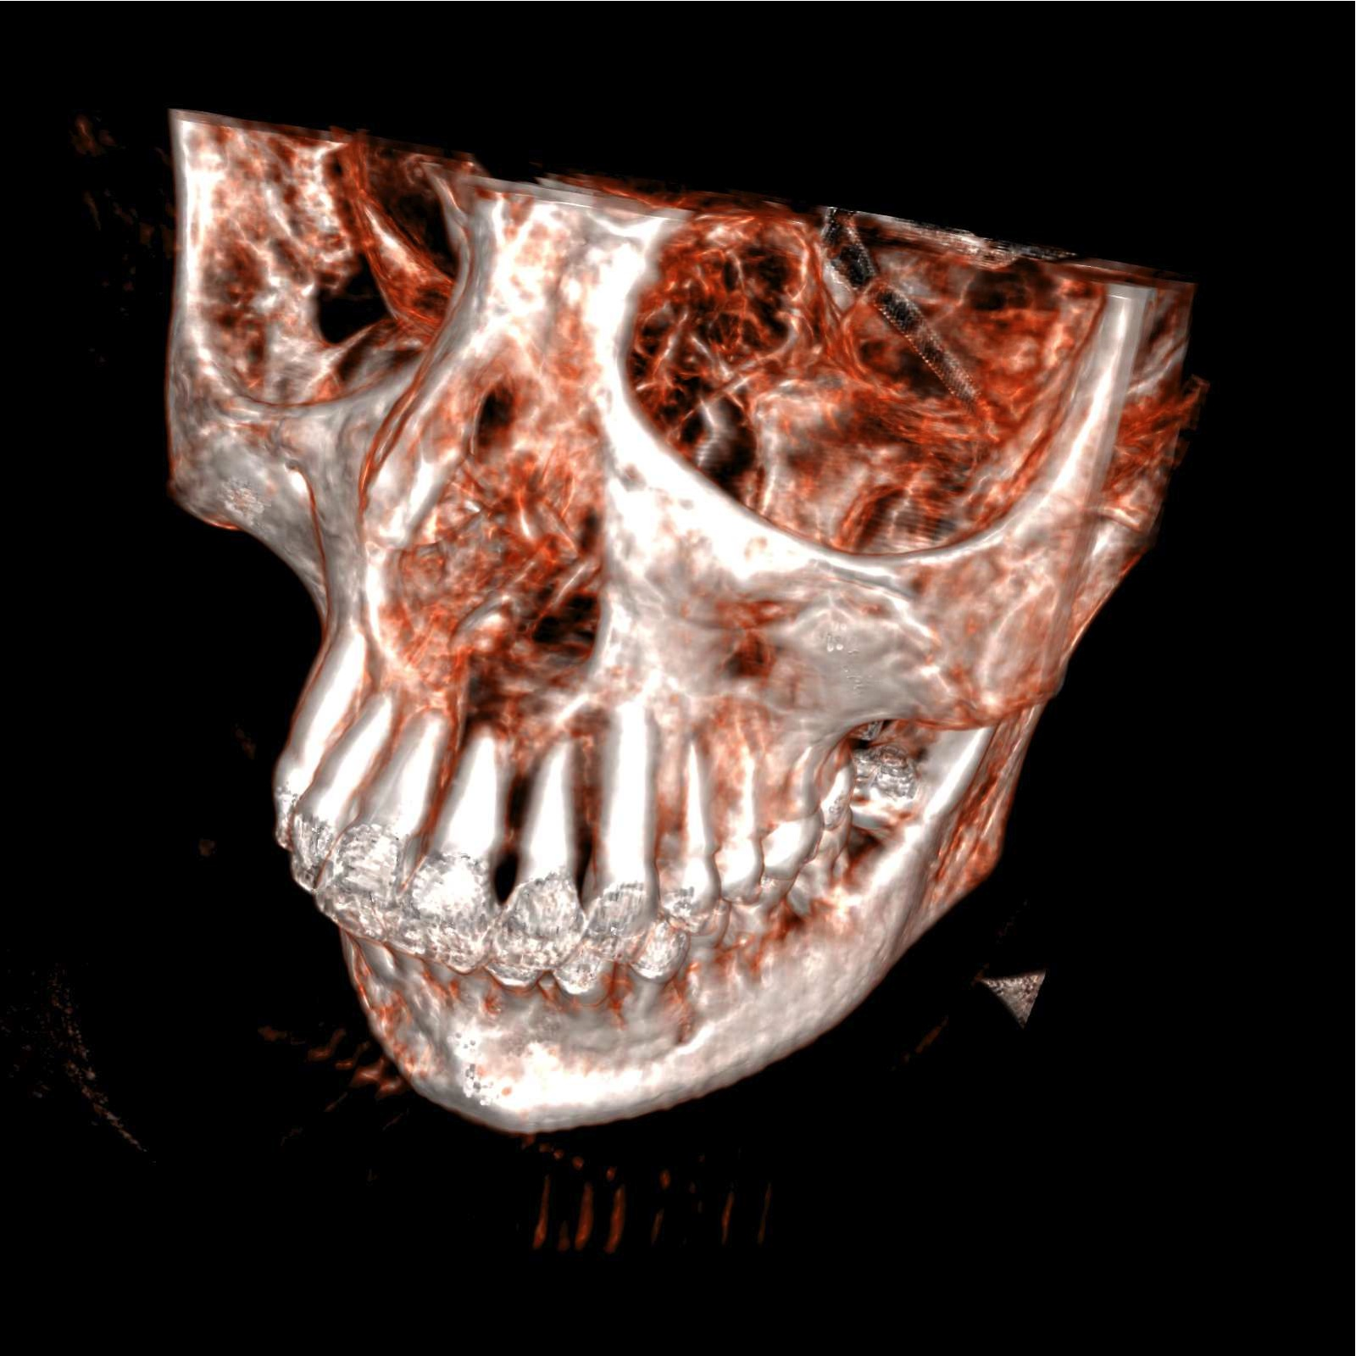
Building Blocks for GPU Computation
CUDPP (“CUDA Data Parallel Primitives”): open-source, popular library for GPU computing primitives
DCGN (“Distributed CPU-GPU Network”): open-source MPI-like message-passing library for GPU clusters
GPMR (“GPU MapReduce”): open-source high-level MapReduce library for GPU clusters
  Implemented volume renderer within MapReduce framework (with K.-L. Ma,
  C.-K. Chen, Ultravis)
Project lead: John Owens, UC
Davis; students: Jeff Stuart,
Shubhabrata Sengupta, Andrew
Davidson, Ritesh Patel

Slide 15
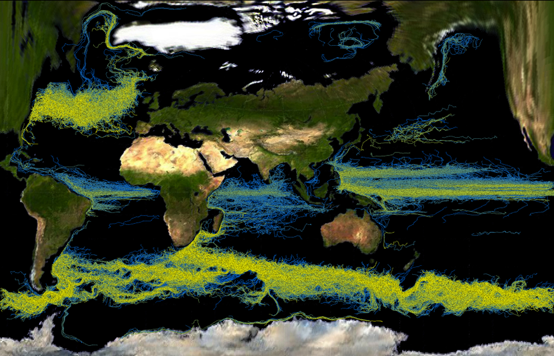
Complex Feature Visualization by Programming Language Interface
Problem
  Today multi-scale/physics systems are modeled with unprecedented complexity
  A daunting task to manually explore all aspects of such complex systems
  Infeasible to always require users to fully substantiate a feature specification in all aspects
  In result, traditional visualizations could be unreliable, inconclusive or incomprehensive
Solution
  Enabling versatile exploration and visualization of complex features by using supercomputers to automatically explore a feature specification’s un-specified aspects.
  Domain scientists control this automation via light weight programming languages (regex).
Impact
  Reliably capture and visualize ocean structures at fine precision on global scales
  Useful to all climate modelers needing to understand or improve ocean models
statement:
  | statement range
  | statement multirange
  | statement TIMEMARKER range
  | statement TIMEMARKER multirange
  ;
range: RBEGIN values REND
  | RWILDCARD
  ;
values: VALUE RTO VALUE
  | VALUE
  | RWILDCARD
  ;
multirange: range MREXPANDER
  ;
/* floating point numbers */
\-?[0-9]+
| \-?"."([0-9])+
| \-?([0-9])+"."([0-9])*
| \-?([0-9])+\.?([0-9])*[eE]\-?([0-9])+
return VALUE;
\[ return RBEGIN;
\] return REND;
\? return RWILDCARD;
\* return MREXPANDER;
\- return RTO;
T return TIMEMARKER;
[ \t\n] ;
. ;
Notes:
Ocean is a principal component of the Earth’s surface and also a dominant factor in the hydrosphere. When needing to better understand globe climate, it is a crucial step to better understand ocean, especially the laws governing long-term regional and larger scale flows and short-term transient eddies. These features are typically unsteady over time, appearing at varying depths and affected by many factors of chemical and physical nature. Previously, ocean features could not be definitively specified – making it hard to create scientifically useful visualizations using traditional methods. In addition, it is hard to simultaneously resolve ocean features with great geospatial, depth and temporal details, while also capturing the entire global scale of our planet. Through SciDAC Ultravis research, we use leadership computing facilties to automate exploring aspects of numerical, spatial and temporal uncertainties, and hence to capture real-world ocean features that do not perfectly fit with theoretical concepts.
The sample visualizations show results from a recent DOE Earth System simulation that modeled global ocean at 0.1 degree resolution from 2001 to 2003. We are able to visually summarize strong short-term transient ocean eddies (upper image) as well as long term regional scale ocean flows (lower image). Colors represent depth of flow features (warm colors for shallow depths, cool colors for deep depths).
More talking points about the ocean flow features:
Upper image -- Eddies can range from centimeters to hundreds of kilometers in diameter and can persist for periods of days to months.
The result shows significant eddy activity in the Atlantic and the Indian Ocean. Well known eddies such as those nearing Cape of Good Hope are distinctly visualized. As expected, most eddy activities occur near coasts and away from those major currents
Lower image -- The Equatorial and Antarctic currents are clearly shown and the Labrador current near Greenland is also well represented. The Beaufort Gyre, a wind-driven current located in the Arctic Ocean, is also highlighted in this visualization. Another interesting flow is
shown when the major ocean current comes above Australia. The flow lines abruptly disappear when reaching this area because a shift
occurs when the current sweeps between Australia and Indonesia.
Contributors:
SciDAC Ultravis computer scientists:
Wesley Kendall, Jian Huang – University of Tennessee, Knoxville
Han-Wei Shen – The Ohio State University
Tom Peterka, Robert Ross – Argonne National Laboratory
SciDAC Climate scientists:
Robert Jacobs – Argonne National Laboratory

Slide 16
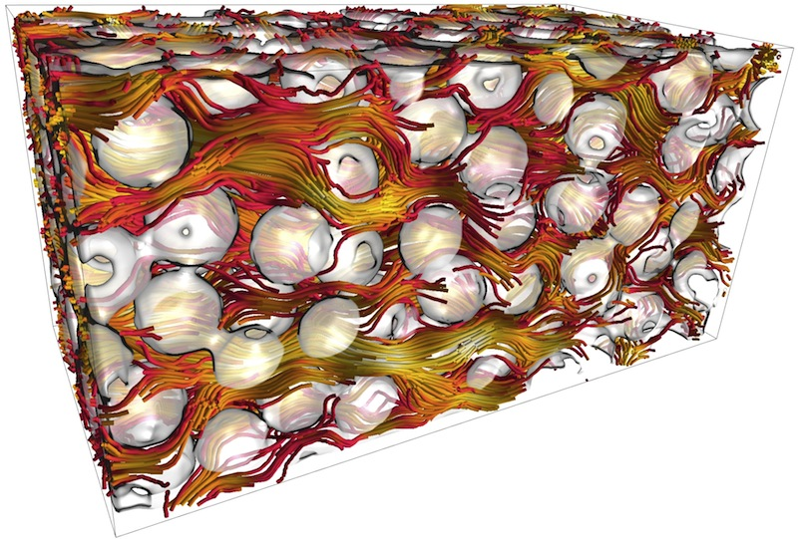
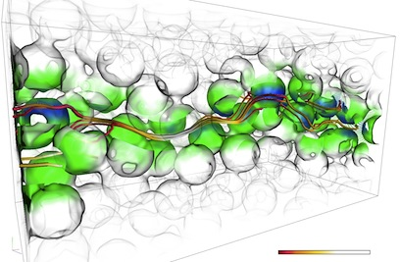
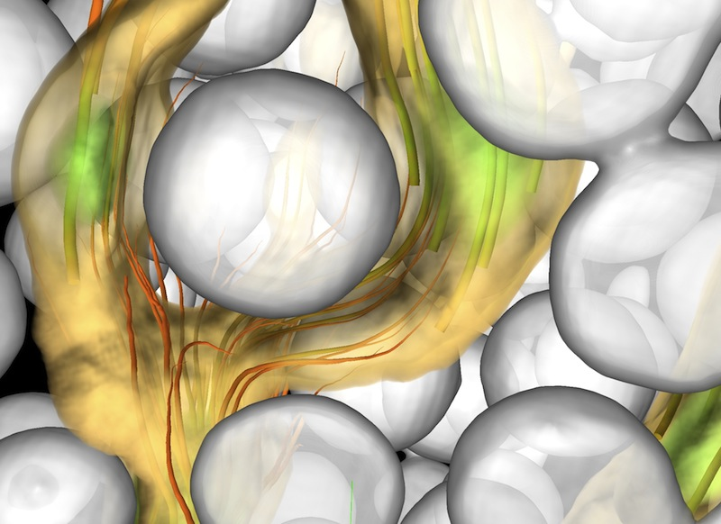
Visualization of Particle-based Groundwater Simulations
Problem
  Scientists at PNL have been developing parallel codes for multiscale particle-based simulations of subsurface biogeochemical processes. They simulate fluid flow, solute transport, and biogeochemical reactions in porous media at the pore scale for fundamental groundwater research.
  Advanced visualization techniques are needed to understand the essential character of pore-scale dispersion processes as well as the the effects of localized zones of relatively low velocity within the pore-scale flow field, and their effect on transport phenomena at larger scales.
Solution
  To enable visualization of specific particles of interest in context and better understanding of particle trajectory behavior, IUSV researchers have invented a hybrid rendering technique based on advanced volume and surface construction methods.
Impact
  The new visualization capability has helped scientists at PNL to better
  Conduct visual checking of output for physical consistency
  Synthesize large datasets in a visual manner to gain understanding of key processes
  Communicate the results of complex simulations to scientific colleagues and non-scientific audiences

Slide 17
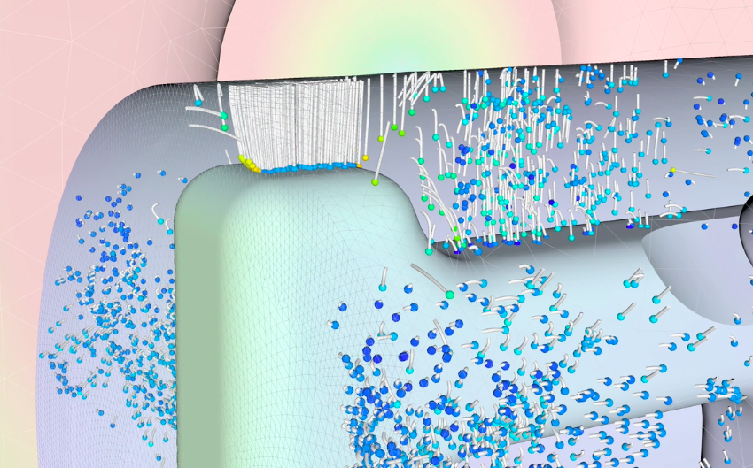

Simulation and Visualization of Potential Multipacting
Problem
  Multipacting is a phenomenon of resonant electron multiplication exponentially in the particle accelerators, leading to an electron avalanche.
  Multipacting can cause significant power losses and heating of the wall, low achievable field gradient and thermal breakdown in superconducting structures.
Solution
  Using DOE’s supercomputing facilities, ComPASS accelerator simulation codes and UltraVis Institute’s visual analysis tools, multipacting behavior can be simulated, visualized, and analyzed.
Impact
  By comparing simulation results to damage in existing accelerator components, SLAC validated the simulation codes.
  Analysis of new cavity designs has enabled that costly multipacting will not occur.
  This important step was made possible by a multidisciplinary collaboration between scientists at SLAC and the Institute for UltraScale Visualization.

Slide 18
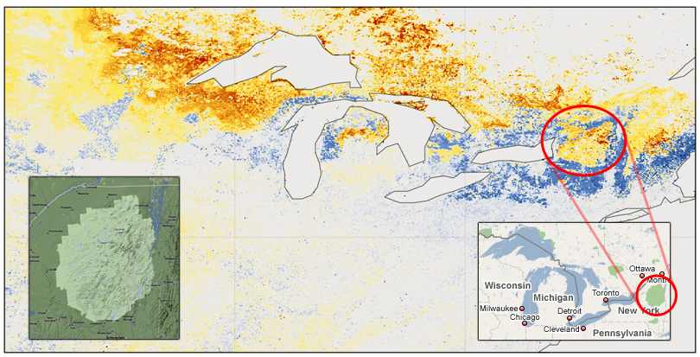
Full Range Analysis of Ultrascale Climate Data Sets
As high quality data sets become available through NASA MODIS satellite programs and IPCC simulation ensembles, the critical link is to develop extreme scale visualization methods and systems that allow discoveries of multi-scale, multi-physics long-term trends in climate change.
Computer scientists at the SciDAC Institute for Ultrascale Visualization have developed novel feature characterization and visualization methods that are scalable to tens of thousands of processors, promising a solution to the upcoming exascale data analysis problem.
These new methods enable ORNL climate scientists with the SciDAC CCSM Consortium, DOE C-LAMP and International C⁴MIP projects to analyze the full extent of their data.
Impact:
This is the first time climate scientists can study a full terabyte of climate-related satellite monitoring data (NASA MODIS) and IPCC simulation data sets, and have discovered, in one single analysis, changes in patterns of phenology in undistributed vegetated ecosystems suggestive of climate change.
– Forrest Hoffman, ORNL
Notes:
It has been a long standing goal to seek the most effective methods for extracting knowledge from complex data. A few of the most difficult challenges stem from situations where a priori knowledge of a pattern cannot be specified with sufficient formalism, as well as when sensitivity of key algorithmic parameters is hard to measure and thus hard to evaluate. We have found a promising approach to address these difficulties for studying climate modeling. We do so by introducing programming language interfaces for feature speciﬁcation in large data visualization. Designed and implemented with great scalability (up to 32,768 cores), our method is capable of handling ultrascale datasets on leadership computing facilities such as Jaguar (OLCF) and Intrepid (ALCF).
When using our system to analyze terabytes of climate data sets, both from NASA's satellite monitoring program like MODIS (http://modis.gsfc.nasa.gov/) and from IPCC climate simulation data sets, our collaborative DOE SciDAC research team has discovered changes in patterns of phenology in undisturbed vegetated ecosystems suggestive of climate change. The imagery example here is a summary visualization of a decade (year 2000 to year 2009) of NASA's MODIS satellite data at a 500-meter per pixel resolution. It shows that, over the past decade, spring growth rates have been becoming qualitatively stronger, rendered with warm colors from yellow to red, within the Adirondack Region (http://visitadirondacks.com/, http://en.wikipedia.org/wiki/Adirondack_Park), while spring growth rates right outside the park reserve have not kept at the same increasing pace (shown with cool blue colors). Complex features of this kind are very hard to capture without ultrascale visualization techniques and were previously unknown to climate scientists.
Contributors:
SciDAC Ultravis computer scientists:
Wesley Kendall, Markus Glatter, Jian Huang – University of Tennessee, Knoxville
Tom Peterka, Robert Latham, Robert Ross – Argonne National Laboratory
SciDAC Climate scientists:
Forrest Hoffman, David Erickson III – Oak Ridge National Laboratory
SciDAC VACET visualization collaborator:
Sean Ahern – Oak Ridge National Laboratory

Slide 19
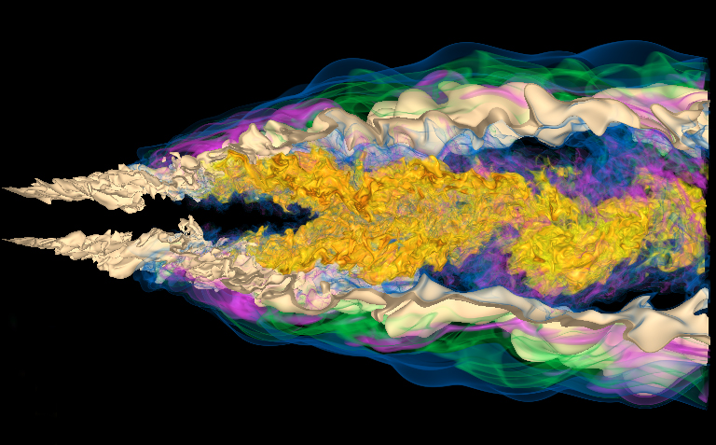
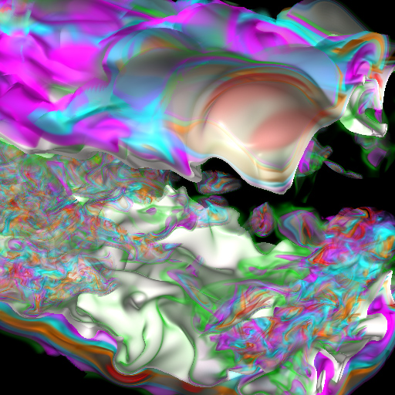
Visualization of the Structures and Dynamics of Turbulent Eddies
Scientists at Sandia National Laboratories utilize DOE’s supercomputing facilities to simulate combustion processes at the finest scales where chemical reactions occur, essential to understanding the process of clean and efficient combustion of alternative fuels.
Computer scientists at the SciDAC Institute for Ultrascale Visualization have developed a novel method for the visualization and understanding of complex multi-scale features in the data output by such simulations.
Impact
  This data reduction and visualization method enables us to zoom in and see for the first time the interaction of small turbulent eddies with the preheat layer of a turbulent flame, a region that was previously obscured by the multi-scale nature of turbulence.
  Jackie Chen, SNL-CA
Notes:
Scientists at Sandia National Laboratories have performed petascale turbulent combustion simulation to study the basic phenomena of reacting flows in the combustion process. Of scientific interest is the main flame structure, which corresponds to a known stoichiometric mixture fraction surface. Scientists hope to observe how other flame properties and chemical species distribute along this main flame surface to evaluate the efficiency of the combustion process. However, the resulting time-varying multivariate data is large and complex, making visualization of fine flow structures and detailed interaction among them a challenging task. Computer scientists at the Institute for Ultrascale Visualization have developed a new visualization method that can reduce the data while enabling scientists to zoom in and see for the first time the interaction of small turbulent eddies with the preheat layer of a turbulent flame, a region that was previously obscured by the multi-scale nature of turbulence.
Contributors:
SciDAC Ultravis computer scientists:
Kwan-Liu Ma– University of California-Davis
Sandia National Laboratories:
Hongfeng Yu and Jackie Chen

Slide 20
fin

