Slide 1
2011 Update on VisIt
Brad Whitlock
DOECGF
April 27, 2011

Slide 2
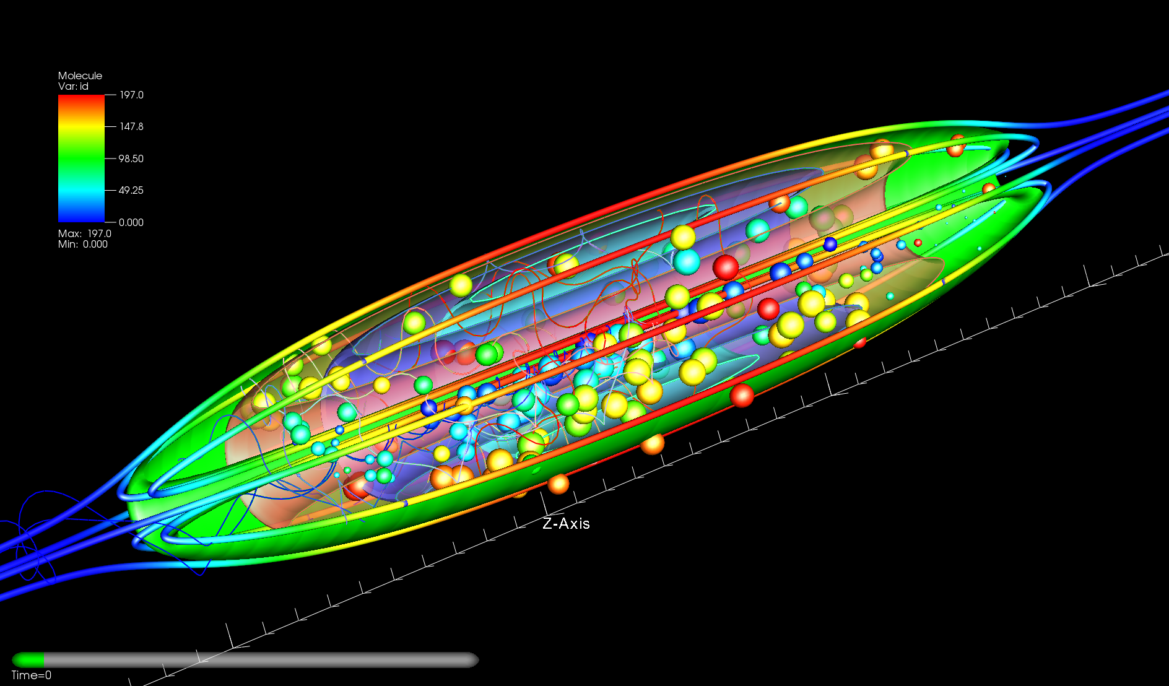
Overview
Current Status
VisIt 2.2.2 released April 2011
VisIt 2.3 release planned for May 2011
Outline
VisIt community
Better Practices
New features
Research
Upcoming
(PIC trajectories in a static equilibrium plasma configuration called the FRC courtesy of Charlson Kim)

Slide 3
VisIt Community
Commit emails
Sean Ahern
Kathleen Bonnell
David Bremer
Eric Brugger
David Camp
Hank Childs
Rich Cook
Marc Durant
Jean Favre
Cyrus Harrison
Tom Fogal
Jeremy Meredith
Mark Miller
Paul Navratil
Prabhat
Dave Pugmire
Oliver Ruebel
Allen Sanderson
Gunther Weber
Brad Whitlock
SVN accounts (NERSC SciDAC Outreach Center)
US Nat'l Labs:
LLNL 7
ORNL 5
LBNL 4
ANL 2
University:
Utah 4
UC Davis 3
UT/Austin 1
NCSA 1
CalTech 1
LSU 1
Private industry:
Tech-X 1
Foreign Labs:
AWE 2
CEA 1
Max Planck 1
CSCS 1
2.0 release
2.1 release
Notes:
Say that there are 30 or so folks in the repo and 20 or so have made commits. Sometimes we commit for users who provide fixes.

Slide 4
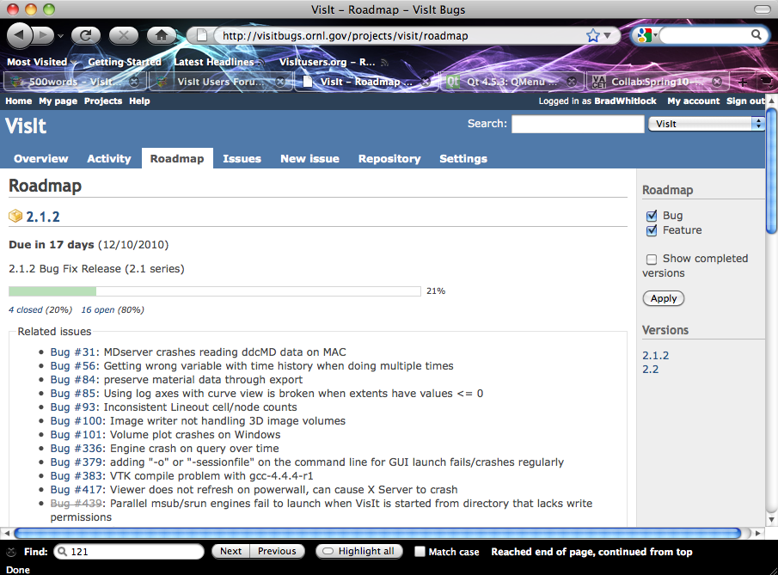
Better Practices
Transitioned from proprietary bug tracker to an online bug tracker at visitbugs.ornl.gov
CMake build system
Continuous integration builds on different platforms using Buildbot
Improved nightly regression testing with more testing modes
Redmine

Slide 5
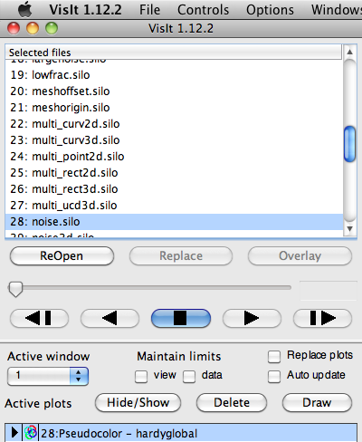
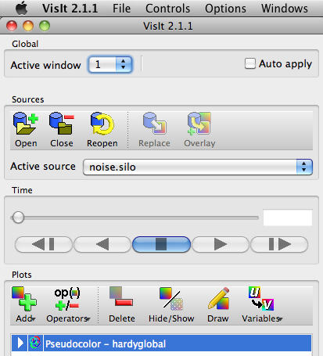
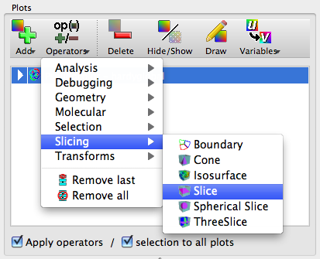
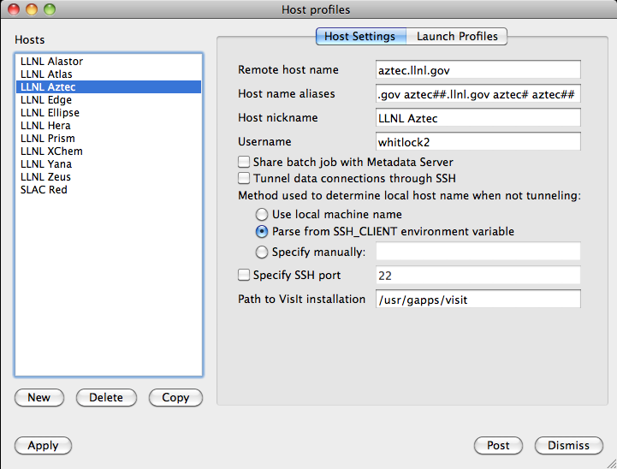
GUI Facelift
1.12
2.0
Selected files list gives way to Open files
Plot and Operator windows group related options
Operators are now categorized
Customizable
Allows all operators to be enabled
Redesigned host profiles window is easier to setup and manage profiles
Notes:
I want to emphasize that for the next few slides, these are features that are deployed in VisIt.

Slide 6
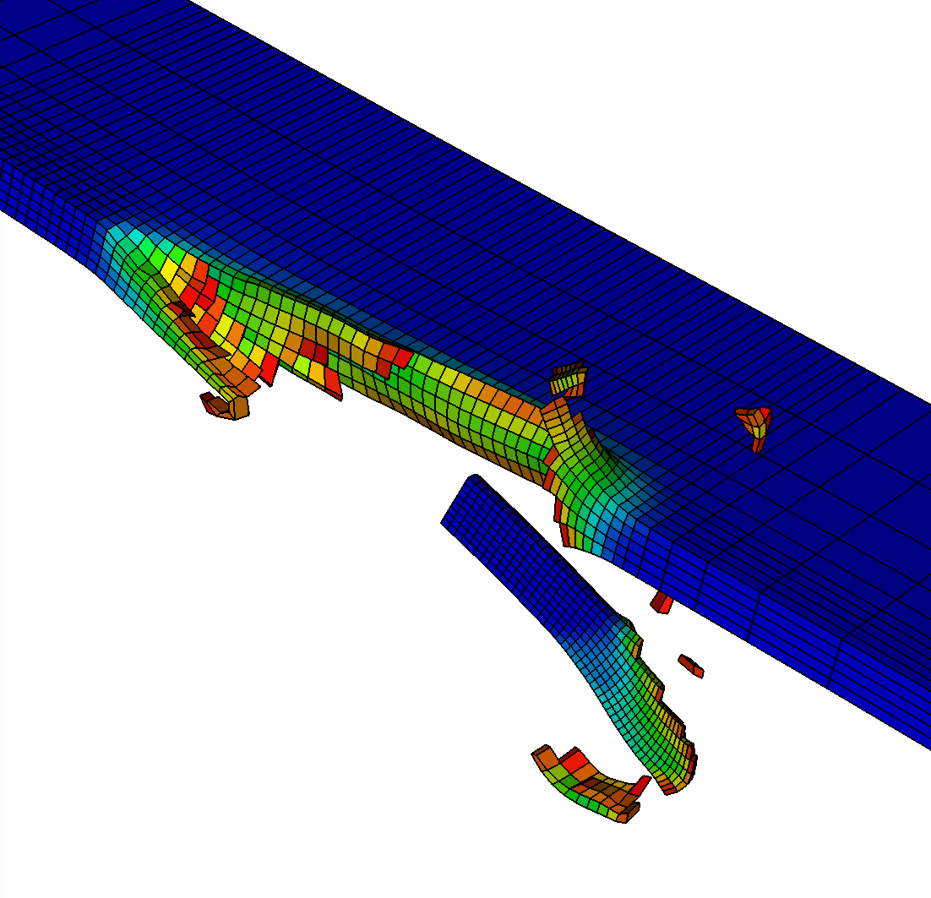
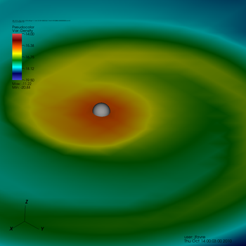
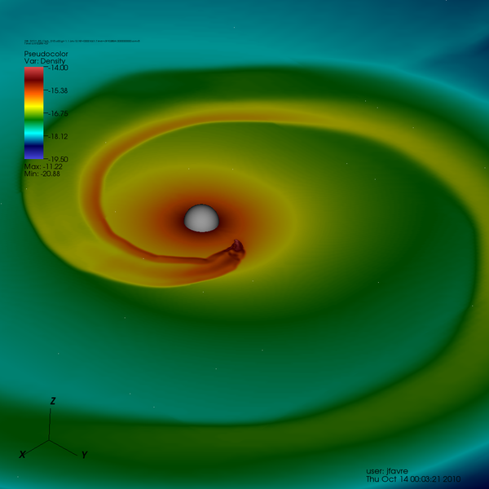
File Reader Improvements
Many improved readers
New readers
Xdmf
GMV
Velodyne
MatrixMarket
AdventureIO
PFLOTRAN
STAR
GULP
PuReMD
MFIX
LATA
Multiresolution support in STAR and Chombo readers
Lower resolution
Higher resolution

Slide 7
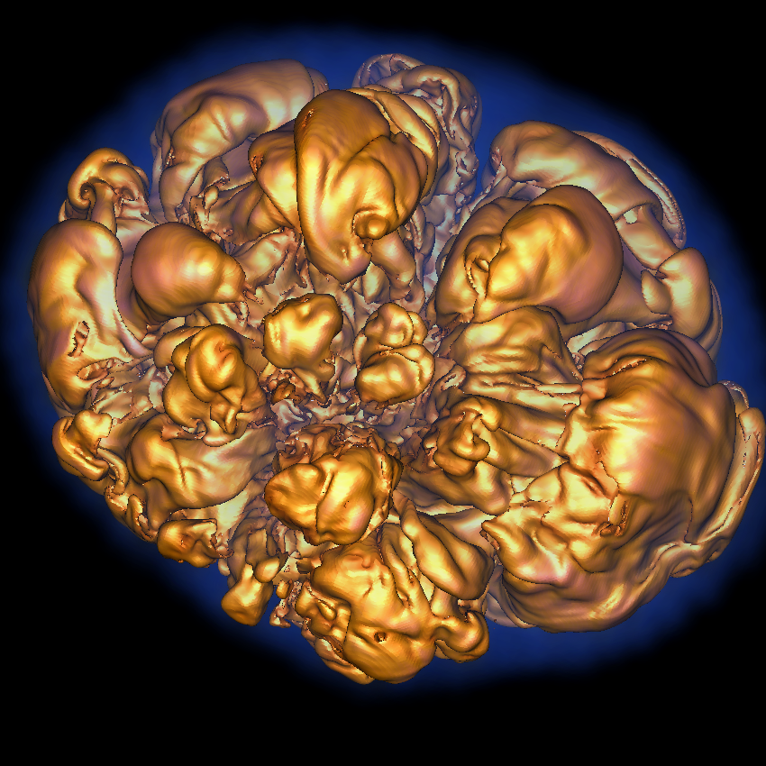
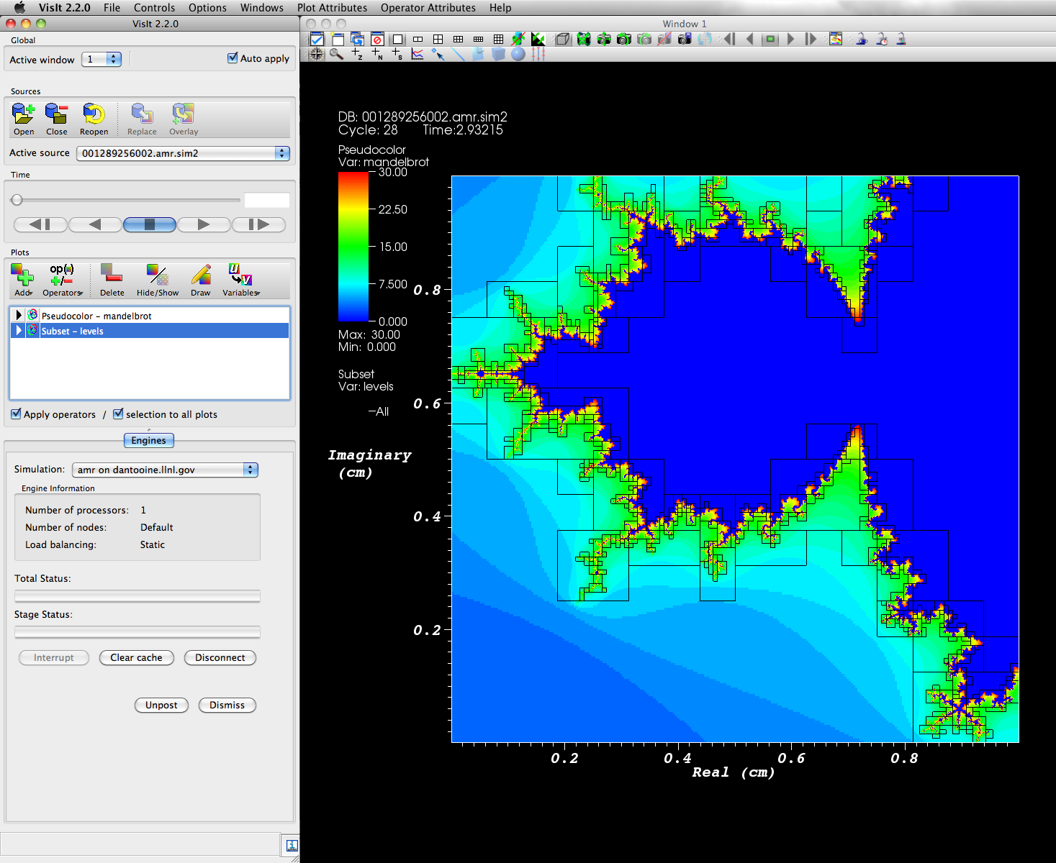
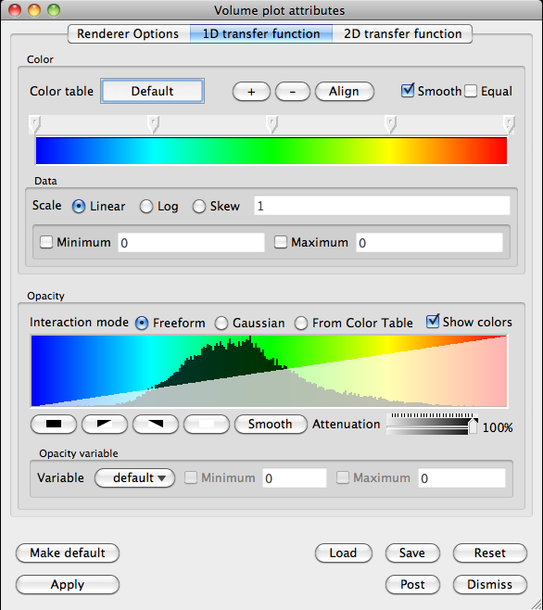
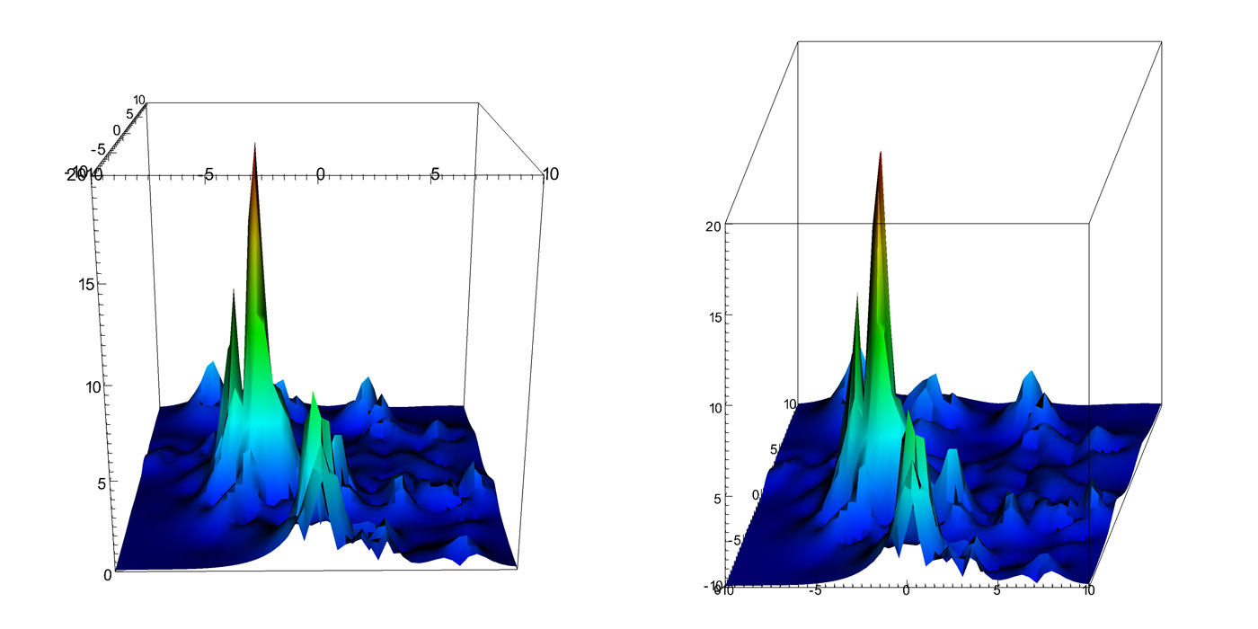
Rendering Improvements
Select GL implementation on demand
Volume Renderer was improved
Ray-caster has been overhauled
Fewer samples are required to make good pictures
Lighting has been improved
The GUI shows histograms of the data to guide transfer function creation
Multi-GPU volume rendering
Mesa3D
Cabinet rendering projections
ICE-T used as compositor and performance increased
Improvements to Mesa3D have been contributed

Slide 8
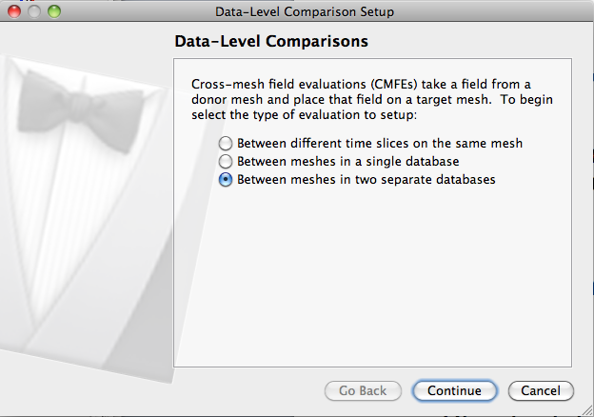
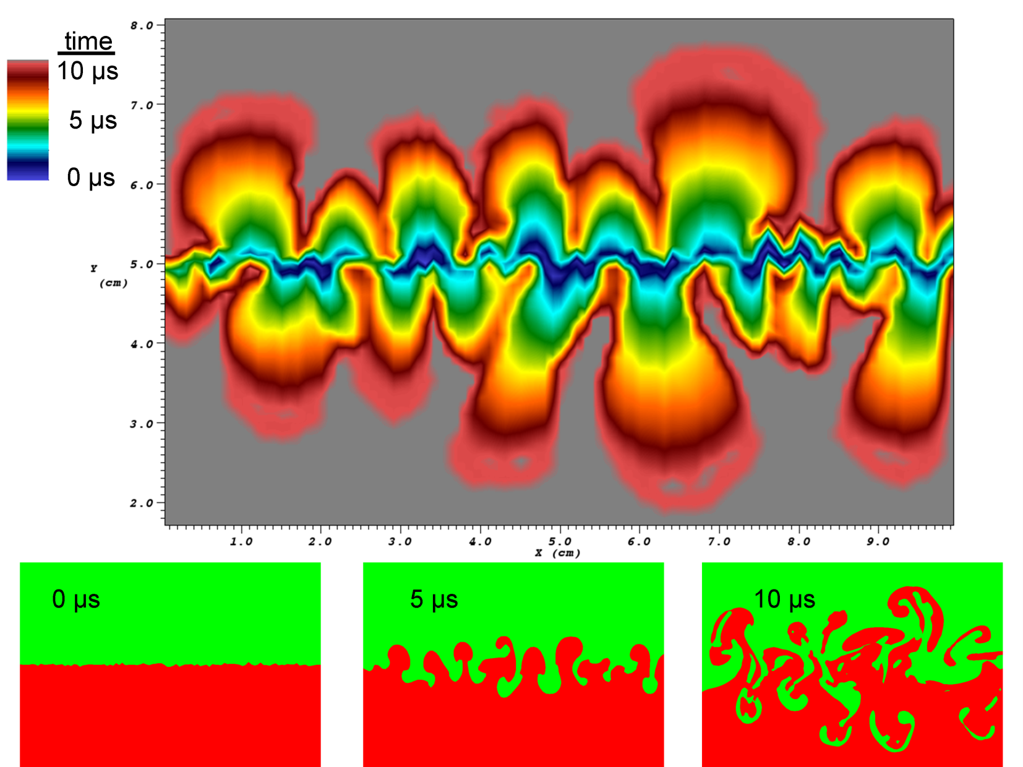
Mesh Comparison and Time Expressions
Data-Level Comparison Wizard
Simplifies comparison of data on different meshes
New expressions for time iteration
Calculate the maximum, minimum or average value at a location
Calculate the time when a condition occurs (e.g. time when the maximum value at a location occurs)
Notes:
Wizard lets you set up comparisons between different runs.
We’ve seen these before but these are now productized.

Slide 9
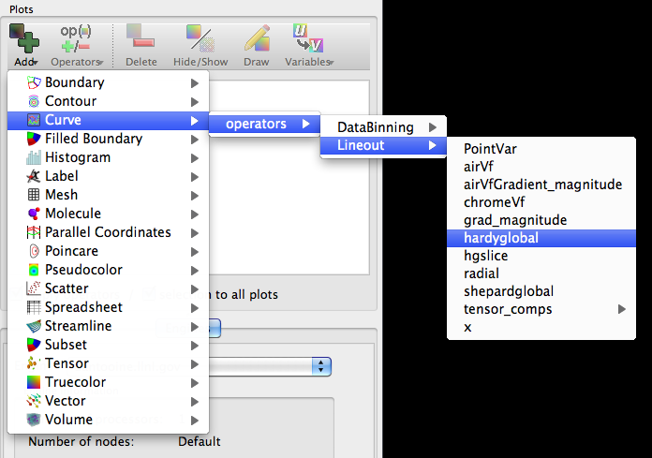
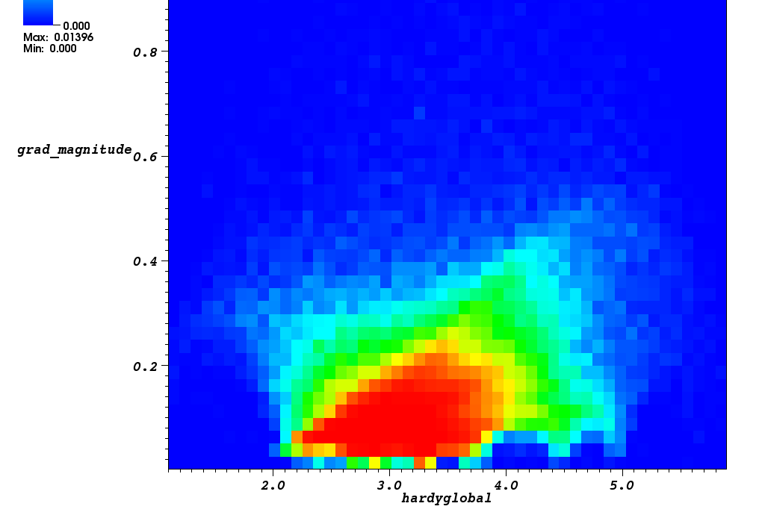
Operator Creation and Data Binning
Operator plugins have been extended to support the creation of variables derived from existing variables
DataBinning operator lets you relate multiple variables and bin them up to compute various quantities per bin
Sum | Standard deviation
Count | Min
PDF | Max
Average | RMS
Variance

Slide 10
Xray Image Query
Produces a frequency dependent orthographic ray tracing, modeling absorption and emission
Supports both 3D and 2D R-Z meshes
Outputs both images and raw floating point values
Does exact ray tracing
Ray tracing through a sphere made up of hexahedra with cone cutouts along the axis

Slide 11
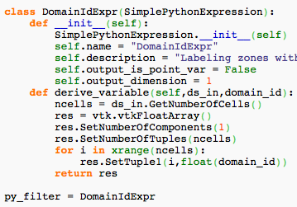
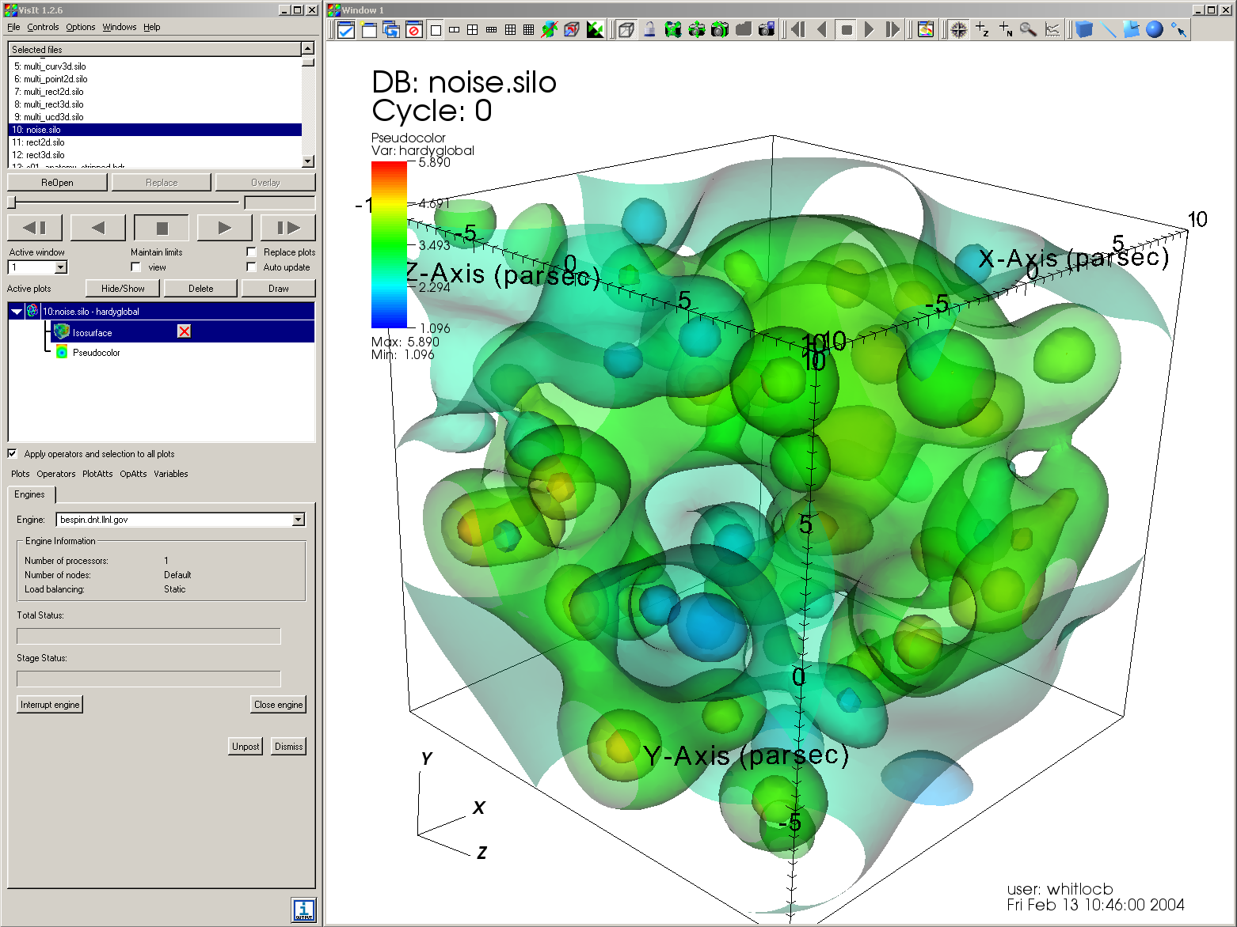
Python Filters
Write new expressions and queries in Python
Enter Python expressions into the Expression window’s Python tab
Manipulate VTK data objects directly
Parallel engine
Data source
Expression filter
User-defined Python expression
Python
Filter
Filter

Slide 12
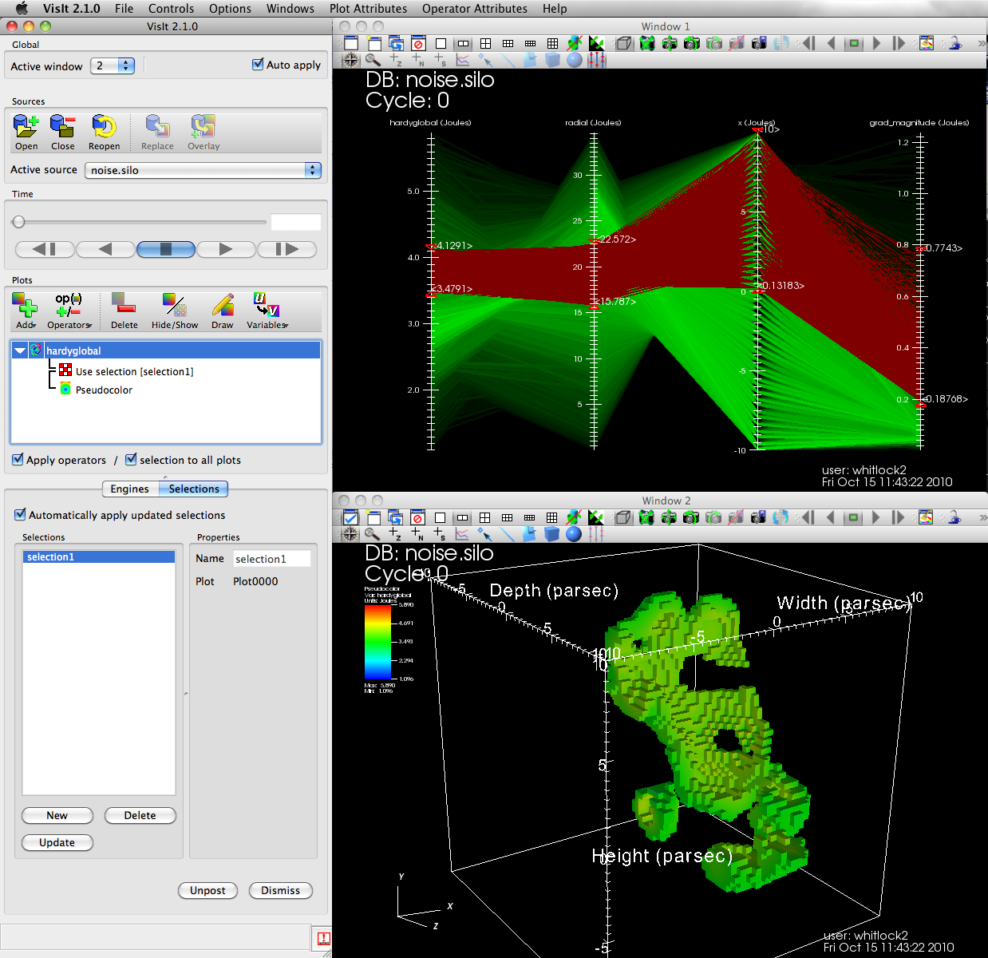
Selections
A selection is a reduced set of cells isolated from a plot
Selections can be applied to other plots, making it easy to look at different views of the data
The Selection window creates a selection from the active plot
Selections are applied to plots via the Subset window
A selection defined by the ParallelCoordinates plot isolates cells in the original mesh

Slide 13
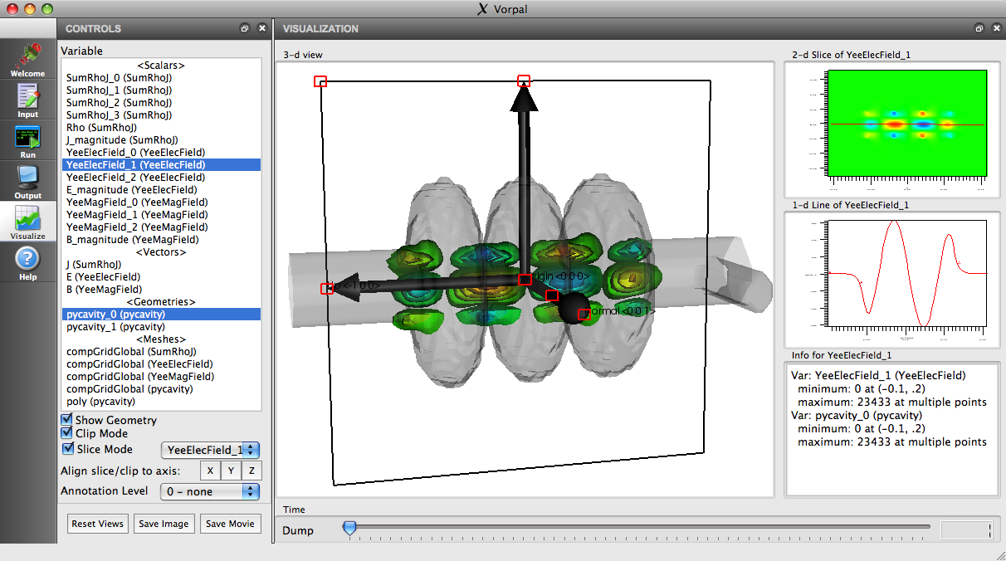
Build Applications Using VisIt
Notes:
We can create replacement GUI’s for Visit in C++,Python,Java
We can even embed VisIt in other applications that need parallel graphics and data processing.

Slide 14
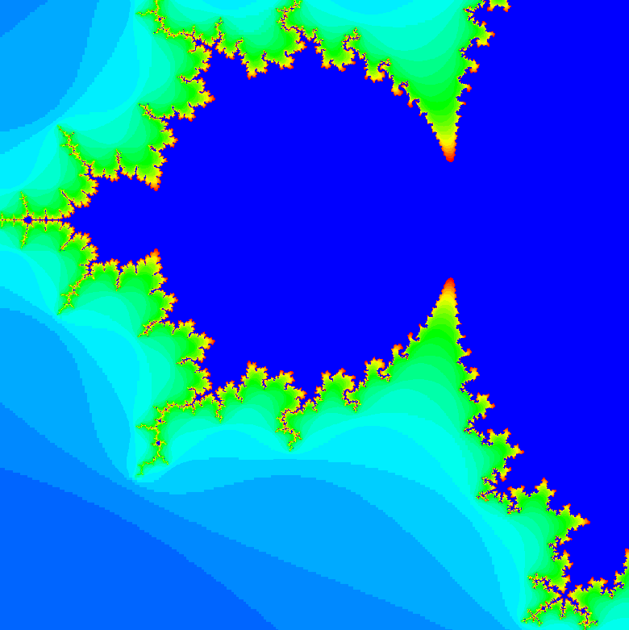
In Situ Visualization
VisIt provides libsim, which is a library that can let VisIt connect to your simulation code and operate in-situ on its data arrays.
Add functions to your simulation that let VisIt connect
Add functions to your simulation that expose your arrays as data VisIt will process
Link your simulation with libsim
Run the simulation and connect with VisIt
You will be able to perform any of VisIt’s operations on your simulation data
Advance the simulation and watch your plots update
commands
data
libsim
VisIt runtime
Glue code
New libsim features
Species
Vector,Tensor data
AMR meshes
CSG meshes
Species
Vector,Tensor data
AMR meshes
CSG meshes
Users don’t allocate memory
Additional error checking
Write in C, Fortran, or Python
Windows support
Simulation
Notes:
Just say we’ve made improvements like running on Windows, Python interface

Slide 15
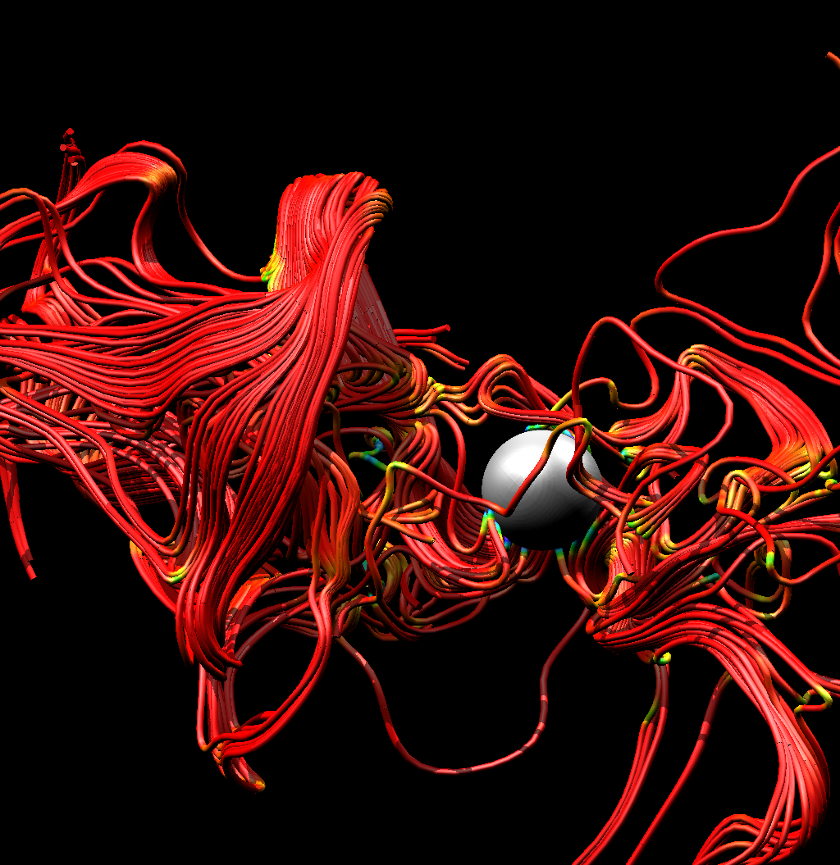
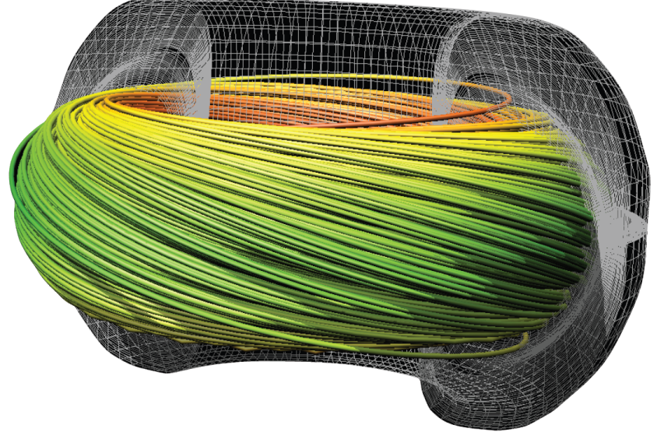
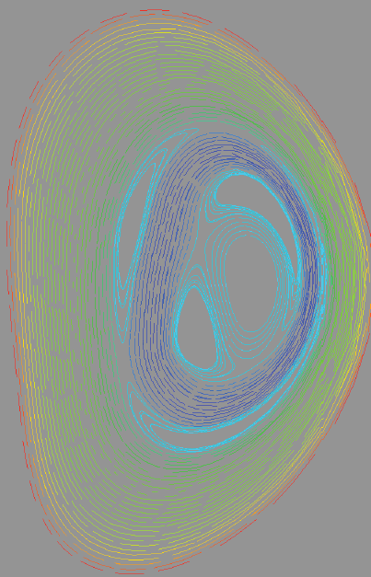
Substantial improvements for particle advection
General particle advection system with customizable options for:
How to evaluate the vector field (e.g. higher order)
What parallelization method to use (e.g. parallelize over seeds, over domains, or some hybrid)
What solver to use (e.g. Runge-Kutta, Dormand-Prince)
Enables different types of analysis: Streamlines, FTLE, Poincare analysis, custom analysis
Pathline support
Significant effort to productize the streamline plot (better defaults, rendering options, etc.)

Slide 16
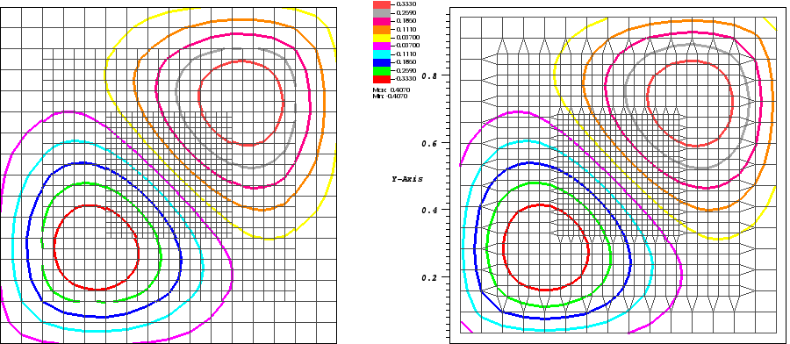
Fixing Cracks in AMR Meshes Using Dual Grid
Dual grid and stitch cells form a mesh that supports continuous interpolation and extraction of isosurfaces without cracks between levels
Using appropriately chosen ghost cell values, we implement this approach effectively in parallel
Before fix
After fix
cracks
Notes:
Standard isosurface extraction schemes produce cracks/discontinuities at coarse-fine boundaries between AMR levels
These discontinuities pose a major problem when analyzing AMR data.
Implemented as an operator in VisIt currently, we plan to hook into VisIt’s ghost zone generation to make it happen automatically

Slide 17
In Progress
These features are in progress

Slide 18
Parallel Processing Over Time Slices Improving Performance for Climate Data
VisIt’s parallel processing techniques were designed for single time slices of very high resolution meshes.
We must adapt this approach for the lower resolution and high temporal frequency characteristic of climate data.
T=0
T=1
T=2
T=3
T=4
T=5
T=6
T=7
T=8
P0
P1
P2
P0
P1
P2
VisIt parallelizing over a high resolution spatial mesh
VisIt parallelizing temporally over a low resolution mesh

Slide 19
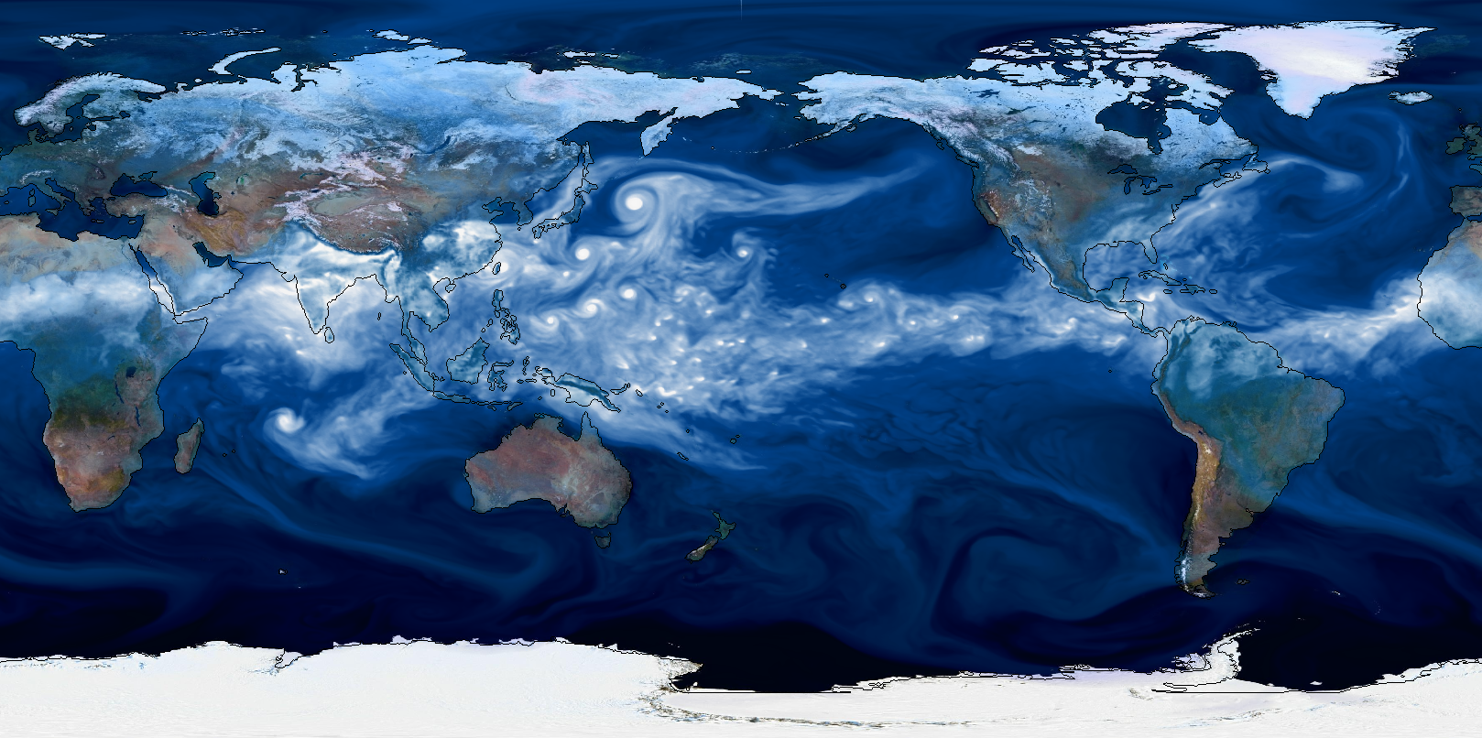
Progress and Results
We have added “parallelize over time” infrastructure
We have implemented “maximum value over time” as a proof of concept
Concurrency | Average Time | Speedup
1 | 480.0s | -
2 | 223.0s | 2.1X
4 | 120.0s | 4.0X
8 | 62.0s | 7.8X
16 | 29.0s | 16.5X
32 | 15.5s | 31.0X
64 | 7.8s | 61.5X
128 | 4.2s | 114X
We have made a basic investment in temporal parallelization infrastructure and it scales well.
This functionality will be useful to the climate community and is accessible to the rest of the VisIt community.
Scaling on 2130 time slices of NetCDF climate data (data source: Wehner, LBL)
Notes:
The scaling goes down a little towards 128 because some processors have a little more work than others.

Slide 20
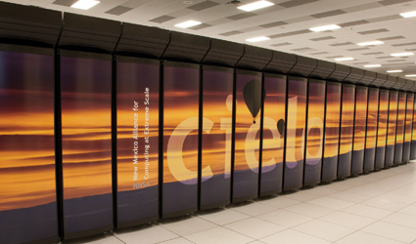
Ported to Cielo
Ported to Cielo – NNSAs newest capability system at LANL – Cray XE6, 100k cores, 1 PF system
Have initial capability working client/server between LANL/LLNL
Required adding support for 2 hops to access the machine since couldn’t log directly onto Cielo from LLNL.
Initial results - Used to create a volume visualization of a 2.1 billion zone NIF calculation on 128 cores
Notes:
And now we’re going to talk about some features that are in development but are not in a release yet.

Slide 21
New Subset Selection Features
Arbitrary collections of subsets
Nodesets, facesets, boundary conditions, etc.
Multiple independent decompositions into materials, processors, files, element blocks, etc.
Part hierarchies
No more fixed numbers/types of subset classes
Targeting Large numbers of subsets
Expressions involving 10^6 subsets < 0.1 secs
Storage of subset expression < current SIL

Slide 22
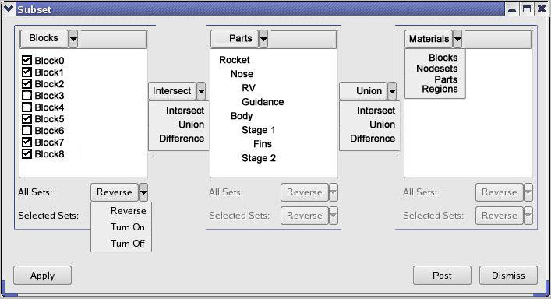
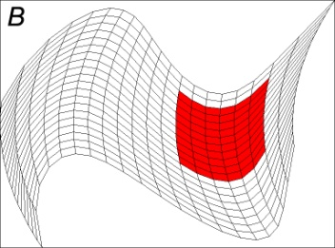
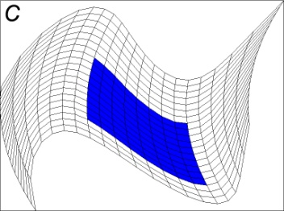
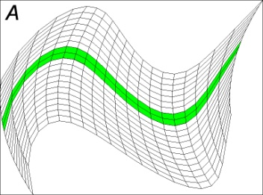
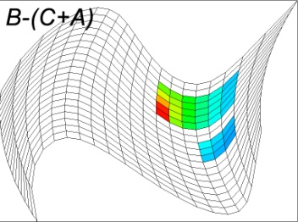
Subset Selection Expressions (SSE)
Subset Controls Mockup
Pseudocolor Plot on B-(C+A)

Slide 23
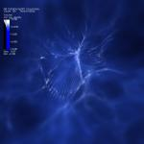
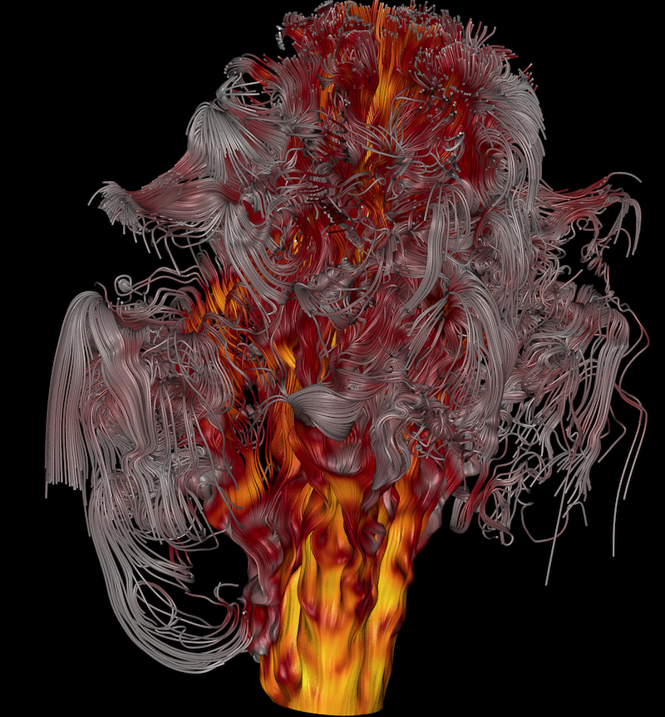
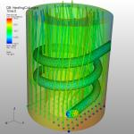
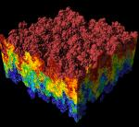
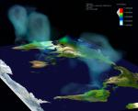
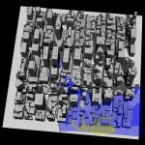
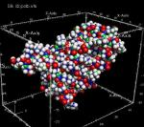
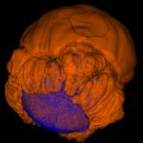
What to Expect in 2011
VTK upgrade
In Situ Improvements
Parallel VisIt on Windows Platform
Subsetting
Hybrid MPI+Threads Parallelism
AMR ghost zone generation
Prepare for exa-scale
smarter visualization algorithms

Slide 24
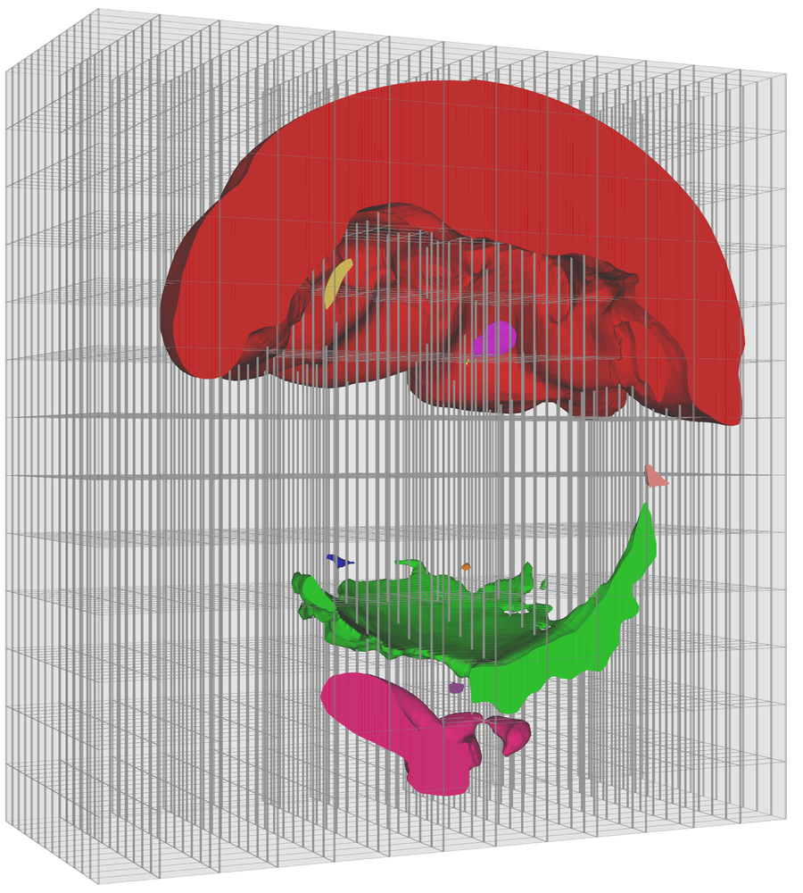
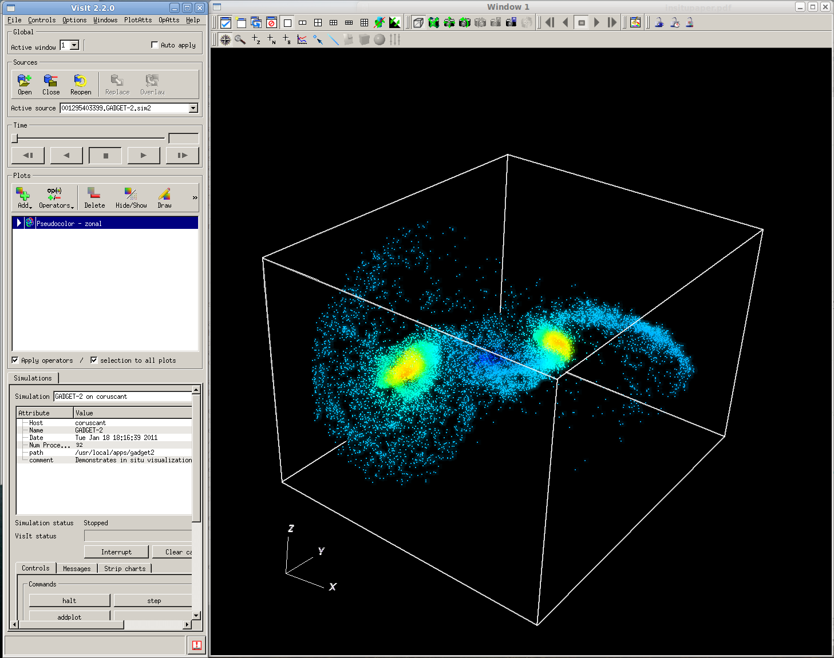
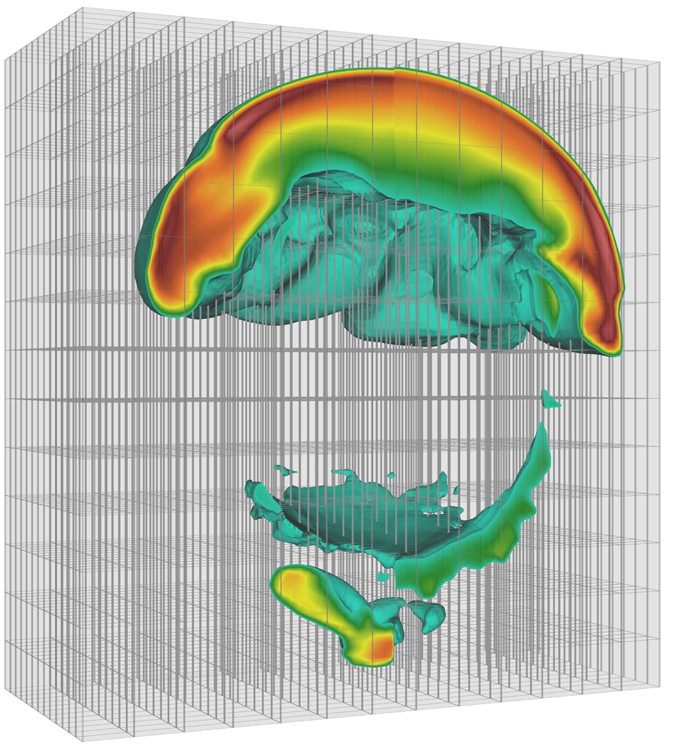
Selected Publications
B. Whitlock, J.M. Favre, J.S. Meredith, "Parallel In Situ Coupling of a Simulation with a Fully Featured Visualization System", EGPGV 2011, Llandudno, Wales April 2011.
C. Harrison, H. Childs, K.P. Gaither, "Data-Parallel Mesh Connected Components Labeling and Analysis”, EGPGV 2011, Llandudno, Wales April 2011.
H. Childs, D. Pugmire, S. Ahern, B. Whitlock, M. Howison, Prabhat, G. Weber, E.W. Bethel. “Extreme Scaling of Production Visualization Software on Diverse Architectures”, IEEE Computer Graphics and Applications, June 2010.
J.S. Meredith and H. Childs, “Visualization and Analysis-Oriented Reconstruction of Material Interfaces”, EuroVis 2010, Bordeaux, France, June 2010.
T.Fogal, H. Childs, S. Shankar, J. Kruger, R.D. Bergeron, and P. Hatcher, "Large Data Visualization on Distributed Memory Multi-GPU Clusters", Proceedings of High Performance Graphics 2010, pp 57-66, Saarbruken, Germany, June 2010.
Notes:
Here are some papers that have been written about features deployed in VisIt in the past year. We just gave 2, 2 weeks ago at EGPGV in Wales.

Slide 25
Resources
For more information about VisIt’s newer features, see
Release notes
Visitusers.org
Contacting the VisIt team
VisIt user’s list (visit-users@email.ornl.gov)
VisIt developer’s list (visit-developers@email.ornl.gov)
VisIt forum (http://www.visitusers.org/forum/forum.pl)

