Slide 1
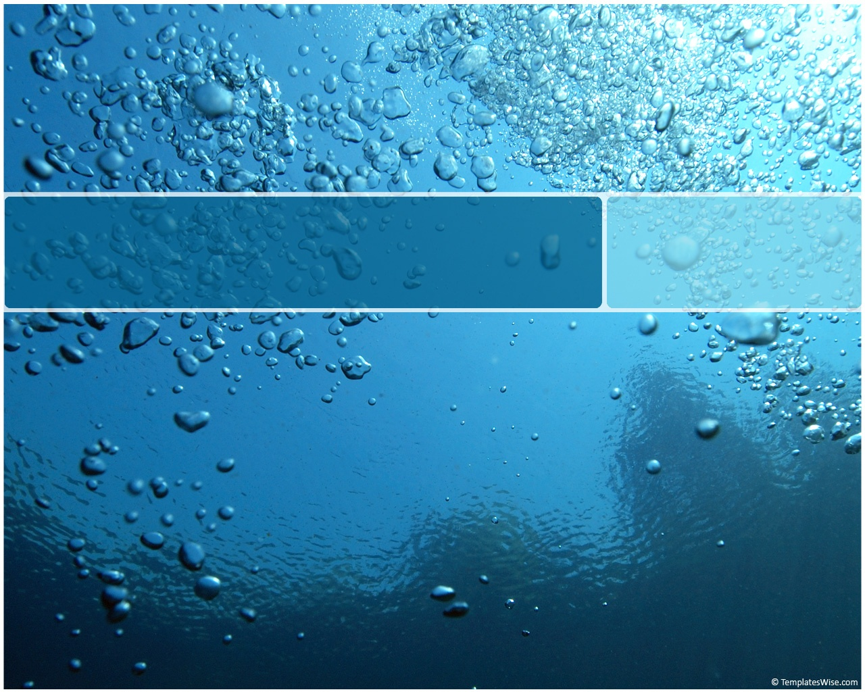
Deformable Registration
in ITK as a Model Error Metric
Sean Ziegeler
DoD HPCMP PETTT
Jay Shriver
Jim Dykes
Naval Research Labs, Code 7320
Notes:
A new error metric for model validation

Slide 2

Overview
Model Validation
Traditional Error Metrics
Registration
  Displacement
  Types of Registration
Synthetic Trials
Results
Conclusions & Future Work

Slide 3

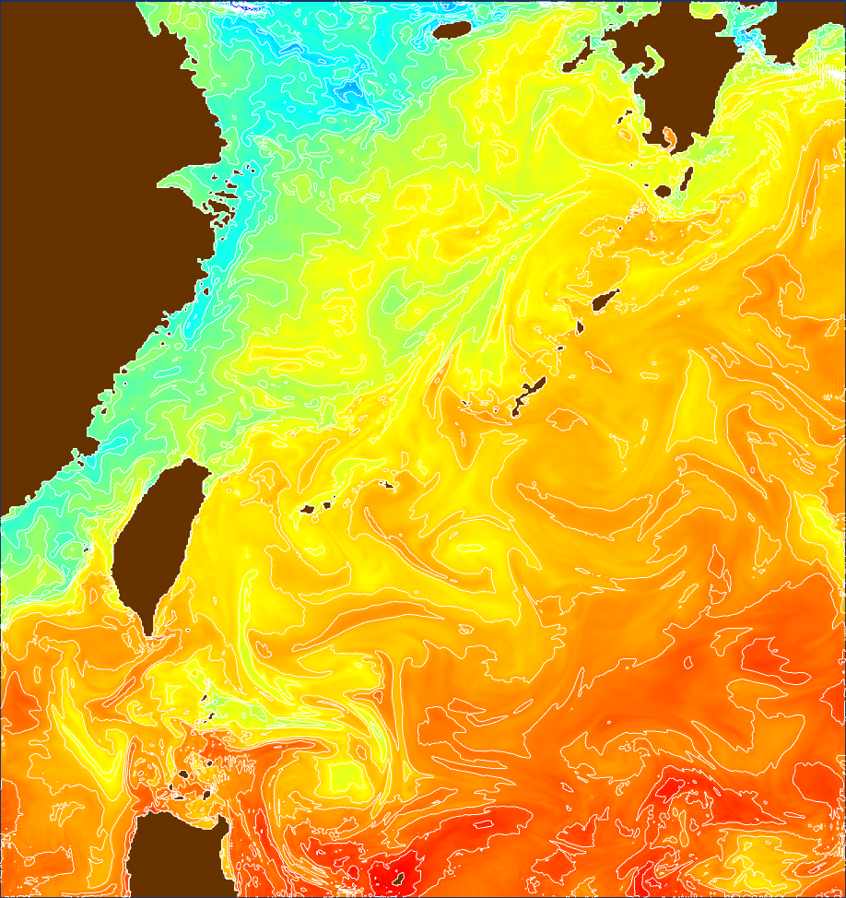
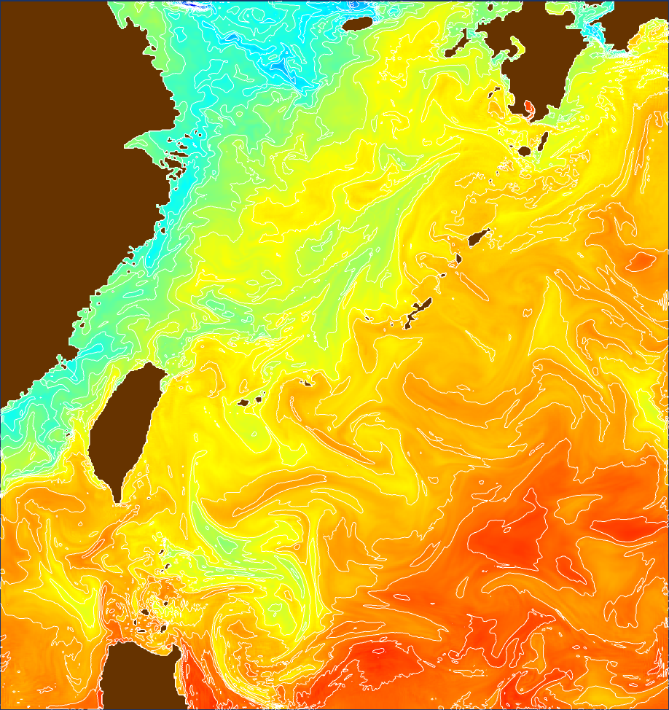
Model Validation
Compare model output to “ground truth” data
  Oceanographic and atmospheric data
  Model Forecast versus Analysis
Notes:
Analysis – assimilation of observed data to correct the model as it runs
Compare today’s pre-run Analysis to yesterday’s 24 hr Forecast

Slide 4
Forecast vs Analysis
Other options for comparison
  Satellite imagery, buoy/station data, surveys, …
Analysis is easier to compare
  Same grid
  Similar scalar properties due to assimilation
  Good starting point for evaluations
Disadvantage
  Hides errors in the assimilation process

Slide 5
Traditional Error Metrics
Single Quantity
  Mean difference, RMS difference, Normalized Cross-correlation, Bias
Composite Quantity
  Skill scores
Imaging / Visualization
  Image Difference
  Animation
Manual feature measurement & tracking

Slide 6
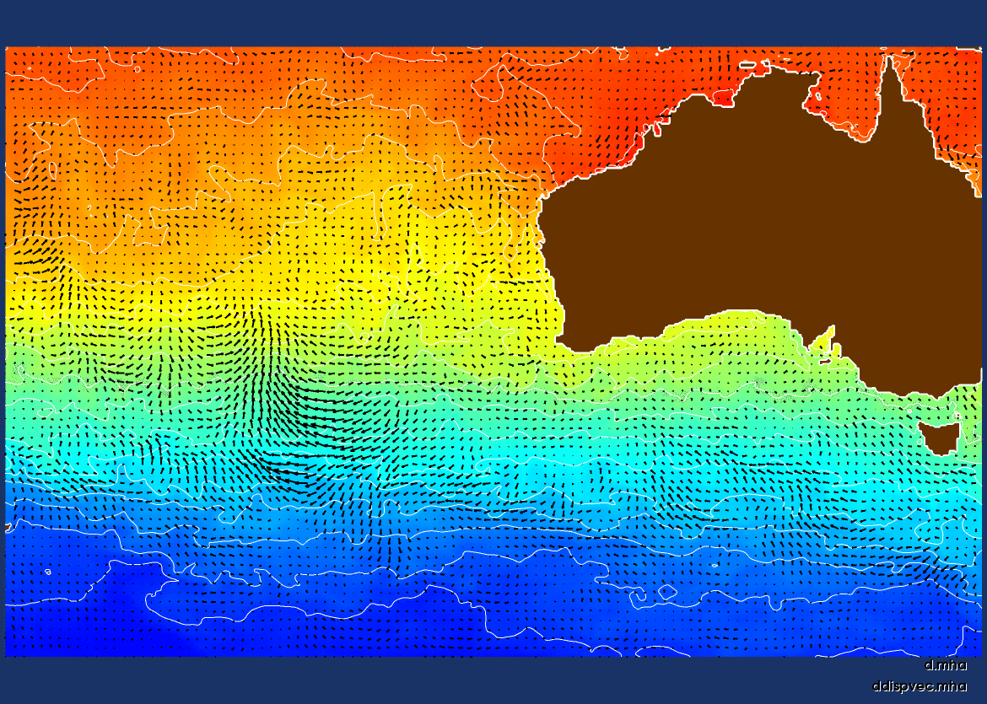
Traditional: Imaging/Visualization
Notes:
- Animating between forecast & analysis

Slide 7
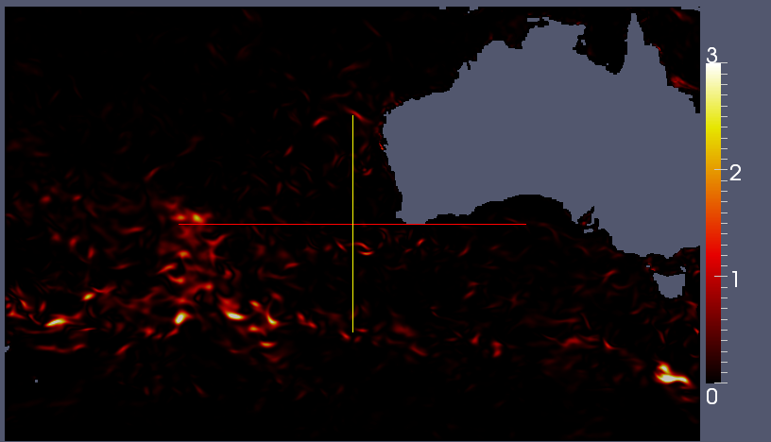
Traditional: Imaging/Visualization
Notes:
- Same data: difference image

Slide 8
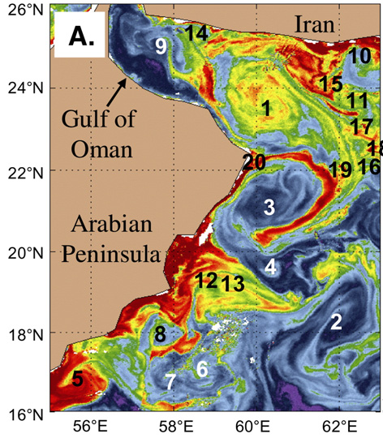
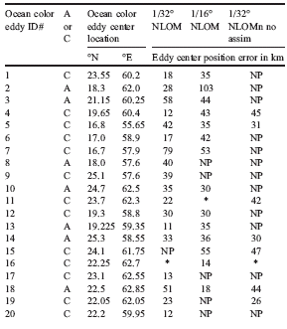
Traditional: Manual Feature Tracking
From: “1/32º real-time global ocean prediction and value-added over 1/16º resolution,” J.F. Shriver, H.E. Hurlburt, O.M. Smedstad, A.J. Wallcraft, R.C. Rhodes, Journal of Marine Systems, 65, 2007, pp. 3-26
Notes:
- Domain expert manually locating features in each, then measuring the distance.

Slide 9
Traditional Error Metrics
Single Quantity
  Affected by local biases
  Don’t show how features moved
Composite Quantity
  Still don’t show how features moved
Imaging / Visualization
  Difficult to get quantitative results
Manual feature measurement & tracking
  Laborious

Slide 10
Registration & Displacement
Find a transform T that best maps features from model forecast to analysis
Measured in terms of “displacement” (i.e., how much did p move to get to q)
  Could be utilized as a form of error measurement

Slide 11
Deformable Registration
Value added:
  Provides consistent spatial error units
  (e.g., meters) instead of scalar units
  (e.g., degrees-C)
  Accounts for proper representation of features, even if features were displaced
  Tolerant to bias
Probably best as accompanying metrics, not necessarily a replacement
  Handling of missing features
Notes:
[4:44]

Slide 12
Registration & Displacement
Analysis
Difference Criterion
Optimizer
Transformed
Forecast
Forecast
Displacement
Field
Transform
Transform forecast until it best matches analysis
  Difference criterion is the measurement of matching between data sets (RMS, correlation, etc.)
  Transform is the type and amount of warping applied to forecast
  Optimizer modifies transform & repeats until difference criterion is minimized/maximized

Slide 13
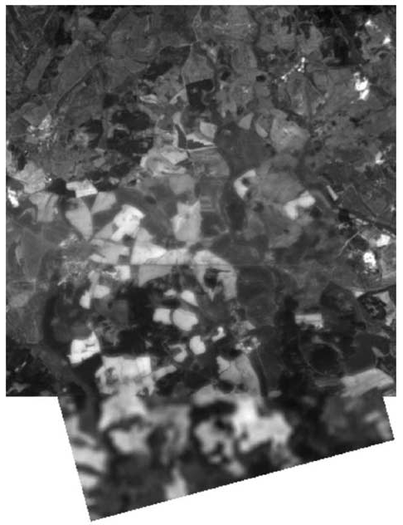
Rigid Registration
Well-established background in transforming multiple satellite images to fit together.
Simplistic transform:
  Translation
  Rotation
Image from “Image Registration Methods: A Survey,” B. Zitova and J. Flusser, Image and Vision Computing, 21, 2003, pp. 977-1000

Slide 14
Deformable Registration
More complex transforms that allow non-uniform deformations.
Heavily used in the medical field
  When a distortion is involved
2D Cubic B-Spline Transform
  Define a set of “control-points” connected in 2D
  Each point can be adjusted in x or y direction

Slide 15
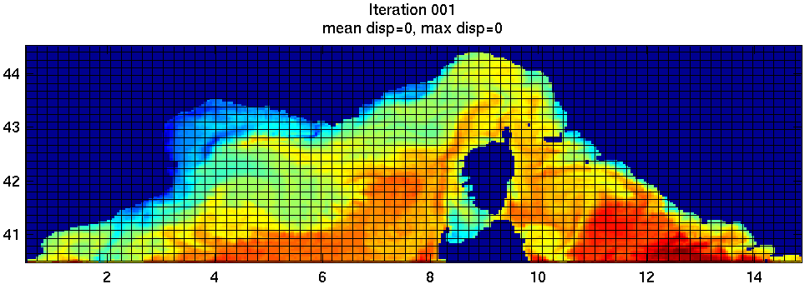
B-Spline Transform Registration
Control points adjusted iteratively
  Optimizing similarity between source and target data sets

Slide 16
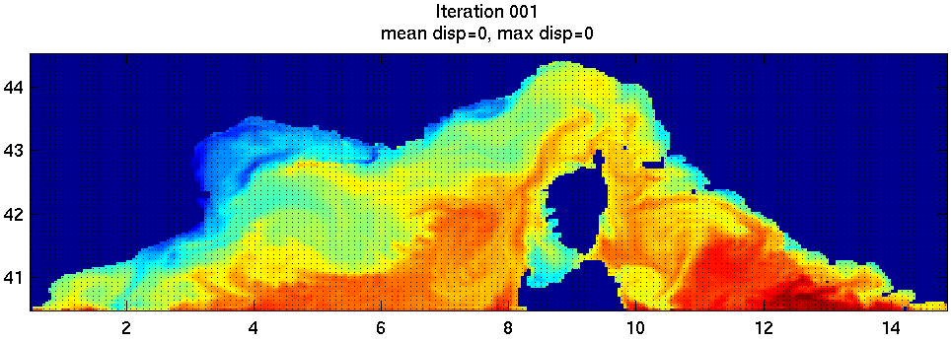
B-Spline Transform Registration
Convert to displacement vectors
  Apply transform to lat/lon data points
  Shift in position of data points is displacement

Slide 17
Registration Difference Criterion
Analysis
Difference Criterion
Optimizer
Transformed
Forecast
Forecast
Displacement
Field
Transform
Measurement of the difference between two data sets
  Mean-square difference
  Normalized Cross-correlation
  Mutual Information
  Precede any of the above with smoothed gradient

Slide 18
Registration Optimizers
Analysis
Difference Criterion
Optimizer
Transformed
Forecast
Forecast
Displacement
Field
Transform
Parameter space is x/y of each control point
Result is the difference criterion value
Several methods available:
  Gradient Descent, Quasi-Newton (L-BFGS-B), Conjugate Gradient (FR), Stochastic and Evolutionary

Slide 19
Configuration Issues
Which metric?
Which optimizer?
Other options:
  Multi-resolution (use or not; # of levels?)
  Spacing of control points for transform
  Linear vs cubic interpolation in transform
  Mutual information histogram bins
  Direct metric or use gradient
  How to handle masks for land / non-data

Slide 20

Study Implementation
Insight Segmentation & Registration Toolkit (ITK)
  Provides classes for transform, metrics, optimizers, …
  Even options for mask handling
  Has examples for multi-resolution
  Oriented toward medical image processing
http://www.itk.org/

Slide 21
Synthetic Displacement Trials
Create a “fake” transform
  Use current vector field as basis for the displacement
  How closely can registration reconstruct the synthetic displacement field?
Synthetic displacement + synthetic biases
  Simple addition of a constant value
  Addition of low and high frequency sinusoidal

Slide 22
Synthetic Displacement Trials
First, run several pre-trials with a few (5) arbitrarily selected data sets
  Start with configurations/parameters recommended by the literature
  Determine which parameters universally work
  Determine which don’t have a clear, single setting
Based on pre-trials, run full study with:
  20 data sets from NCOM model output in 2009
  & 24 time steps (2 per month) each

Slide 23
Pre-trial Results
Transform
  Control point spacing of 6 or 8 works best
    Which of the two varies from one data set to the next
    Except very small data sets (32x32), 4 is better
  Must use multi-resolution data
    Use enough levels to get smallest level to ~64x64
    Must also resample control points to be spaced 6-8 at each resolution
  Linear vs. Cubic interpolation varies between data sets

Slide 24
Pre-trial Results
Difference Criterion
  MI seems best, but no clear winner, especially in bias situations
  MI is fastest, NC very slow
  MI requires enough histogram bins, especially for low-gradient areas in data sets
    Minimum of 64 bins for lowest resolution
    Also need to double bins at each higher resolution
  Effectiveness of using gradient varies between data sets

Slide 25
Pre-trial Results
Optimizer
  Regular-step gradient descent (RSGD) too slow to converge and too sensitive to initial step size
  Fletcher-Reeves (conjugate gradient) and L-BFGS-B much faster due to better adaptive step size
  Simultaneous Perturbation Stochastic Approximation (SPSA) and One-Plus-One Evolutionary (OPOE) too slow to converge due to not accounting for gradient

Slide 26
Pre-trial Results
Land Masks
  Must be handled properly to get good convergence
  Improper handling caused:
    Convergence to poor results
    Results sometimes better not using masks at all

Slide 27
Pre-trial Results
Land Masks: Needed the following:
  Propagate a C1 continuous boundary condition throughout masked area
    For gradients and interpolations near land
  Re-implement multi-resolution interpolation to ignore masked data points
  Leave masked data points out of MI min/max

Slide 28
Final Trial
Run synthetic displacements on all data sets
Compare the following variations:
  MS vs. NC vs. MI difference criteria
  Direct value vs. gradient criteria
  Linear vs. cubic interpolation
  6 vs. 8 control point to data point spacing

Slide 29
Final Trial Results
Normalized Displacement RMSE
Notes:
-- Gradient is consistently worse except “Add C” for MS, but still worse than MI for “Add C”
-- MS worst for “Add C”; MI best -- MI seems best for “No Bias” -- Sin’s inconclusive
-- Linear vs. Cubic inconclusive -- 8 maybe slightly better than 6

Slide 30
Final Trial Results
Can discard gradient-based metric in this case
Each of MS/NC/MI can be compared respectively
  Choose the minimum of each optimized metric

Slide 31
Final Trial Results
Normalized Displacement RMSE
Notes:
-- MS much worse for Add C; MI best -- MI best for No Bias
-- Sin-low roughly same -- MI slightly worse for Sin-high

Slide 32
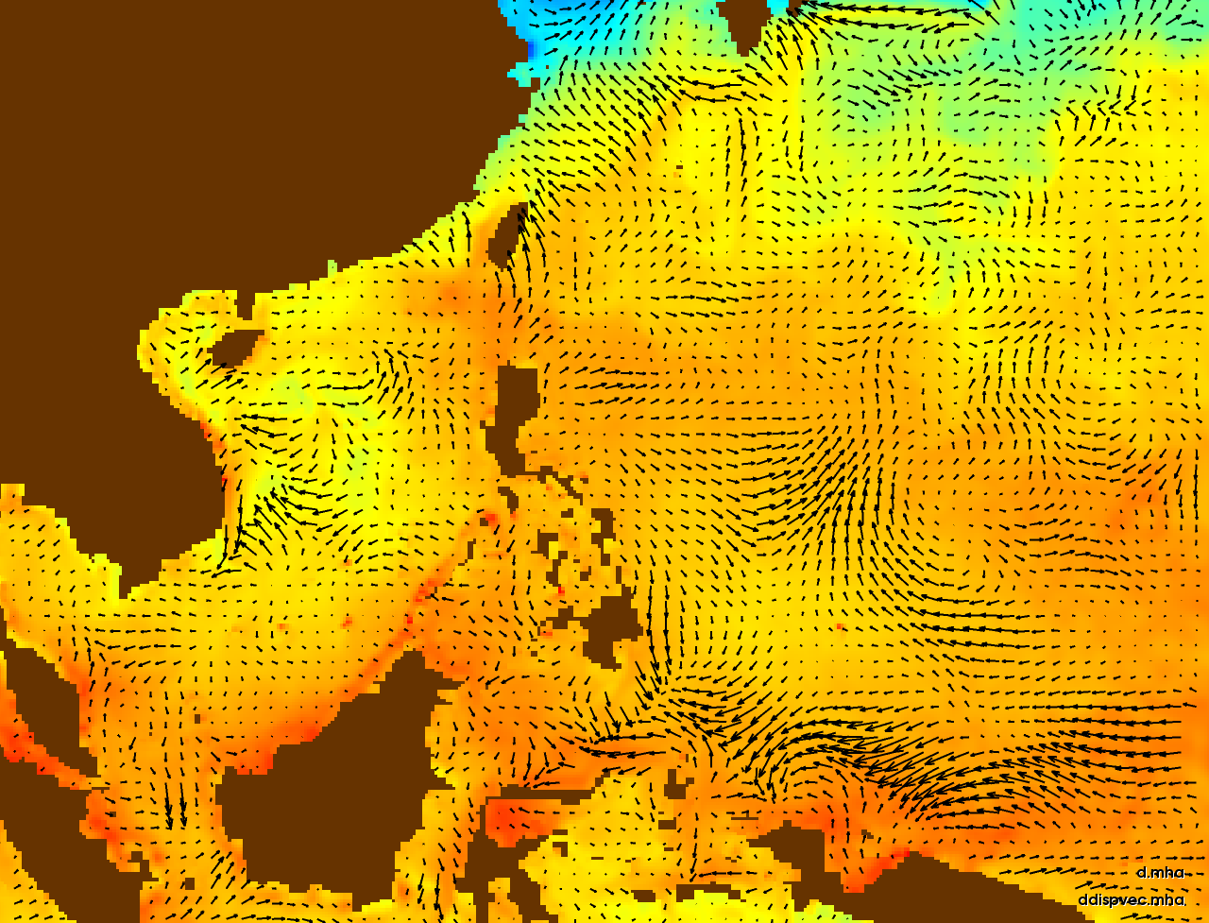
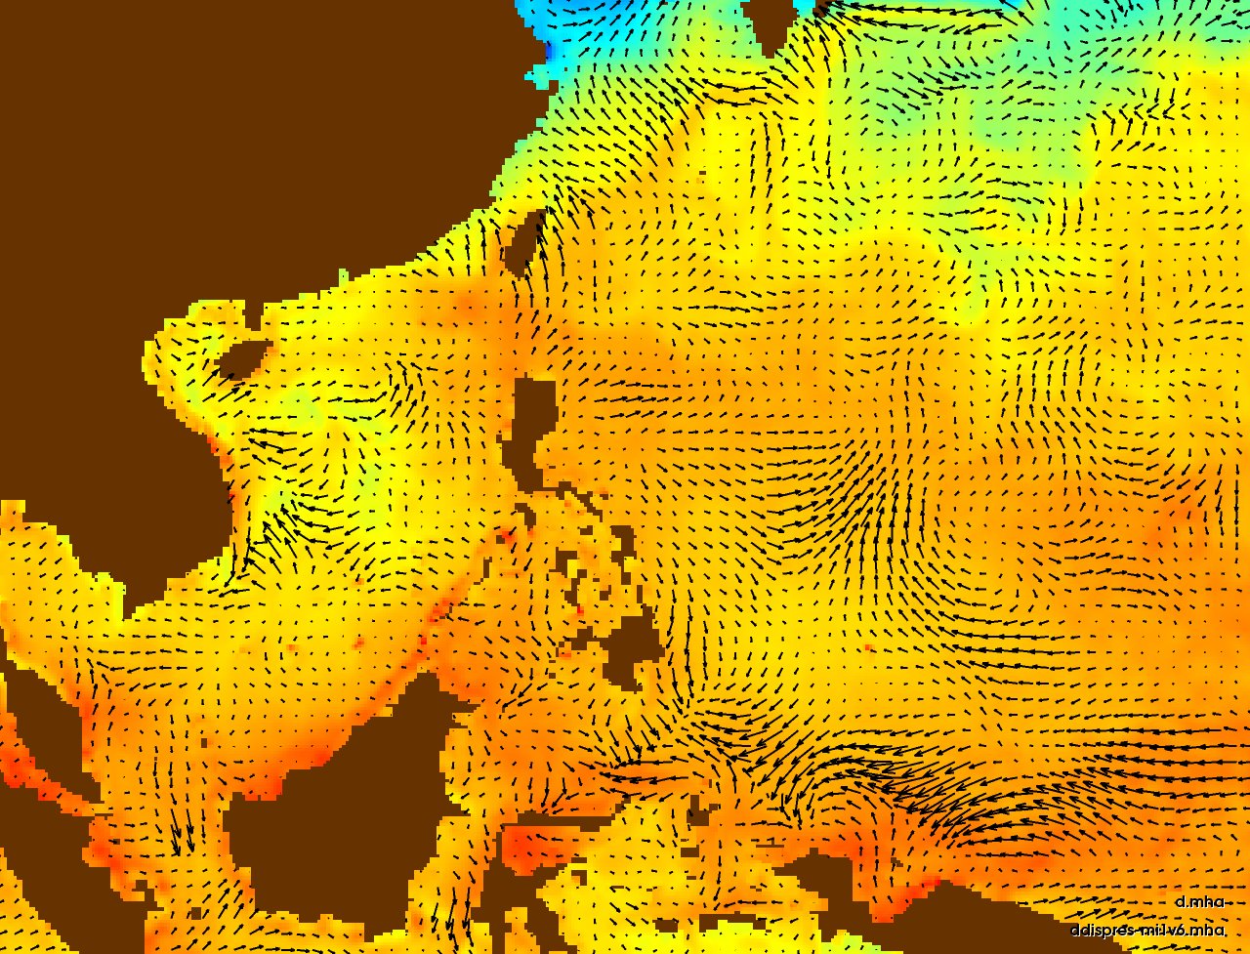
Synthetic displacement field
Displacement field recovered by registration (mutual information, linear, 6-spacing, no gradient)

Slide 33
Conclusions
MI best overall for these test cases
  As expected, handles low-entropy biases
MI also fastest
Gradient not useful in these cases
Linear vs. cubic, spacing varies per data set
  But can choose the one that best optimizes criteria
Pay attention to land masks

Slide 34
Future Work
User-based study with real displacement
Application to other ground truth types
  Assimilation systems, satellite imagery
“Demons” & FEM-based deformable registration
Explore MI alone

