Slide 1


Dax: Rethinking Visualization Frameworks for Extreme-Scale Computing
DOECGF 2011
April 28, 2011
Kenneth Moreland
Sandia National Laboratories
SAND 2010-8034P
Sandia National Laboratories is a multi-program laboratory managed and operated by Sandia Corporation,
a wholly owned subsidiary of Lockheed Martin Corporation, for the U.S. Department of Energy’s National
Nuclear Security Administration under contract DE-AC04-94AL85000.
Notes:
This talk is mostly my reflections on our scalable visualization tools today
How they might perform on an exascale computer
A path forward for new visualization algorithm design
We’re going to throw everything away.

Slide 2
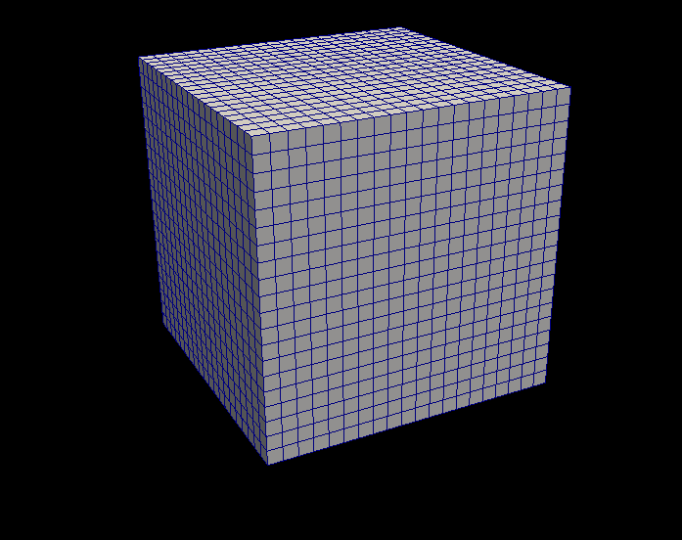
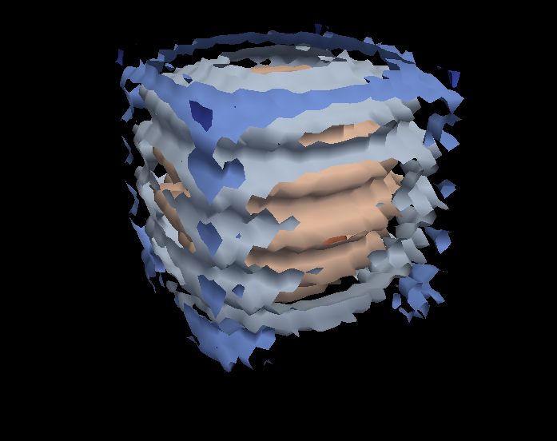
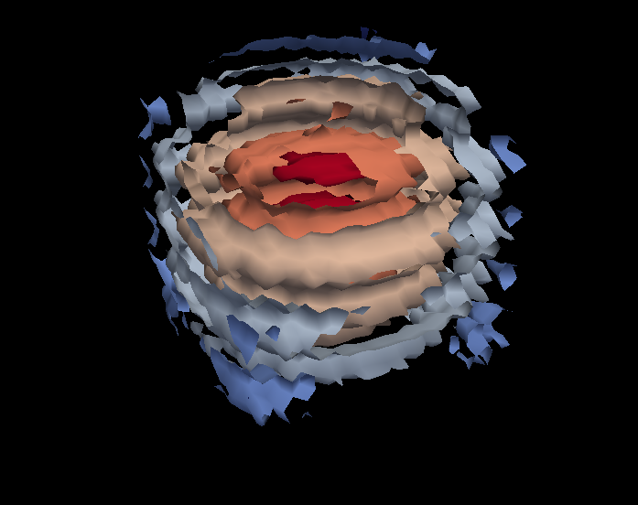
Serial Visualization Pipeline
Contour
Clip

Slide 3
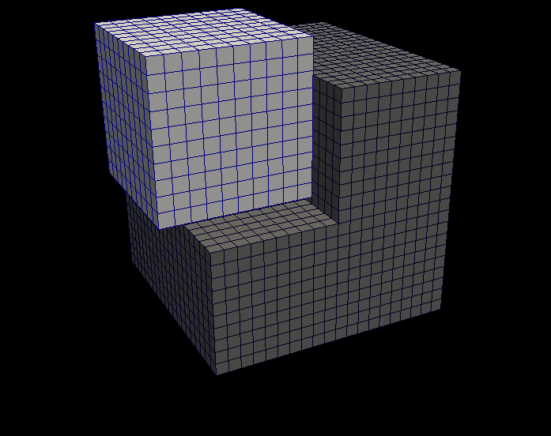
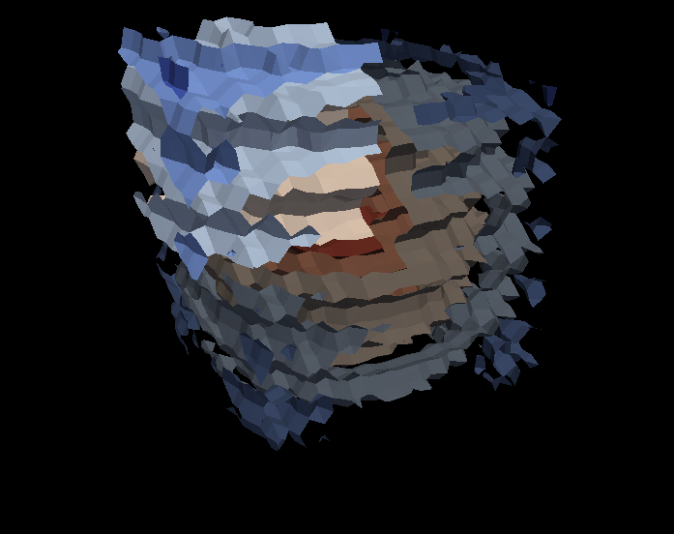
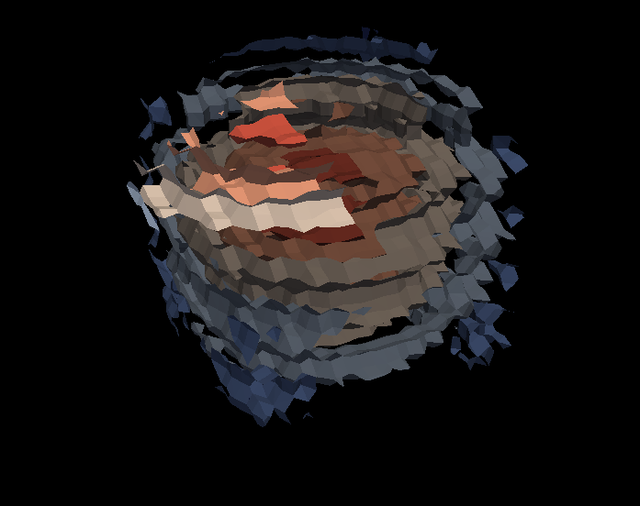
Parallel Visualization Pipeline
Contour
Contour
Contour
Clip
Clip
Clip
Notes:
Not all visualization systems specifically use this approach, but the successful parallel scalable versions use similar data partitioning.

Slide 4
Exascale Projection
 | Jaguar – XT5 | Exascale* | Increase
Cores | 224,256 | 100 million – 1 billion | ~1,000×
Concurrency | 224,256 way | 10 billion way | ~50,000×
Memory | 300 Terabytes | 128 Petabytes | ~500×
*Source: International Exascale Software Project Roadmap, J. Dongarra, P. Beckman, et al.
Notes:
Memory includes both DRAM and NVRAM. Don’t actually get to use all as working memory.

Slide 5
Exascale Projection
 | Jaguar – XT5 | Exascale* | Increase
Cores | 224,256 | 100 million – 1 billion | ~1,000×
Concurrency | 224,256 way | 10 billion way | ~50,000×
Memory | 300 Terabytes | 128 Petabytes | ~500×
MPI Only?
Vis object code + state: 20MB
On Jaguar: 20MB × 200,000 processes = 4TB
On Exascale: 20MB × 10 billion processes = 200PB !
*Source: International Exascale Software Project Roadmap, J. Dongarra, P. Beckman, et al.

Slide 6
Exascale Projection
 | Jaguar – XT5 | Exascale* | Increase
Cores | 224,256 | 100 million – 1 billion | ~1,000×
Concurrency | 224,256 way | 10 billion way | ~50,000×
Memory | 300 Terabytes | 128 Petabytes | ~500×
Visualization pipeline too heavyweight?
On Jaguar: 1 trillion cells → 5 million cells/thread
On Exascale: 500 trillion cells → 50K cells/thread
*Source: International Exascale Software Project Roadmap, J. Dongarra, P. Beckman, et al.

Slide 7
Hybrid Parallel Pipeline
Distributed Memory Parallelism
Contour
Contour
Contour
Shared Memory
Parallel Processing
Clip
Clip
Clip
Notes:
The new hotness: hybrid mode parallelism
Large scale systems still (always will be) broken into distributed memory nodes
In each node, implement threaded parallel program
Whereas distributed memory we got mostly for free, threaded parallelism is hard
Over 400 filters in VTK

Slide 8
Threaded Programming is Hard
Example: Marching Cubes
Easy because cubes can be processed in parallel, right?
How do you resolve coincident points?
How do you capture topological connections?
How do you pack the results?
Notes:
The takeaway here is that the “reimplement components with threads” is not the easiest or best solution.
It may not even be viable.

Slide 9
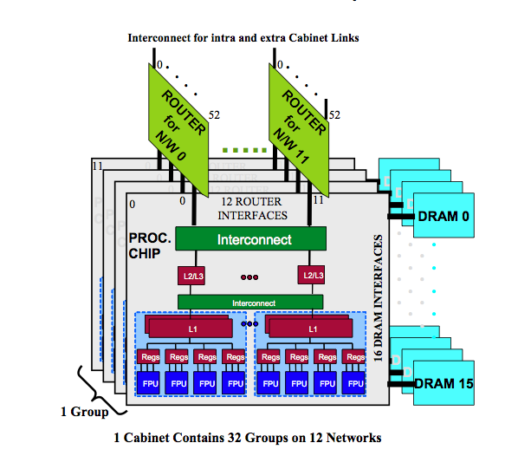
Multicore ≠ SMP
ExaScale Software Study: Software Challenges in Extreme Scale Systems
Notes:
It gets even more complicated.
The theoretical SMP model has uniform access to memory.
A multicore processor is more like a NUMA model.
There is a deep hierarchy of memory access.
Naïve loop unrolling is ineffective.
So, how do we support easier parallel programming?

Slide 10
GPU: Memory Management and Scheduling
Device Memory
Host Memory
Multiprocessor
Multiprocessor
Multiprocessor
Multiprocessor
Multiprocessor
Shared Memory
Processor
Processor
Processor
Processor
Processor
Registers
Caches
Notes:
GPUs provide yet another memory hierarchy with separate host and device memory, multiple types of caches, and blocks of processors.
All must be considered when scheduling threads and managing memory.
The takeaway here is that the “reimplement components with threads” is not the easiest or best solution.
It may not even be viable.

Slide 11
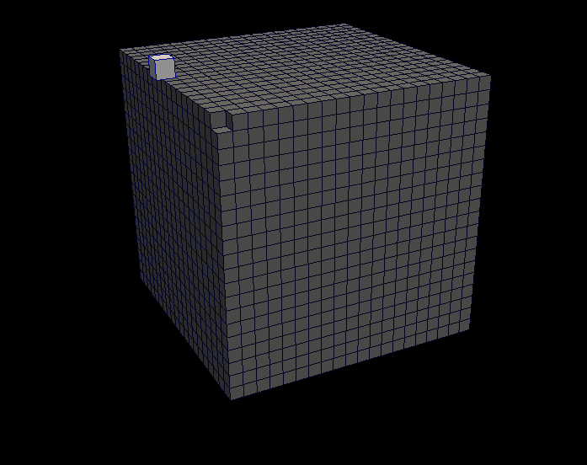
Revisiting the Pipeline
Lightweight Object
Serial Execution
No explicit partitioning
No access to larger structures
No state
Filter
Notes:
Lightweight object: low overhead for indefinite parallelism.
Serial Execution: the point is to break the problem to its finest level and then run those units in parallel.
No explicit partitioning: cannot afford to divide data into pockets at this fine of a level and still capture connectivity.
No access to larger structures: remove possibility of race conditions, avoid complicated indexing semantics.
No state: private state quickly grows to a sizable chunk of overall memory and shared state opens up race conditions again.

Slide 12
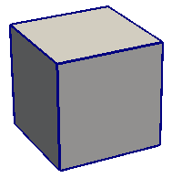
function ( in , out )
Notes:
The solution is remarkably basic: a function.
A function has no state associated with it.
We can limit the accessible data to structures passed in and out of it.
The function need not worry about race conditions. It will be the caller’s responsibility to pass data the function can safely access.
The structures passed can be in place. We just wrap them in objects that restrict access to a single element.
If the function follows the rules, it can be executed concurrently on an indefinite number of threads.
The takeaway is that as a visualization algorithm developer, you provide no more than a concise, serial function.

Slide 13
Worklet
function ( in , out )
Notes:
We don’t really want to execute the function on a single element. We want to apply it to an entire mesh.
To provide the facilities necessary to dynamically operate the function, we wrap it in an object called a functor.
The functor provides metadata such as introspection, calling conventions, and usage patterns for the function.

Slide 14
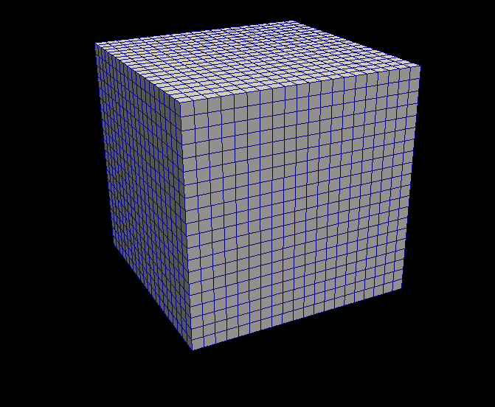
Iteration Mechanism
Executive
Functor
Functor
foreach element
Functor
Functor
Functor
Functor
Functor
Functor
Functor
Functor
Functor
Worklet
Functor
Functor
Worklet
Conceptual
Iteration
Reality: Iterations can be
scheduled in parallel.

Slide 15
Comparison
Executive
Filter
foreach element
foreach element
Worklet
Notes:
For the functor on the left, we can write an engine once, which is the hard part, and apply it to multiple functors.
For the traditional vis pipeline filter, this iteration mechanism is embedded and entangled in the algorithm implementation.
Every time you write a filter, parallel scheduling needs to be rethought and reimplemented.
We can also used different engines for a functor.
Use a serial engine for debugging purposes.
Compile with both C and OpenCL, use GPU engine.

Slide 16
Comparison
Executive
Filter 1
foreach element
foreach element
Worklet 1
Worklet 2
Filter 2
foreach element
Notes:
When chained together, functors provide better memory access patterns.
Each filter must independently read in each element of the data, processes it, and write out the entire results.
Constantly pulling data from main memory and pushing results back.
Functors can be chained inside the engine iteration.
Each entity loaded is processed entirely before its results are written back.
Maximizing execution to memory access ratio. Important when you can compute data faster than access it.

Slide 17
Dax System Layout
Control
Environment
Execution
Environment
Executive
Worklet
Worklet
Worklet

Slide 18
Worklet vs. Filter
__worklet__ void CellGradient(...)
{
daxFloat3 parametric_cell_center =
(daxFloat3)(0.5, 0.5, 0.5);
daxConnectedComponent cell;
daxGetConnectedComponent(
work, in_connections, &cell);
daxFloat scalars[MAX_CELL_POINTS];
uint num_elements
= daxGetNumberOfElements(&cell);
daxWork point_work;
for (uint cc=0; cc < num_elements; cc++)
{
point_work = daxGetWorkForElement(&cell, cc);
scalars[cc]
= daxGetArrayValue(point_work, inputArray);
}
daxFloat3 gradient = daxGetCellDerivative(
&cell, 0, parametric_cell_center, scalars);
daxSetArrayValue3(work, outputArray, gradient);
}
int vtkCellDerivatives::RequestData(...)
{
...[allocate output arrays]...
...[validate inputs]...
for (cellId=0; cellId < numCells; cellId++)
{
...
input->GetCell(cellId, cell);
subId = cell->GetParametricCenter(pcoords);
inScalars->GetTuples(
cell->PointIds, cellScalars);
scalars = cellScalars->GetPointer(0);
cell->Derivatives(
subId,pcoords,scalars,1,derivs);
outGradients->SetTuple(cellId, derivs);
}
...[cleanup]...
}

Slide 19
Execution Types: Map
Example Usage: Vector Magnitude
Notes:
Basic application of functor on field. Input is field value, output is new field value for same element.

Slide 20
Execution Type: Cell Connectivity
Example Usages: Cell to Point, Normal Generation
Notes:
Collect field values connected to element, reduce to single value, output to element.

Slide 21
Execution Type:
Topological Reduce
Example Usages: Cell to Point, Normal Generation
Notes:
Collect field values connected to element, reduce to single value, output to element.

Slide 22
Execution Types:
Generate Geometry
Example Usages: Subdivide, Marching Cubes
Notes:
Functors operate on cells and generate new geometry.
Features of geometry linked to the input cell constituent parts.

Slide 23
Execution Types: Pack
Example Usage: Marching Cubes
Notes:
If functors output variable-sized output, pack them efficiently in an array.

Slide 24
Initial Observations
Implementing engines is hard, but implementing functors is easy.
Efficient memory management is the most challenging problem (so far).
It is often easier to write specialized functors than to chain basic functors.
GPUs scream…
  …but we have yet to implement all but the obvious map engines on them.
Notes:
Implementing: this is actually what we were shooting for. We want to encapsulate the “hard” part of parallel programming and leave the “user” to focus on the algorithm.
Efficient memory: originally was hoping to be able to adapt to any memory layout. That might not work out so well.
It is often easier: perhaps the mechanism for actually chaining functors together not necessary. System encourages that implementation anyway.
GPUs scream: encouraging because we hope that functors generally lend to good GPU/vector processing.
This is hopefully an implementation detail of the engines that will be “solved” for users.

Slide 25
Conclusion
Why now? Why not before?
  Rules of efficiency have changed.
Concurrency: Coarse → Fine
Execution cycles become free
Minimizing DRAM I/O critical
The current approach is unworkable
  The incremental approach is unmanageable
Designing for exascale requires lateral thinking
Notes:
Minimizing DRAM I/O
Computation limited by how often need to pull from memory
May not even have enough power to regularly access main memory

