Slide 1



Advanced Simulation Capability for
Environmental Management
ASCEM Visualization Thrust
Joerg Meyer
Hari Krishnan
Wes Bethel

Slide 2
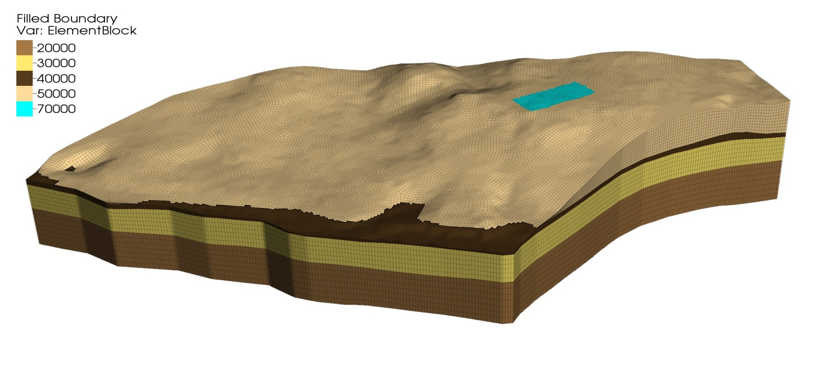
HPC – Unstructured Mesh
Largest F-basin
Unstructured hexagonal-mesh for the model with 25-ft horizontal resolution
Hydrostratigraphic layers are colored according to the number of mesh elements given in the legend

Slide 3
HPC Simulation and Visualization
Data flow:
MS
XML
Pika
Akuna
(CP ISE)
Visualization Applications and Services
HPC Input
Amanzi
XDMF
UQ

Slide 4

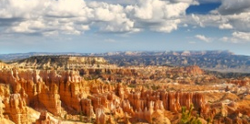
Collaboration and Integration
Cross-thrust integration:
  Data Management (DM)
  Core Platform Integrated
  Software Environment (CP ISE)
  Model Setup (MS)
  Parameter Estimation (PE)
  High Performance Computing/
  Simulation (HPC)
  Uncertainty Quantification (UQ)
Use case
(F site: MS, Pika, Amanzi, Vis/UQ)
Provenance
DM

Slide 5


ASCEM Visualization
Use case: F Area
(Acidic, U-contaminated water; pH treatment)
Goal: Develop visual analysis tool to help determine when pH treatment can be turned off
Software Development:
VisIt visualization templates for
  U concentration (Google Maps Overlay)
  pH (Google Maps Overlay)
Requirements:
  Historical Data
  Predicted Data

Slide 6
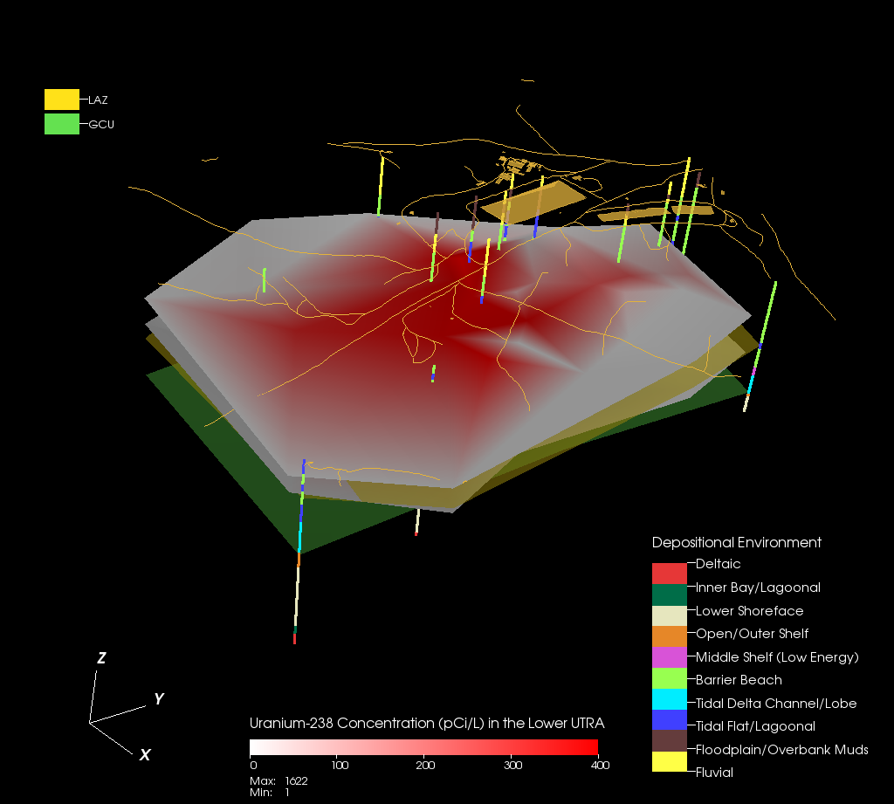
Environmental Cleanup
Visualization:
  U-238 conc.
  Well sites
  Depositional
  Environment
  F area
  VisIt

Slide 7
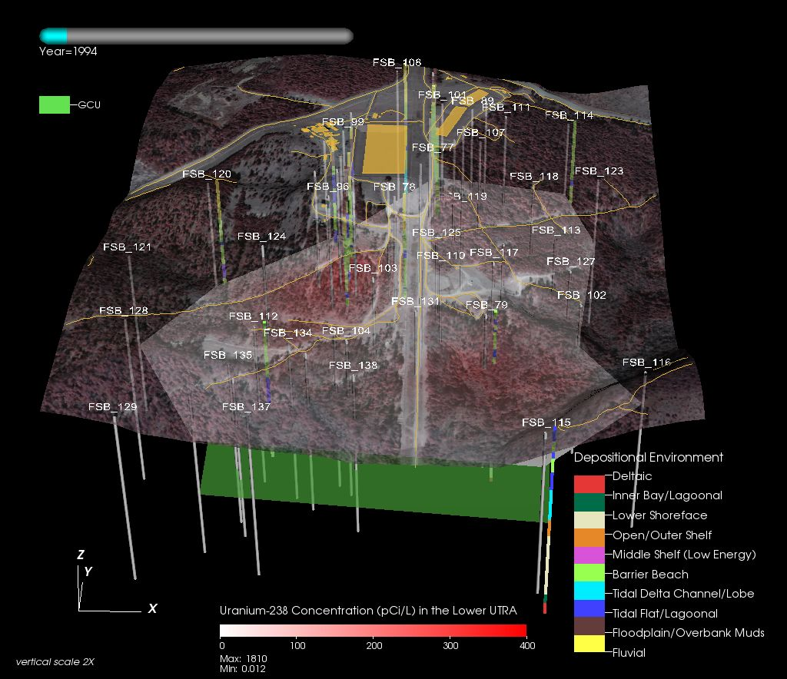
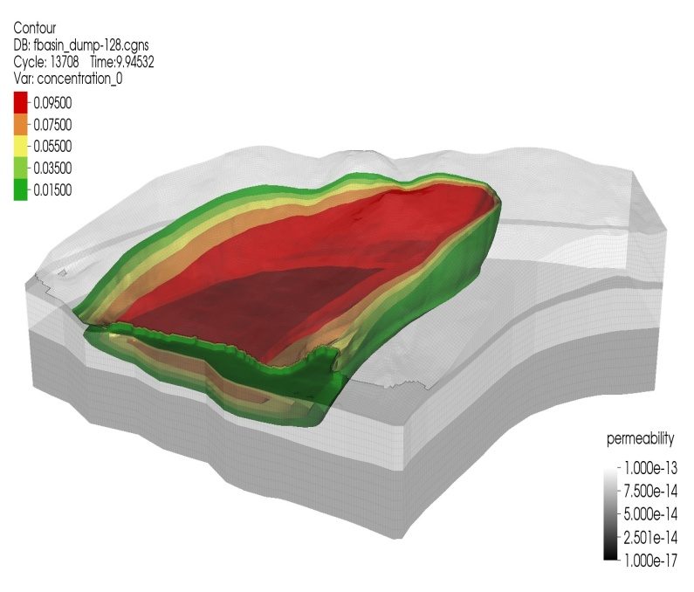
ASCEM Visualization
Visual data exploration of
  Part 1: Historical field data.
  Part 2: Simulation data.
  Part 3: Ensemble data.

Slide 8
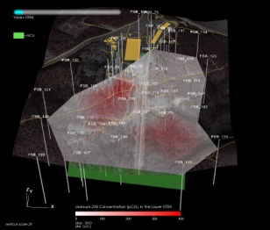
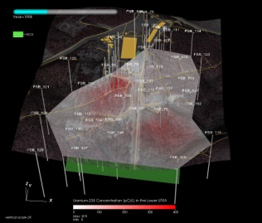
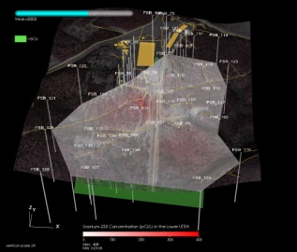
ASCEM Visualization
Visual data exploration of different types of geospatially registered data for the F-area seepage basin:
  Observation wells, surface topography, depositional environment, observed concentration from many years.
Objectives:
  3D navigation through the F-area historical concentration data.
  Temporal browsing to show time evolving contaminant plume.
  Selectively enable display of several different types of data.
Approach
  Add new capabilities to well-established, production-quality, open source visual data analysis and exploration software infrastructure to meet ASCEM needs.
  Demonstrate viability via application to ASCEM-specific problems.

Slide 9
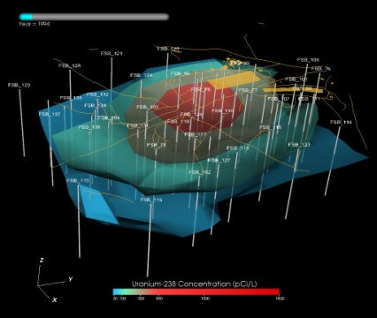
ASCEM Visualization
3D, temporal browsing of concentration data, geospatially registered surface topography, GIS data, and observation wells.
Movie showing 3D navigation
Movie showing time evolving U238 concentration.
Movie showing time evolving U238 plume computed via resample/isosurface operators.
Notes:
The image(s) show:
Observation wells, color coded along depth according to depositional environment, along with well labels
Surface topography and GIS data (roads, buildings) to show context
U238 concentration level within the Lower UTRA aquifer (red-white surface)
Gordon Confining Unit (aquifer) location in green.
The first movie shows 3D navigation around this data.
The second movie shows time-evolution of the U238 level within the Lower UTRA aquifer over time. Note: the Lower UTRA triangulated surface appears to change shape over time. This change is due to the fact that those wells were not sampled in all years, so for years in which there is no data, the portion of the triangulated surface that uses that particular well location disappears. This is expected behavior.
The third movie shows time-evolution of U238 computed via interpolation across the entire domain.
Note: Friday 12 Nov 2010 – these three movies are still in production, should be ready by 13 Nov 2010

Slide 10
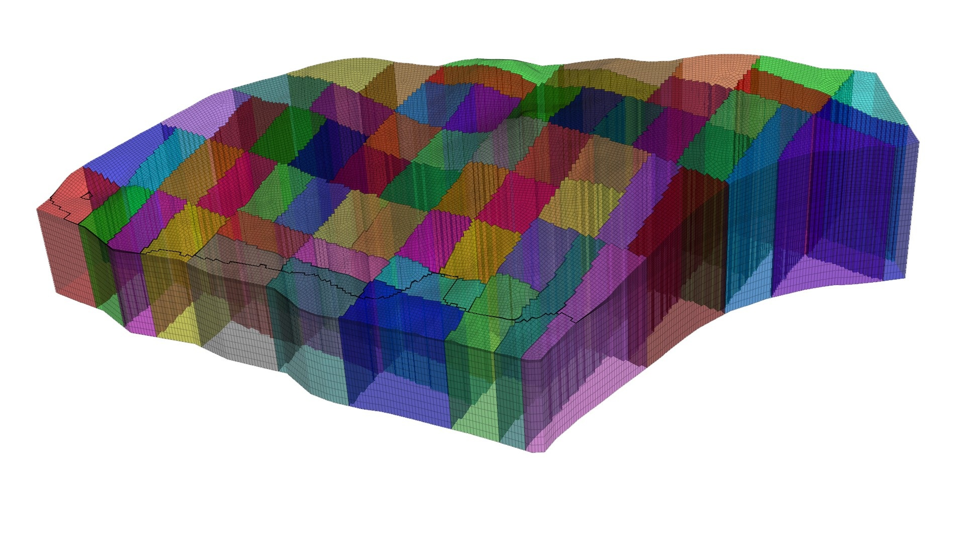
HPC – Partitioning of the Unstructured Mesh
Accomplishments
Partitioning of the unstructured mesh for a 64 processor parallel simulation
Each color represents a partition assigned to a different processor

Slide 11
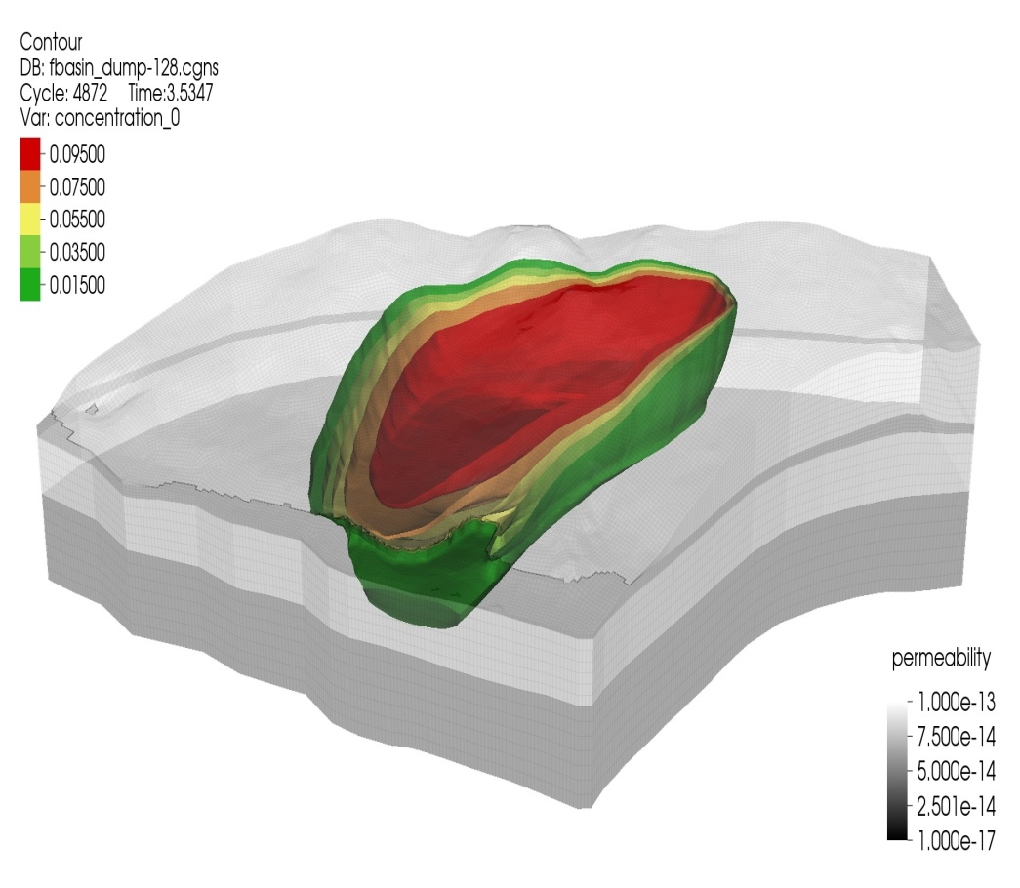
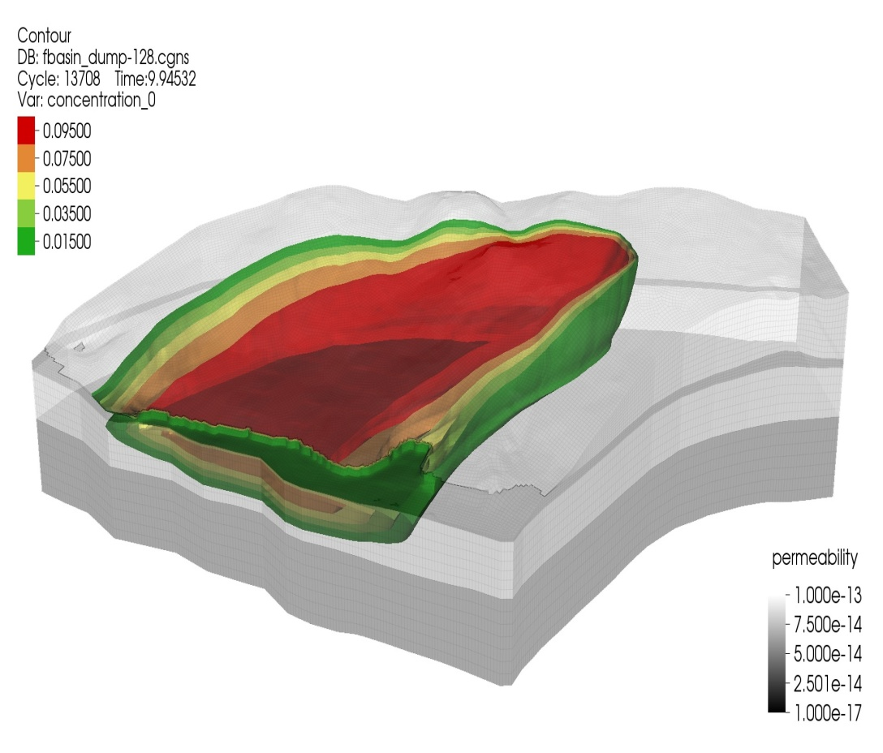
HPC Simulation of Non-Reactive Contaminant
Isosurfaces of a non-reactive contaminant at ~3.5 years and ~9.9 years
Flux into the basin was 19 m/y; infiltration due to rainfall was constant at 38 cm/y

Slide 12
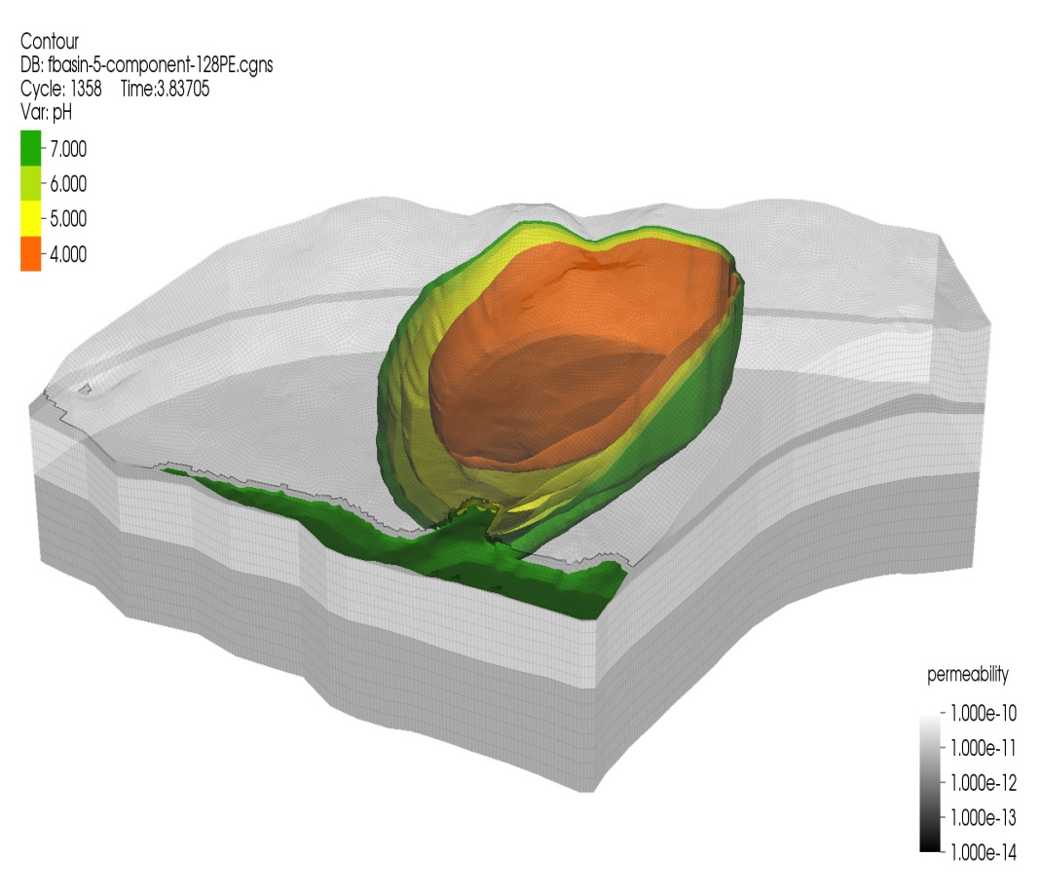
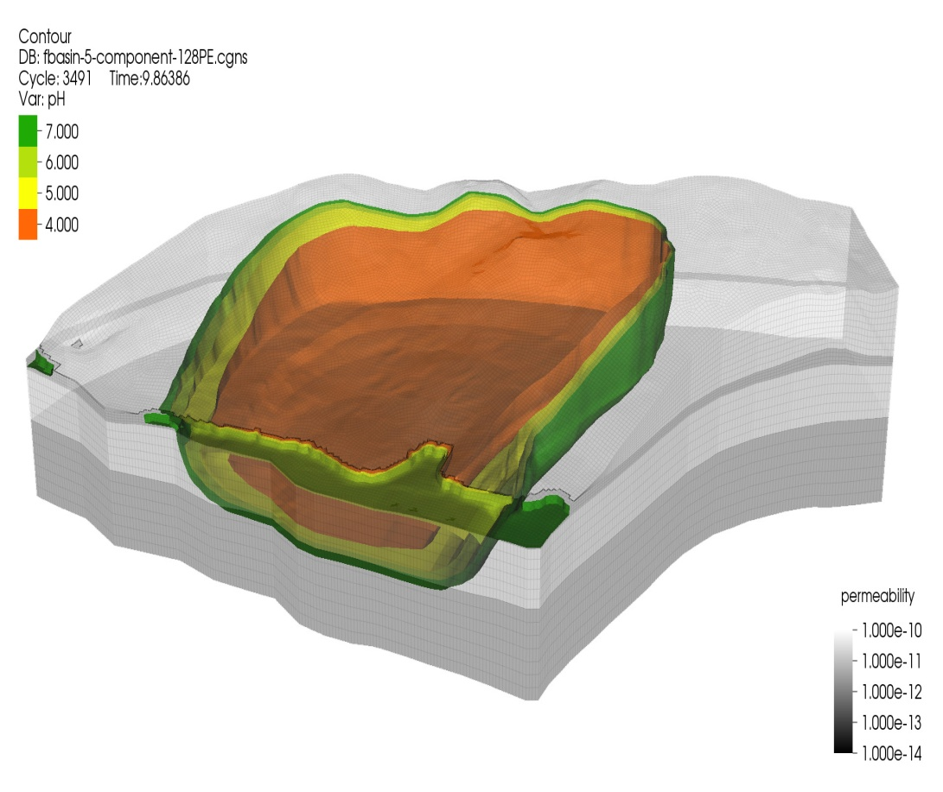
HPC Simulation of pH Using Unstructured Grid
Isosurfaces of pH for the 5-component system shown at ~3.8 years and ~9.8 years

Slide 13
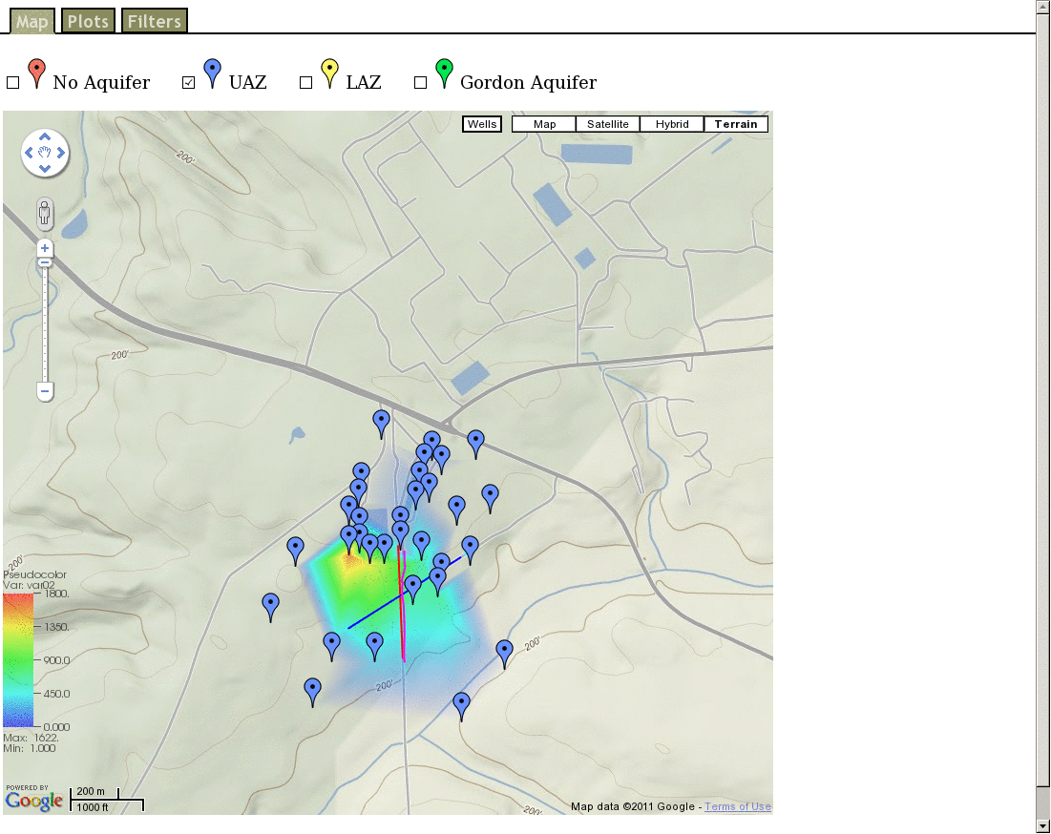
Google Maps Overlay (VisIt)
Integration of
  Gmaps interface
  Visualization s/w
Animation:
  U-238 conc.
  1993-2009
  F area
  VisIt, Google Maps Overlay

Slide 14
Summary
Advanced visualization capabilities that meet ASCEM needs being delivered via:
  Deploying new algorithms, practices atop well established, production-quality, parallel capable, open source visual data analysis and exploration infrastructure.
  Demonstration of: 3D, temporal browsing of historical data along with geospatially registered observation wells, GIS data (LBNL).
  Demonstration of: visual data exploration and analysis of ensemble collections produced by Monte Carlo simulation runs (SRNL).
  Demonstration of: visual data exploration and analysis of HPC simulation output (LANL).
Deep Vadose Zone Animation

Slide 15
Joerg Meyer
JoergMeyer@lbl.gov
Questions?
Additional information:
LBNL Vis Group:
http://vis.lbl.gov

