Slide 1
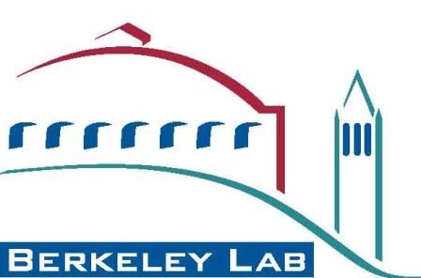
Site Report: Lawrence Berkeley National Laboratory
Joerg Meyer
joergmeyer@lbl.gov

Slide 2
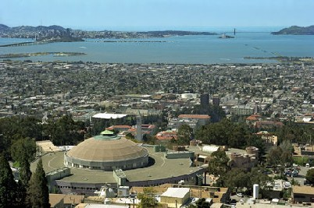
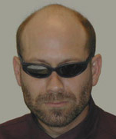
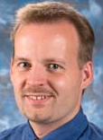
LBNL Visualization Group
Introduction
Wes Bethel (Vis Group Lead)
Recent hires:
Hari Krishnan Burlen Loring Joerg Meyer Oliver Rübel
(Computer Systems Engineers)

Slide 3
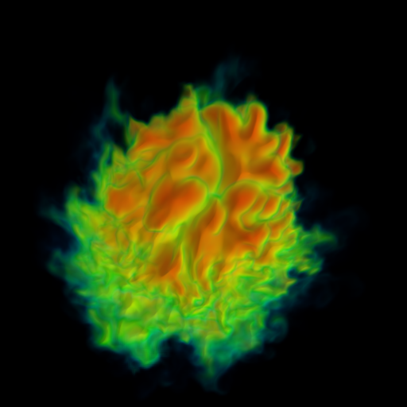
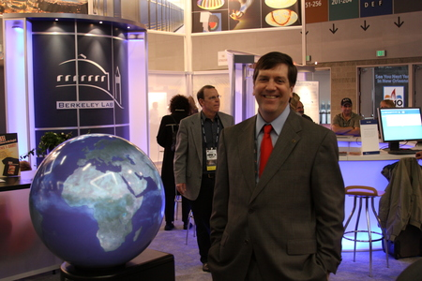
LBNL Visualization Base Program
Problem(s): scientific discovery hindered by sheer size and complexity of data.
Approach: R&D in areas of parallelism in vis/analysis, feature-based filtering and analysis, query-driven visualization and analysis.
Impact: new understanding of technologies/architectures for running vis and analysis algorithms at highest-ever levels of concurrency on advanced platforms, many specific impacts on science through ongoing collaborations.
Images: (top) results of 216K-way parallel run of new hybrid-parallel technology on JaguarPF on a 3TB dataset. (Bottom) globe display in LBNL booth at SC conference.

Slide 4
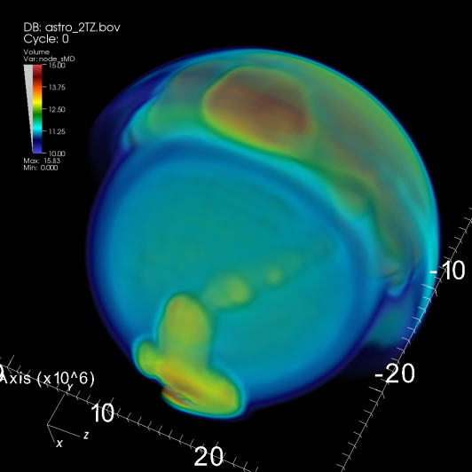
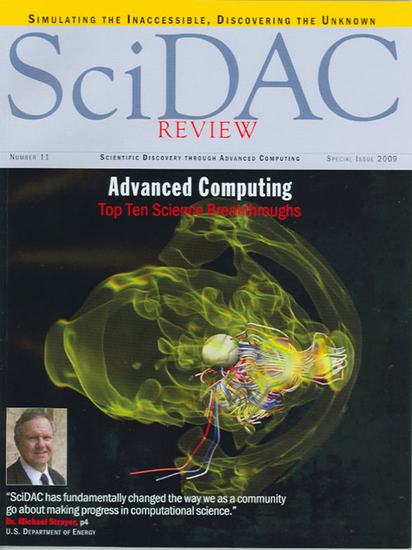
SciDAC Visualization and Analytics Center for Enabling Technology
Problem. Need for production-quality, petascale-capable visualization s/w infrastructure to enable scientific knowledge discovery.
Approach. Blend of R&D, software engineering, and direct application interactions to produce high quality visualization software and tools.
Impact. Delivering high-quality, petascale-capable vis s/w, numerous direct impacts on science applications (knowledge discovery, cost savings, etc.)
Images. (Top) VisIt generated image of 2T zone data on 32K cores of Franklin. (Bottom) VisIt image of type II SN simulation.

Slide 5
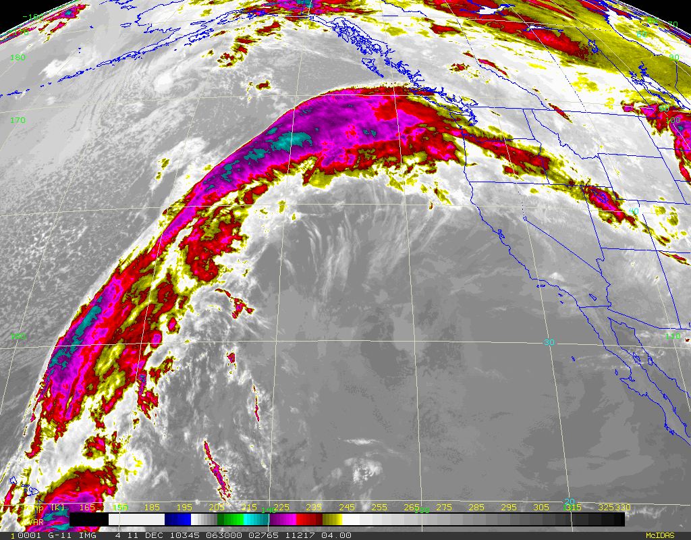
Visualization and Analysis of Ultra-scale Climate Data
Problem. Traditional climate vis and analysis tools won’t work on increasing large and complex climate simulation data.
Approach. Combination of leverage/extend scalable vis s/w, and develop new analysis tools to study specific classes of climate science problems.
Impact. New s/w that directly meets needs of climate science community, esp. wrt upcoming IPCC assessment.
Images. (Top) Our team has developed s/w for detecting and analyzing atmospheric rivers using supervised machine learning. (Bottom) Our team applies statistical models to predict seasonal, regional precipitation extremes.

Slide 6
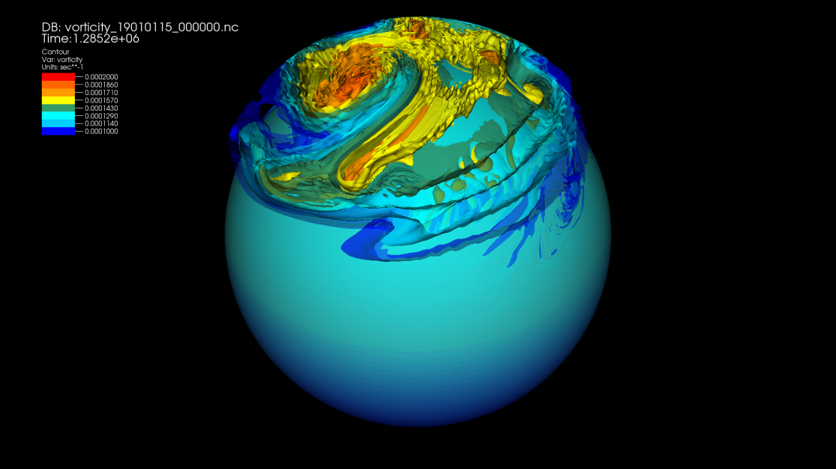
DOE/BER: Climate Modeling
Visualization and Analysis support of Global Cloud Resolving Models
Data Models for geodesic unstructured grid
Parallel plugin development in VisIt
Profiling and benchmarking of I/O
VisIt Climate skin development for ease of use
Custom plots and operators

Slide 7
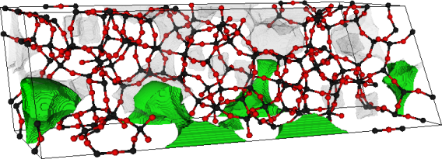
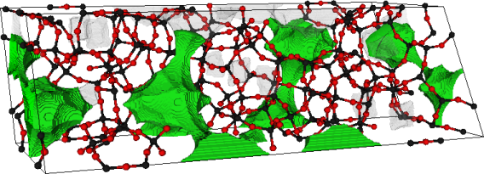
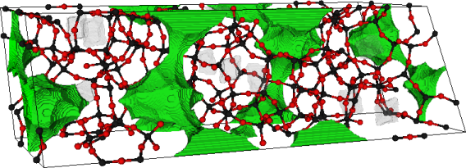
SciDAC-e: Math and Geometric Tools for Energy-Related Gas Separations
Problem. A limiting factor in characterizing porous media for use in carbon capture is the lack of tools for structural analysis.
Approach. Apply Fast Marching methods to find voids and isolated regions, which can then be quantitatively analyzed. Develop highly scalable codes to facilitate real-time analysis.
Impact. Help advance materials understanding to achieve better carbon capture, sequestration.
Images. These three show the propagation of a front through 3D, revealing channels (green) and inaccessible voids, which are then eliminated from use in future simulations evaluating different carbon capture/sequestration strategies.

Slide 8
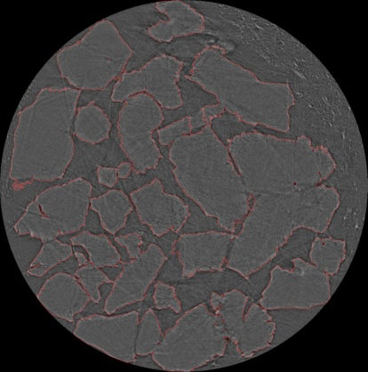
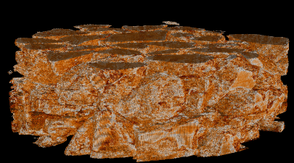
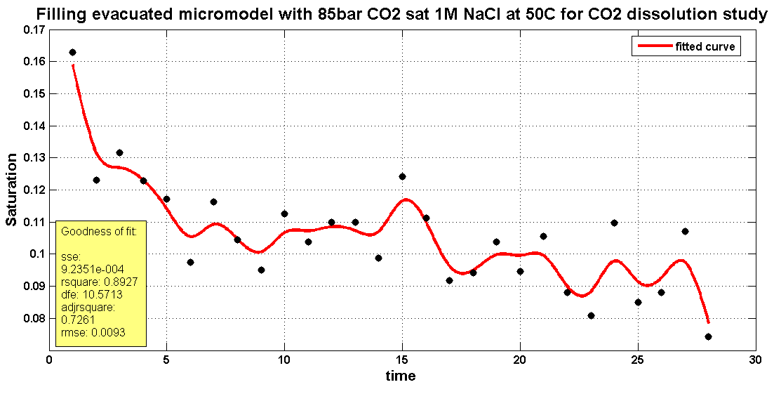
SciDAC-e: Vis and Analysis for Nanoscale Control of CO2
Problem. CO2 sequestration strategy evaluation needs better tools for analyzing experimental data.
Approach. Develop new 3D image analysis and surface reconstruction software tools.
Impact. Reconstruction and analysis from experimental data provide data critical for accurate CO2 sequestation modeling.
Images. (Top) 2D slice of micromodel (observed). (Middle) 3D segmentation/surface reconstruction of porous media. (Bottom) CO2 flow rates computed by simulation.

Slide 9
NEAMS
Purpose: provide visualization support to reactor campaign of NEAMS (Nuclear Engineering Advanced Modeling and Simulation), specially Nek5000 code, which does thermal hydraulics simulations.
Approach: deploying and customizing VisIt for Nek5000 community
Key aspects: flow analysis, large unstructured meshes, in situ processing

Slide 10
DOE/ASCR Exascale SDM Project
ExaHDF5: An I/O Platform for Exascale data models, analysis and performance
Taking HDF5 to the Exascale
Removing collective operations, Fault tolerance, Auto-tuning, Asynchronous I/O
Benefits all HDF5 and NetCDF-4 users
Taking FastBit to the Exascale
Index/Query on distributed multi-core platforms
Operates on generic NetCDF and HDF5 files
Designing easy to use data models for climate, groundwater and accelerator modeling
Hide complexity of underlying file system
H5hut, GCRM

Slide 11
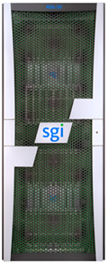
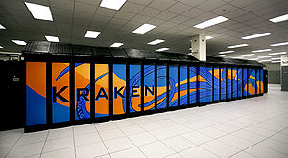
NSF/RDAV
Recent accomplishments
Vis software deployment on
+
Nautilus
Ver. 3.10.0 now available!
Ver. 2.2.2 now available!
Free, interactive parallel visualization and graphical analysis tool for viewing scientific data
Parallel, open-source, multi-platform data analysis and visualization application

Slide 12
Joerg Meyer JoergMeyer@lbl.gov
Questions?
Additional information:
LBNL Vis Group: http://vis.lbl.gov

