Slide 1
Parallel In Situ Coupling of Simulation with a Fully Featured Visualization System
Brad Whitlock
Lawrence Livermore National Laboratory
Jean M. Favre
Swiss National Supercomputing Centre
Jeremy S. Meredith
Oak Ridge National Laboratory

Slide 2
What We’re Doing
We are processing simulation data in situ to avoid the high costs of I/O associated with writing and then reading the data
We have created a library that lets simulations interface to a fully featured parallel visualization system
We have used our library to instrument a parallel cosmology code to investigate some of its performance aspects compared to doing I/O

Slide 3
Case For Using In Situ
Machine | Year | Writable FLOPS | Whole-System Checkpoint
ASCI Red | 1997 | 0.075% | 300 sec
ASCI Blue Pacific | 1998 | 0.041% | 400 sec
ASCI White | 2001 | 0.026% | 480 sec
ASCI Red Storm | 2005 | 0.035% | 660 sec
ASCI Purple | 2005 | 0.025% | 500 sec
NCCS XT4 | 2007 | 0.004% | 1400 sec
Roadrunner | 2008 | 0.005% | 480 sec
NCCS XT5 | 2008 | 0.005% | 1250 sec
ASC Sequoia | 2012 (planned) | 0.001% | 3200 sec
I/O in supercomputers has not kept pace with compute power
Some applications report 90% of time spent in I/O [Peterka et al.]
Post processing simulation files requires write then read, paying for I/O twice in different application
In Situ may let us avoid some I/O

Slide 4
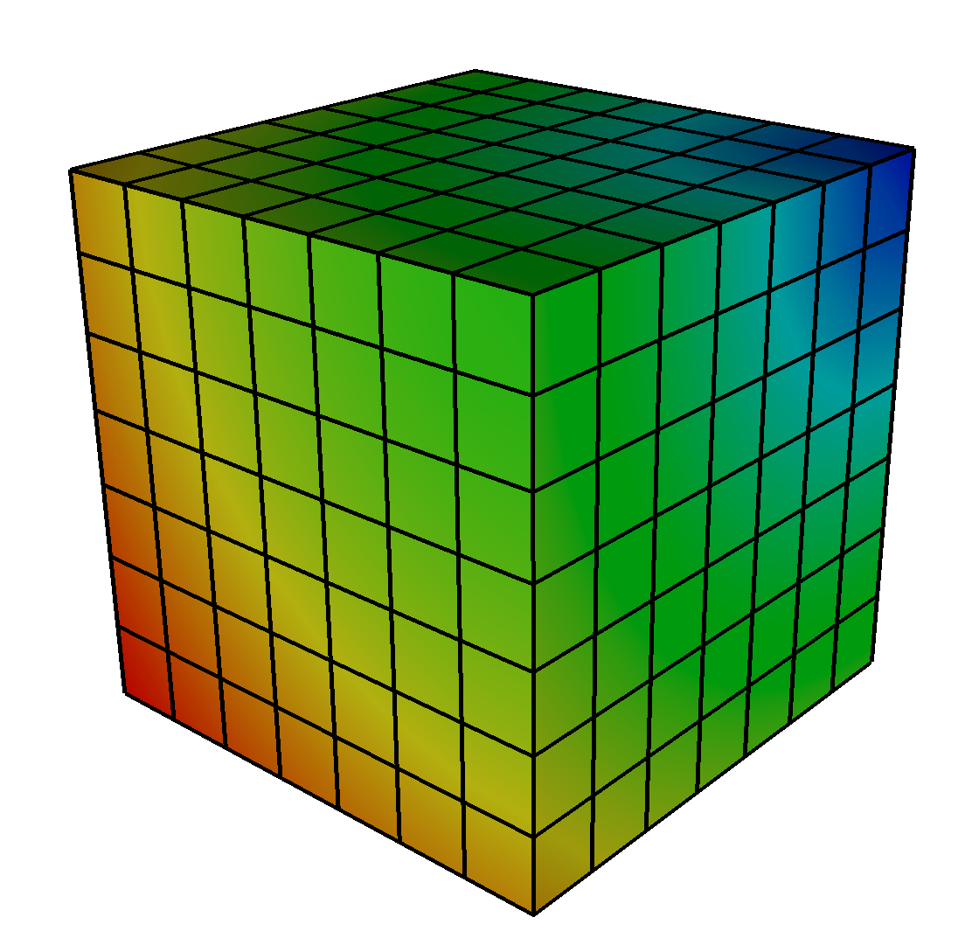
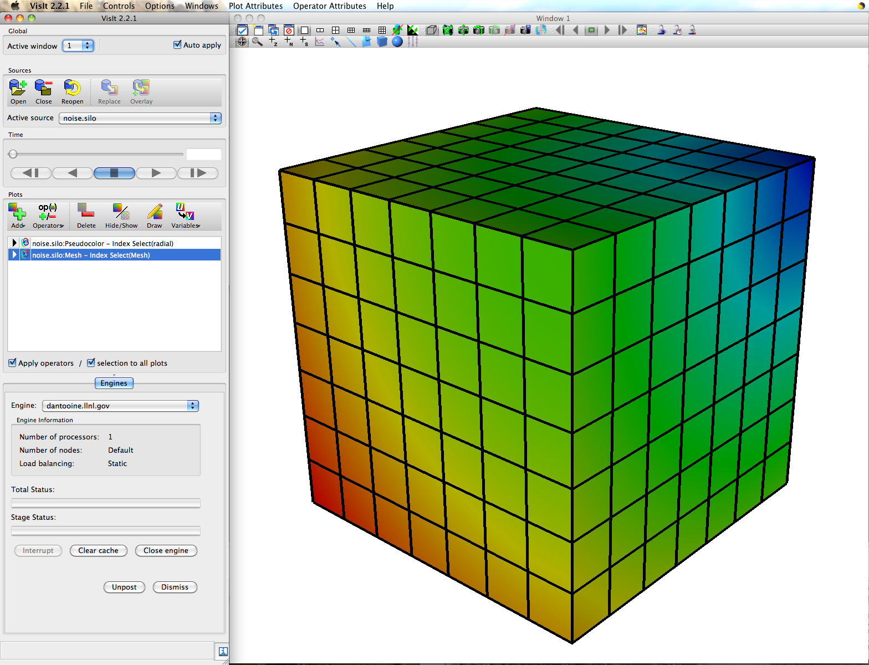
A Marriage Between Two Fairly Inflexible Partners…
We are presenting a systems research paper that describes how a general purpose visualization tool can be flexibly coupled with a simulation.
Layer
In
Between
Simulation
Visualization and Analysis Application
Notes:
This represents a marriage between two pretty inflexible partners

Slide 5
In Situ Processing Strategies
We find 3 main strategies for in situ processing:
In Situ Strategy | Description | Negative Aspects
Loosely coupled | Visualization and analysis run on concurrent resources and access data over network | Data movement costs Requires separate resources
Tightly coupled | Visualization and analysis have direct access to memory of simulation code | Very memory constrained Large potential impact (performance, crashes)
Hybrid | Data is reduced in a tightly coupled setting and sent to a concurrent resource | Complex Shares negative aspects (to a lesser extent) of others

Slide 6
Loosely Coupled In Situ Processing
I/O layer stages data into secondary memory buffers, possibly on other compute nodes
Visualization applications access the buffers and obtain data
Separates visualization processing from simulation processing
Copies and moves data
Simulation
data
I/O Layer
Possible network boundary
Memory buffer
Visualization tool
read
data

Slide 7
Tightly Coupled Custom In Situ Processing
Simulation
Custom visualization routines are developed specifically for the simulation and are called as subroutines
Create best visual representation
Optimized for data layout
Tendency to concentrate on very specific visualization scenarios
Write once, use once
data
Visualization Routines
images, etc
Notes:
Optimal performance since algorithms can be tied to the needs and data layout of the simulation.

Slide 8
Tightly Coupled General In Situ Processing
Simulation
Simulation uses data adapter layer to make data suitable for general purpose visualization library
Rich feature set can be called by the simulation
Operate directly on the simulation’s data arrays when possible
Write once, use many times
data
Data Adapter
General Visualization Library
images, etc
Notes:
Acceptable performance since there are opportunities to directly use data arrays. Performance won’t be as good as custom solution.

Slide 9
Which Strategy is Appropriate?
There have been many excellent papers and systems in this space. Different circumstances often merit different solutions.
 | Tightly Coupled | Loosely Coupled | Hybrid
Custom
General
✖
✖
✖
✖

Slide 10
Design Philosophy
Visualization and analysis will be done in the same memory space as the simulation on native data to avoid duplication
Maximize features and capabilities
Minimize code modifications to simulations
Minimize impact to simulation codes
Allow users to start an in situ session on demand instead of deciding before running a simulation
Debugging
Computational steering
Notes:
Target distributed memory parallelism using MPI

Slide 11
Selecting an In Situ Strategy
Our strategy is tightly coupled, yet general
Fully featured visualization code connects interactively to running simulation
Allows live exploration of data for when we don’t know visualization setup a priori
Opportunities for steering
We chose VisIt as the visualization code
VisIt runs on several HPC platforms
VisIt has been used at many levels of concurrency
We know how to develop for VisIt

Slide 12
Visualization Tool Architecture
Clients runs locally and display results computed on the server
Server runs remotely in parallel, handling data processing for client
Local VisIt Clients
Parallel Cluster
Files
Vis Server
Data Plugin
Data
MPI
Vis Server
Data Plugin
network connection
Data
Vis Server
Data Plugin
Data
Data processed in data flow networks
Filters in data flow networks can be implemented as plug-ins
Vis Server
Filter
Data Flow Network
Filter
Filter
Notes:
Describe what we were starting with.

Slide 13
Coordination Among Filters Using Contracts
data
Source
Contract₁
Update
Filter
Execute
Contract₀
Filter
Notes:
One key feature that we take advantage of is contracts.
Contracts help coordinate behavior among filters
One key use is to identify the pieces of data that must be processed in the data flow network

Slide 14
Coupling of Simulations and VisIt
We created Libsim, a library that simulations use to let VisIt connect and access their data
Simulation
Libsim Front End
Libsim
Front End
Libsim
Runtime
Source
Filter
Data Access Code
Data Access Code
Data
Filter
Notes:
Libsim is divided into front end and runtime library pieces to avoid large increases in the size of the simulation executable
The front end library is a small, static, C library with mechanisms that let VisIt connect to the simulation
Does not introduce C++ dependencies into simulation
Simplifies automatic generation of other language bindings
The runtime library loads when VisIt connects to the simulation
Provides access to all of VisIt’s visualization and data analysis algorithms
Lets one simulation executable benefit from newer VisIt server runtimes

Slide 15
A Simulation Using Libsim
Front end library lets VisIt connect
Runtime library processes the simulation’s data
Runtime library obtains data on demand through user-supplied Data Access Code callback functions
Local VisIt Clients
Parallel Cluster
Simulation Code
Front end
Libsim Runtime
Data Access Code
Data
Simulation Code
MPI
Front end
Libsim Runtime
Data Access Code
Data
network connection
Simulation Code
Front end
Libsim Runtime
Data Access Code
Data

Slide 16
In Situ Processing Workflow
The simulation code launches and starts execution
The simulation regularly checks for connection attempts from visualization tool
The visualization tool connects to the visualization
The simulation provides a description of its meshes and data types
Visualization operations are handled via Libsim and result in data requests to the simulation

Slide 17
Instrumenting a Simulation
Additions to the source code are usually minimal, and follow three incremental steps:
Initialize Libsim and alter the simulation’s main iterative loop to listen for connections from VisIt.
Create data access callback functions so simulation can share data with Libsim.
Add control functions that let VisIt steer the simulation.

Slide 18
Adapting the Main Loop
Libsim opens a socket and writes out connection parameters
VisItDetectInput checks for:
Connection request
VisIt commands
Console input
Initialize
Visualization Request
Complete VisIt Connection
VisItDetectInput
Solve Next Step
Process VisIt Commands
Process Console Input
Check for convergence, end of loop
Exit
Notes:
Call libsim initialization to make it set up a socket that it will use to listen for inbound VisIt connections.
Call VisItDetectInput from your main loop to check for various types of input then use the return code to handle the data appropriately.

Slide 19
Sharing Data
VisIt requests data on demand through data access callback functions
Return actual pointers to your simulation’s data (nearly zero-copy)
Return alternate representation that Libsim can free
Written in C, C++, Fortran, Python
Notes:
OnceVisIt decides which variables it needs using the contract, it calls your sim’s data access callback functions.
Data access callbacks are used to get metadata, meshes, variables, AMR nesting information, etc.

Slide 20
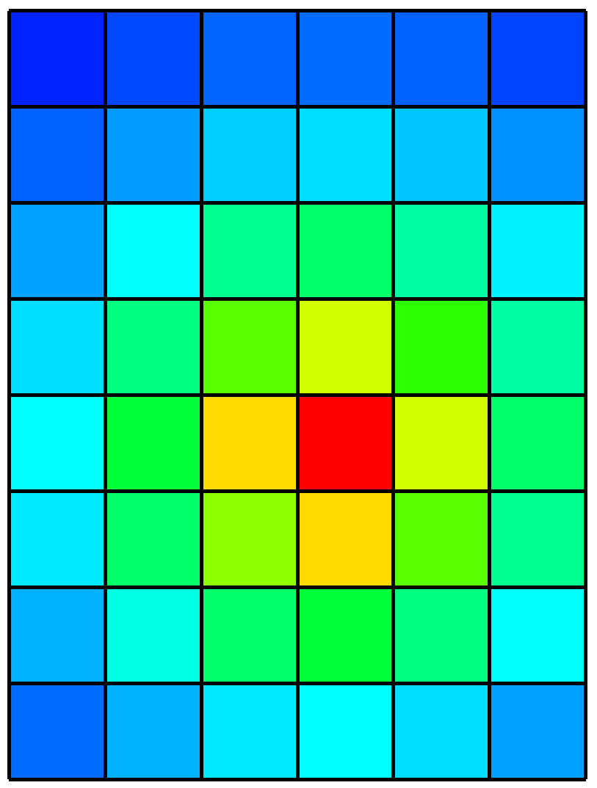
Sharing Data Example
// Example Data Access Callback
visit_handle
GetVariable(int domain, char *name,
void *cbdata)
{
visit_handle h = VISIT_INVALID_HANDLE;
SimData_t *sim = (SimData_t *)cbdata;
if(strcmp(name, "pressure") == 0)
{
VisIt_VariableData_alloc(&h);
VisIt_VariableData_setDataD(h,
VISIT_OWNER_SIM,
1, sim->nx*sim->ny,
sim->pressure);
}
return h;
}
Simulation Buffer
SimData_t
Nx=6
Ny=8
pressure
Pass simulation buffer to Libsim

Slide 21
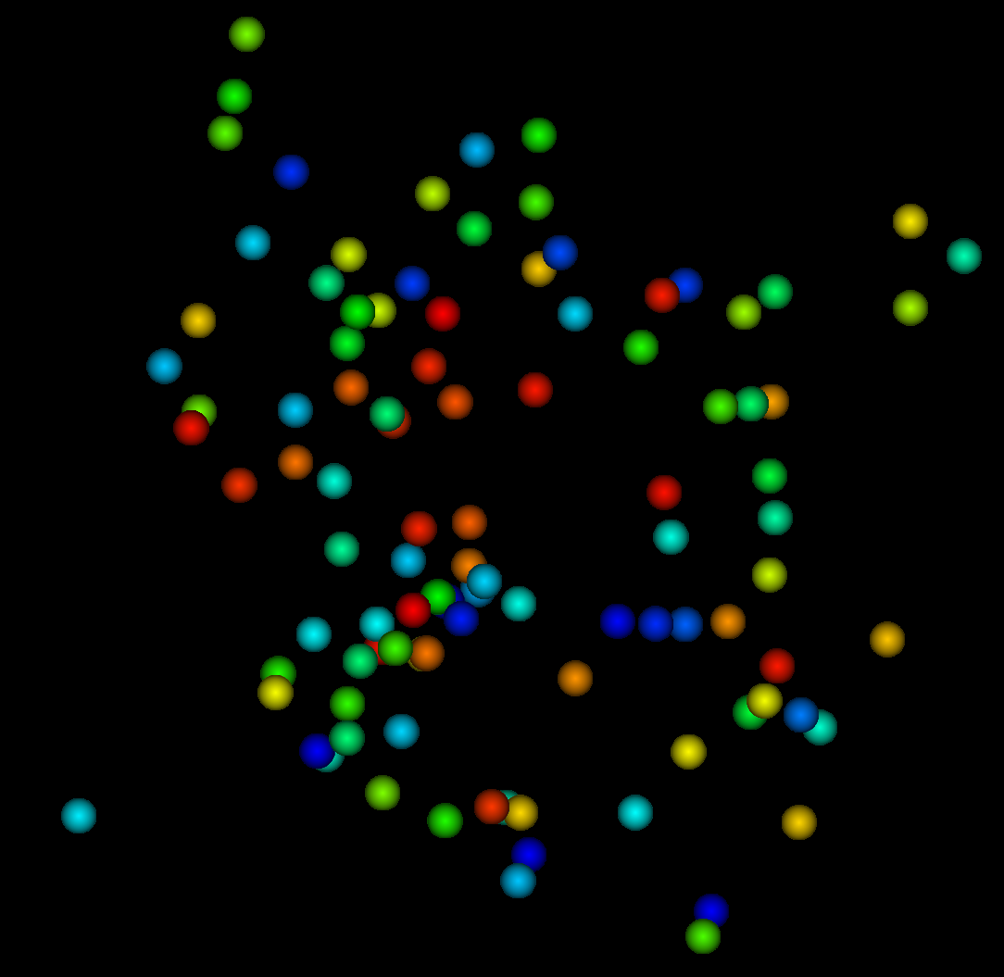
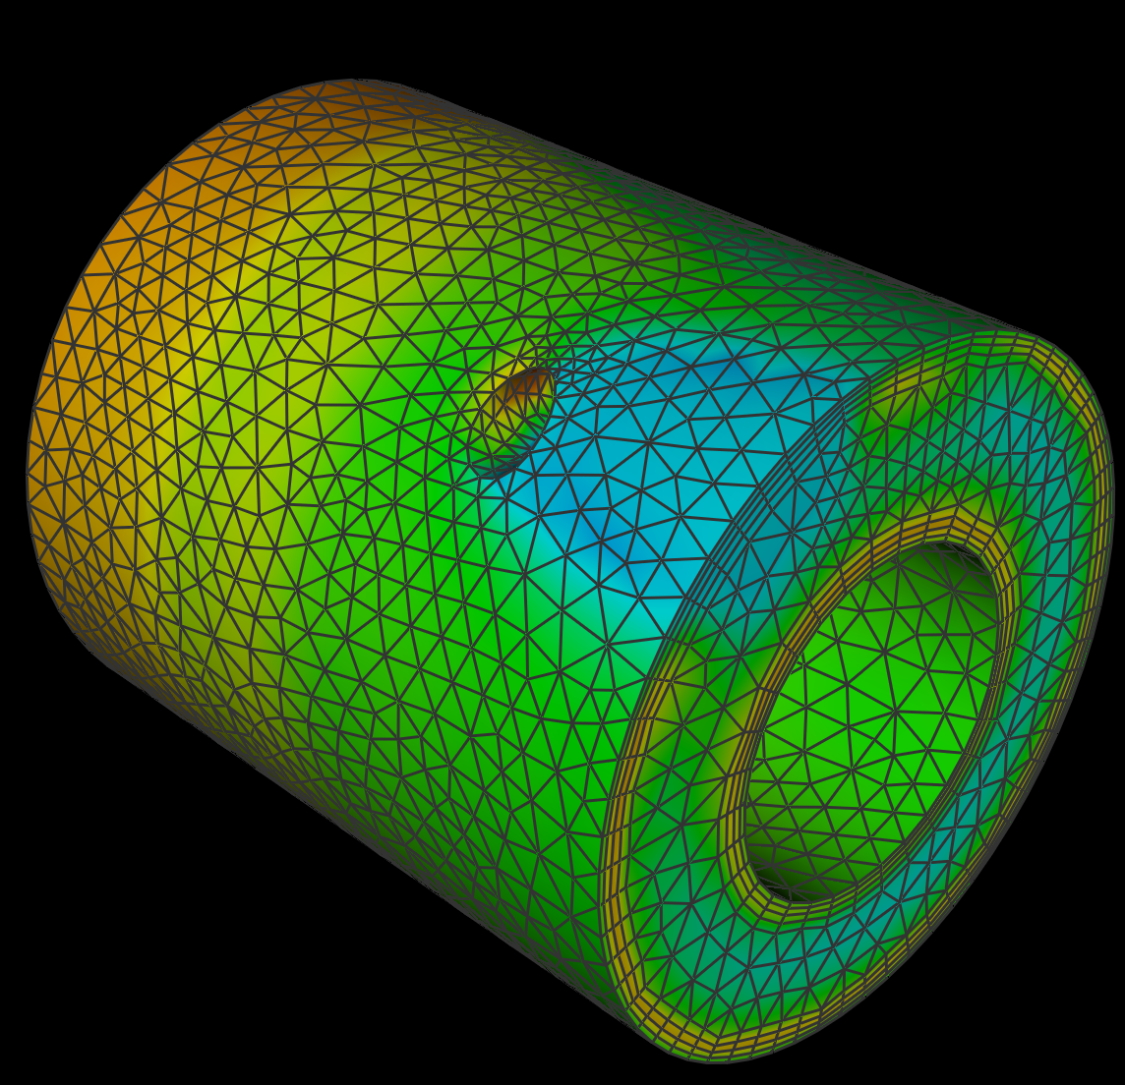
Supported Data Model
Mesh Types
Structured meshes
Point meshes
CSG meshes
AMR meshes
Unstructured & Polyhedral meshes
Variables
1 to N components
Zonal and Nodal
Materials
Species
Notes:
Here are the types of data that can be returned from the various data access callback functions

Slide 22
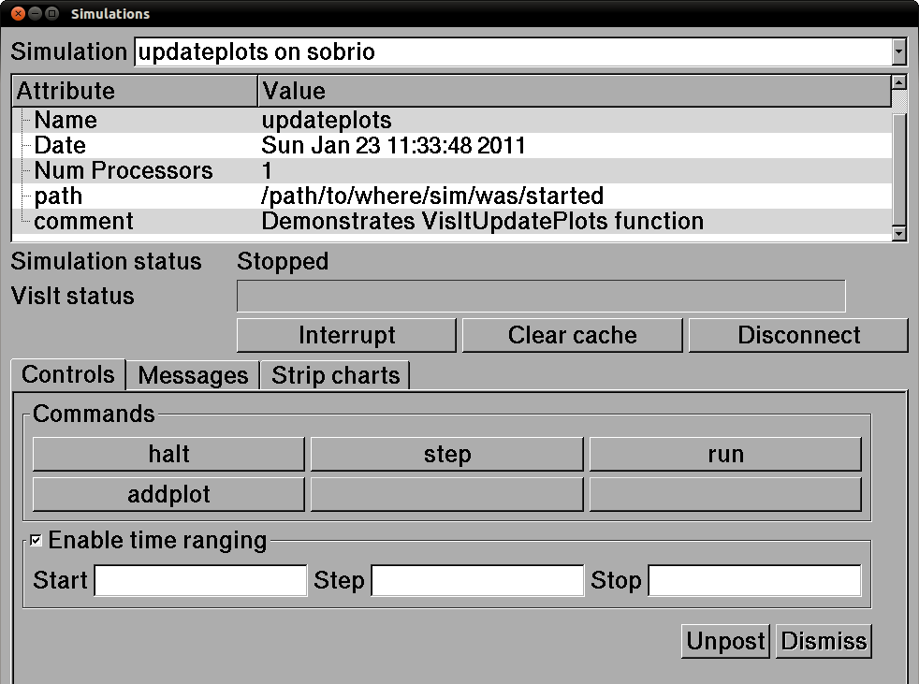
Adding Control Functions
The simulation provides commands to which it will respond
Commands generate user interface controls in Simulations Window

Slide 23
Custom User Interfaces
Simulation can provide UI description for more advanced computational steering
Notes:
Sims can provide a Qt Designer XML file that lets VisIt generate UI on the fly. The widgets have the same names as commands so interacting with them causes commands to be issued to the simulation

Slide 24
Libsim in Practice
We conducted our experiments on a 216 node visualization cluster
Two, 6 core 2.8GHz Intel Xeon 5660 processors
96Gb of memory per node
InfiniBandQDR high-speed interconnect
Lustre parallel file system
We measured the impact of Libsim on a simulation’s main loop, without connecting to VisIt
We measured memory usage after loading VisIt
We instrumented GADGET-2, a popular cosmology code, with Libsim and measured performance

Slide 25
Impact on the Main Loop
Measure cost of calling Libsim in the main loop
Instrumenting the main loop for a parallel simulation requires calling VisItDetectInput and MPI_Bcast
We timed how long it took to call both using 512 cores
10K main loop iterations
Cores | VisItDetectInput overhead | MPI_Bcast overhead | Overhead loading VisIt runtime libraries
512 | 2μs | 8μs | 1s (1 time cost)

Slide 26
Impact on Memory Usage
Measure memory used before and after VisIt is connected
Measured our updateplots example program
Read values from /proc/<pid>/smaps
Event | Size | Resident Set Size
Simulation startup | 8.75 Mb | 512 Kb
After Libsim Initialization | 8.75 Mb | 614 Kb
After Loading VisIt | 222 Mb | 43.5 Mb

Slide 27
Impact on GADGET-2 Simulation
GADGET-2, a distributed-memory parallel code for cosmological simulations of structure formation
We measured in situ performance versus I/O performance at 3 levels of concurrency
Render 2048*2048 pixel image
Collective I/O and file-per-process I/O
16 million particles and 100 million particles
Results show that in situ using a fully featured visualization system can provide performance advantages over I/O
We relied on VisIt’s ability to scale (runs up to 65,356 cores have been demonstrated)

Slide 28
Libsim/GADGET-2 Timing Results
16M particles | 32 cores | 256 cores
I/O 1 file | 2.76s | 4.72s
I/O N files | 0.74s | 0.31s
In situ | 0.77s | 0.34s
100M particles | 32 cores | 256 cores | 512 cores
I/O 1 file | 24.45s | 26.7s | 25.27s
I/O N files | 0.69s | 1.43s | 2.29s
In situ | 1.70s | 0.46s | 0.64s
I/O results are the average of 5 runs per test case
In Situ results are averaged from timing logs for multiple cores
In situ competitive or faster than single file I/O with increasing cores
It should be possible to do several in situ operations in the time needed for I/O
Time savings compared to simulation followed by post processing

Slide 29
VisIt Connected Interactively to GADGET-2

Slide 30
Additional Results
Time to Detect Environment
We have recently instrumented additional simulations to investigate Libsim’s scaling properties on a Cray XE6 using up to 4224 cores
We identified and corrected a performance bottleneck in Libsim’s environment detection functions

Slide 31
Additional Results
Time per iteration
Simulation was run on 11, 22, 44, 88 and 176 nodes (24 cores/node)
Each MPI task had a 512x512x100 block of data to isocontour at 10 different thresholds
Parallel I/O to disk was done with netCDF-4, in files of size 27, 55, 110, 221, and 442 Gb per iteration
Notes:
The parallel IO part does not do any contouring. It simply does one iteration of the solver and dumps the data straight to disk.
The file system is Lustre.
All timings are averages over 70-100 iterations ( a 1 hour run-time on the queue). The machine was open to the public, except when I requested the full number of nodes when nobody else could run any queued jobs.
The in-situ part was connecting the Cray to my desktop.

Slide 32
Additional Results
We completed a Python language binding to Libsim using SWIG
Demonstrates that our choice to provide a pure C API for Libsim simplifies generation of language bindings
Functions that accept a callback function pointer do require some special care and we are thinking of ways to mitigate

Slide 33
Limitations of Implementation
Memory intensive
Runtime library cost is larger than with static-linking since we use the whole feature set
Filters may use intermediate memory
Zero-copy is not fully implemented
We currently require an interactive session though with some changes we could avoid this
Notes:
Intermediate memory may not be much of an issue because in a typical simulation there are many variables so the amount of data per core tends to be lower than when we read the data in postprocessing on a tenth of the resources.

Slide 34
Future Work
Provide additional functions for setting up visualization so in situ processing can be less user-driven
Further limit resources consumed by the VisIt runtime libraries in order to lessen the impact that in situ analysis has on the simulation
Characterize performance costs of using shared libraries on larger scale runs

Slide 35
Conclusion
We have implemented Libsim, an easy to use library that enables in situ computations
Provides access to a fully featured, parallel visualization and analysis tool that excels at scale
Minimizes impact to simulation performance
Minimizes the amount of new code that must be written
Fully integrated with the open-source distribution of VisIt

