Slide 1
In Situ Sampling of a Large-Scale Particle Simulation
Jon Woodring
Los Alamos National Laboratory
DOE CGF 2011

Slide 2
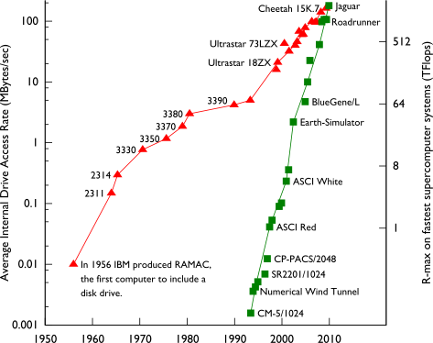
Exascale I/O Bandwidth compared to Compute Rate is Imbalanced
One of the largest challenges for analysis at exascale (and currently) is I/O bandwidth, both for disks and networks
Roadrunner Universe MC³ 4000³ run (64 billion particles) generates 2.3 TB per time slice
Compute (green) is growing faster than disk bandwidth (red)
For x flops it generates x/c amount of data, where c is constant

Slide 3
Implicit Visual Downsampling through Massively Parallel Visualization
Lack of display bandwidth compared to data sizes
This data on the right aren’t even “large” – it’s 256³ (16 million points) which is 3 orders of magnitude smaller than 4000³ (64 billion)
Need to use level-of-detail (multi-scale)
Can’t see the structure in a cosmology data set
because there are more data point than pixels

Slide 4
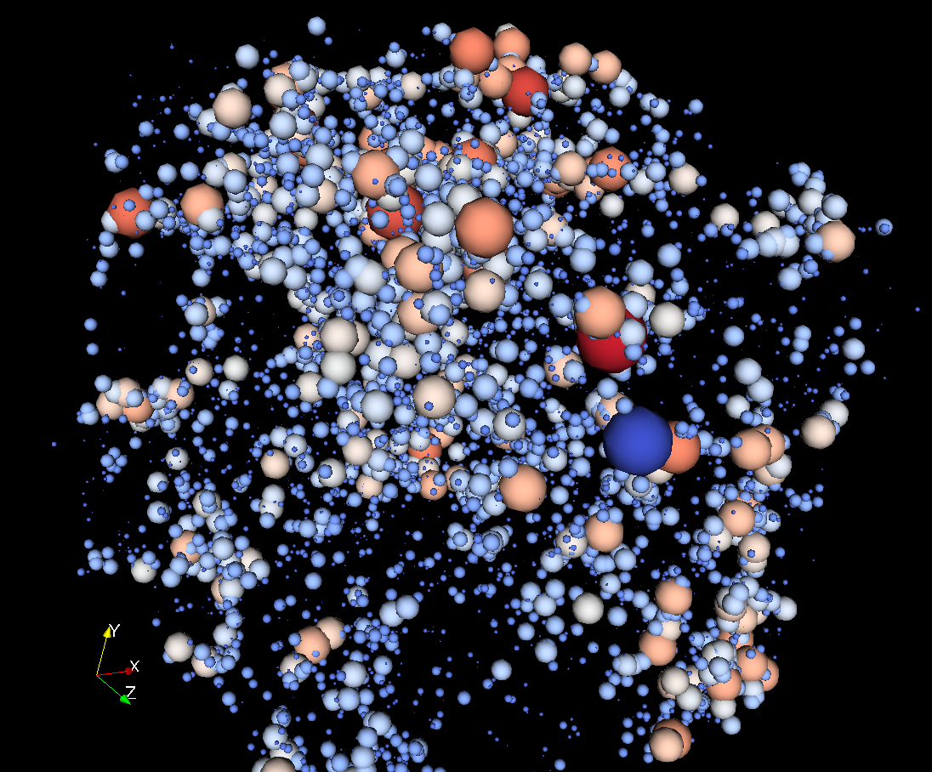
In-Situ Visualization and Analysis
In-situ visualization and analysis performs some analysis operations while a simulation is running
The trick is trying to figure out what data, images, or features to save for post-analysis
For the 4000³ run, they only saved the “halos”
Visualization of dark matter clusters from a cosmology simulation.
Clusters can be calculated as the simulation is running, greatly reducing
the necessary storage space, instead of writing the full resolution data
to storage and calculating the clusters in post-analysis.

Slide 5
Quantified Data Scaling at Exascale
To adapt to bandwidth limitations, we focus on managing data for analysis
Use simulation-time analysis, to explicitly reduce data at compute run-time, such as using statistical sampling to store data samples
Use quantifiable data reduction, such as recording of original statistical variance when performing data reduction
This work is in conjunction with LANL statistics group (CCS-6)

Slide 6
Benefits and Drawbacks of In-Situ Visualization and Analysis
Benefits
Data can be scaled down to a compact form, such as images, features, clusters, and samples
By scaling down the data, the simulation I/O time can be budgeted in a fine-grain fashion
Drawbacks
The types of analysis to be generated at run-time has to be decided in advance: which plots to calculate, which features to extract, and which data to save for post-analysis
Some simulation time has to be spent in analysis

Slide 7
Try to Defer the Decision: Use Statistical Sampling to Store “Raw” Data
We utilize statistical random sampling as a raw data scaling operation for interactive post-analysis and visualization
Random sampling is applied, as the simulation is running, to store a smaller sample
The implementation is slightly more involved than simple random sampling (slides to come)
Raw cosmology simulation data
Sampled cosmology data

Slide 8
Benefits of Random Sampling as an In-Situ Data Scaling Algorithm
Most analysis operations can be applied on the sample data in post-analysis, instead of deciding the the analyses in advance
Storage space and bandwidth can be fine-grain to make decisions on scaling I/O utilization
Provides a data representation that is unbiased for statistical estimators, e.g., mean
Increases the time fidelity in post-analysis by increasing the number of available time slices
Can quantify the difference between sample data and original full-resolution data

Slide 9
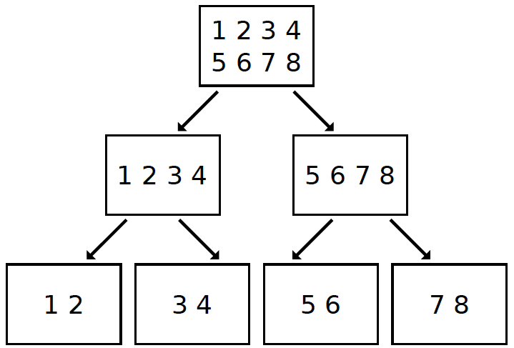
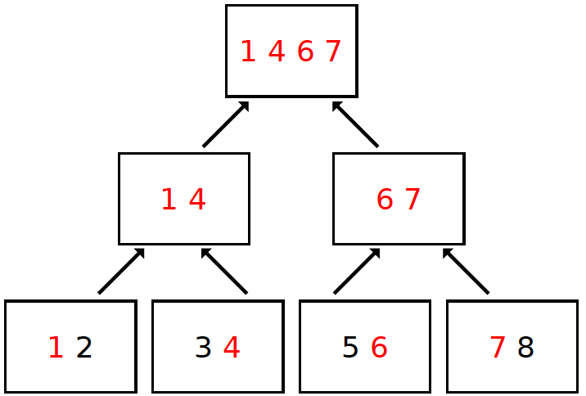
Stratified Random Sampling via kd-tree and Parallel Decomposition
Using parallel processor decomposition and kd-tree sorting, random samples are evenly spread across space: statistical estimators have lower variance
This is “stratified random sampling” in the statistics literature (though, the statisticians had to verify)
Sorting data into sampling strata
Acquiring a stratified random sample from decomposition
Woodring et al., “In-situ Sampling of a Large-Scale Particle Simulation
for Interactive Visualization and Analysis”, EuroVis 2011

Slide 10
Stratified Sampling maps directly to Interactive Visualization by Level-of-Detail
The sampling strata decomposition naturally maps into a tree-based storage hierarchy that can be used to read the data
Removes post-processing
Level-of-detail (multi-resolution) scaling for interactive visualization
Movie: Level-of-detail interaction matching data density to pixels
Woodring et al., “In-situ Sampling of a Large-Scale Particle Simulation
for Interactive Visualization and Analysis”, EuroVis 2011
Movie: Streaming interaction showing block reads from disk

Slide 11
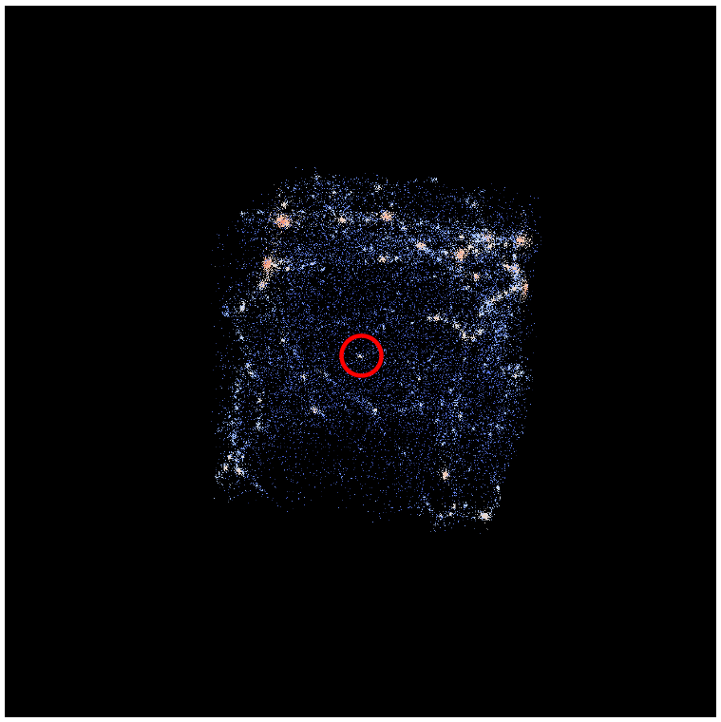
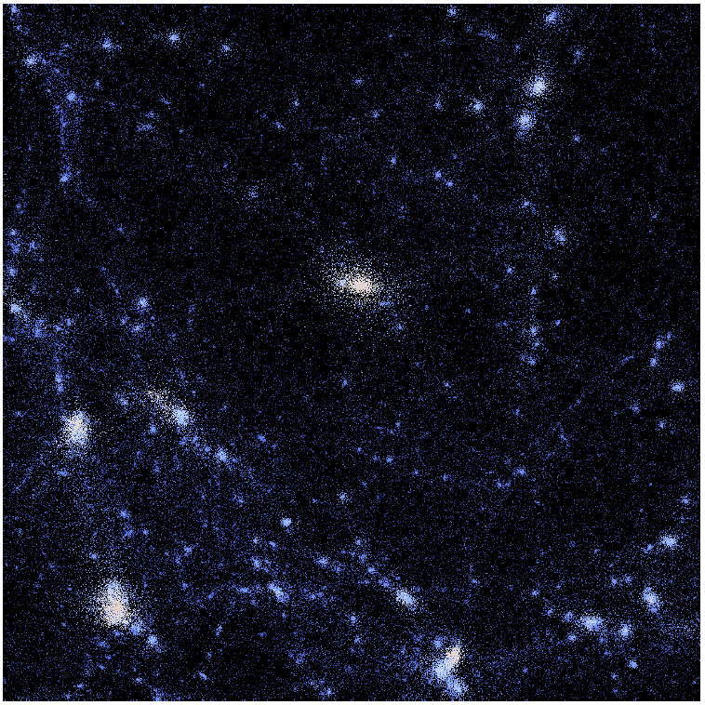
Quantifying the Local Differences Between Samples and Original Full-Resolution Data
Since the sampling algorithm is done in situ, we are able to measure the local differences between sample data augment sample data with original data statistics
The full-resolution statistics provide an error bounds for the sample data and information about the “lost” data
A cluster is identified in low density region
Woodring et al., “In-situ Sampling of a Large-Scale Particle Simulation
for Interactive Visualization and Analysis”, EuroVis 2011
Particles are colored by the local variance of the original data

Slide 12
Small Samples still reflect the Original Data: A 0.19% Sample and Full Resolution Data
Histograms of velocity components in cosmological particle data: red is sample data and black is original data
Sample size is 32K (0.19%) and original size is 16M
Average velocity component values over space in cosmological particle data: red is sample data and black is original data
Sample size is 32K (0.19%) and original size is 16M
Red is sample data, black is original simulation data -
Both curves exist in all graphs, but the curve occlusion
is reversed on top slides compared to bottom slides

Slide 13
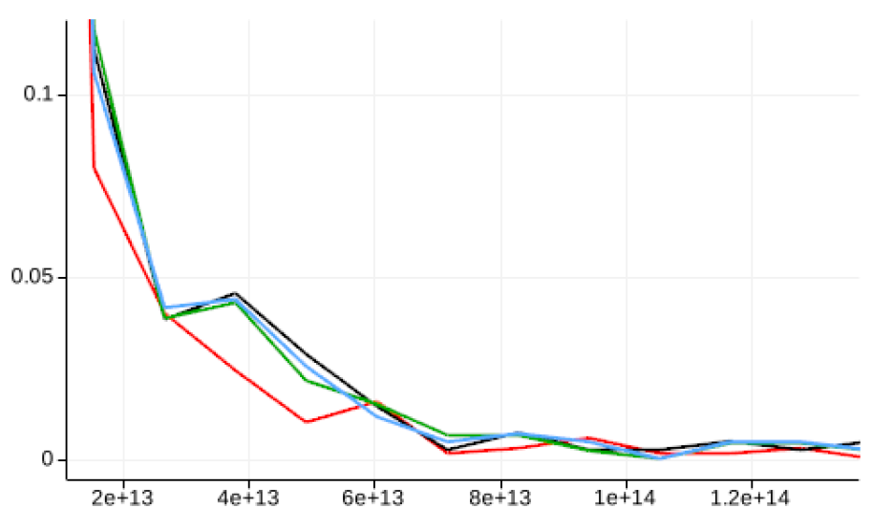
Complex Analysis of Sample Data Compared to Original Simulation Data
We are also able to perform many other analyses on “raw” sample data: here, we use a domain-specific “halo” (cluster) analysis on the sample data
The types of analysis that can be used is completely domain and analysis dependent, and has to be tested on a case-by-case basis
Histogram of cluster analysis in cosmology data for different sample sizes:
Original size is 16M (black) with 3 samples:
Red is 0.19% sample, green is 1.6% sample, and blue is 12.5% sample

Slide 14
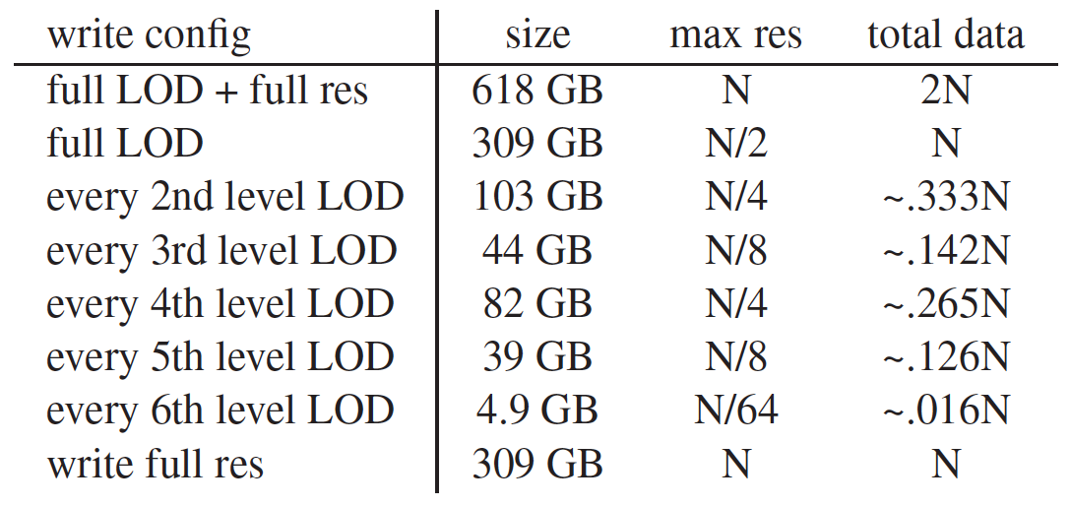
Measuring the Performance of Statistical Sampling with a Simulation
We tested the system performance characteristics of our sampling method with a 2048³ (8 billion) particle (RoadRunner Universe MC³) simulation per time slice
Different sample size configurations in our testing per time slice, where N is the original data size (2048³ particles)
(“GB” is short for gigabytes, “res” is short for resolution, “LOD” is short for level-of-detail)

Slide 15
Workflow Savings by Writing the Data directly into an Interactive Format
Assuming we use the same simulation I/O time, we always save 6 minutes, per time step, from simulation to interactive post-analysis by directly writing data into a level-of-detail format
We remove one read and one write of the data in post-processing and it is immediately ready for visualization and analysis from the simulation
“Write full” is the time to write full resolution data from the simulation,
while “read full” is the time is takes to read full resolution data (Cerrillos connected to a Panasas).
“Lag save” is the time saved between simulation and post-analysis.

Slide 16
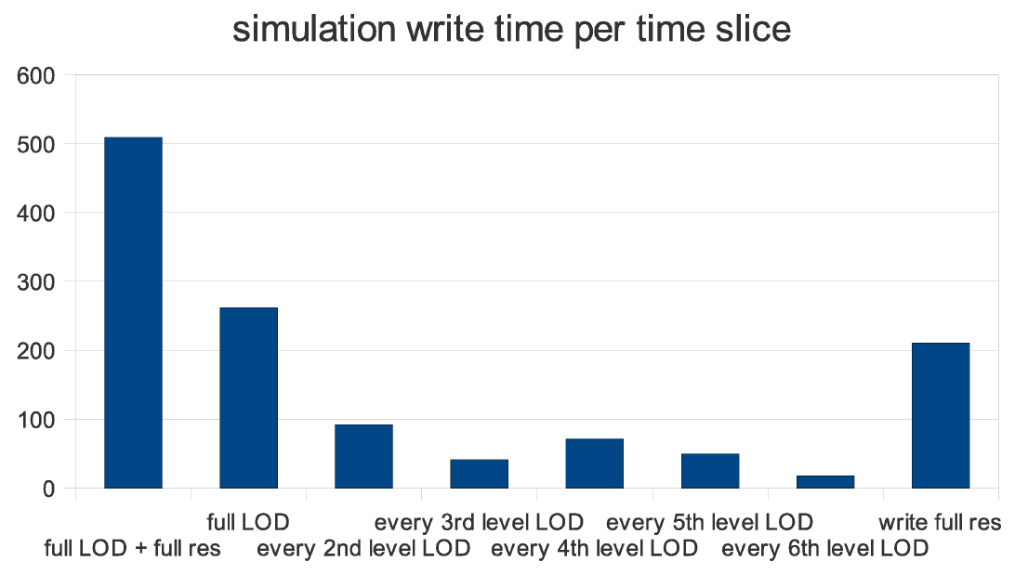
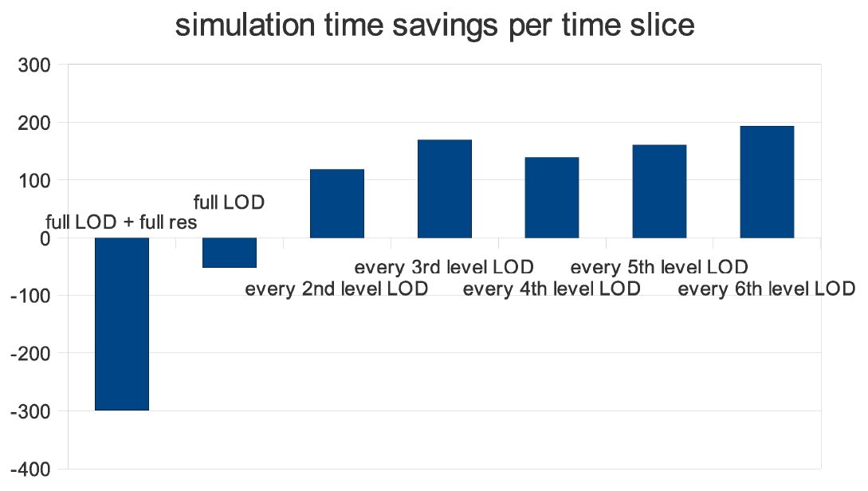
Simulation I/O Time Savings per Time Slice for Different Sample Sizes
Writing less data through sampling significantly reduces the amount of time spent in I/O per time slice
The green highlighted bars are instances of writing half of the original data size or less
Time taken in seconds to write a time slice
for different sample configurations (sizes)
Time savings in seconds to write a time slice
for different sample configurations (sizes)

Slide 17
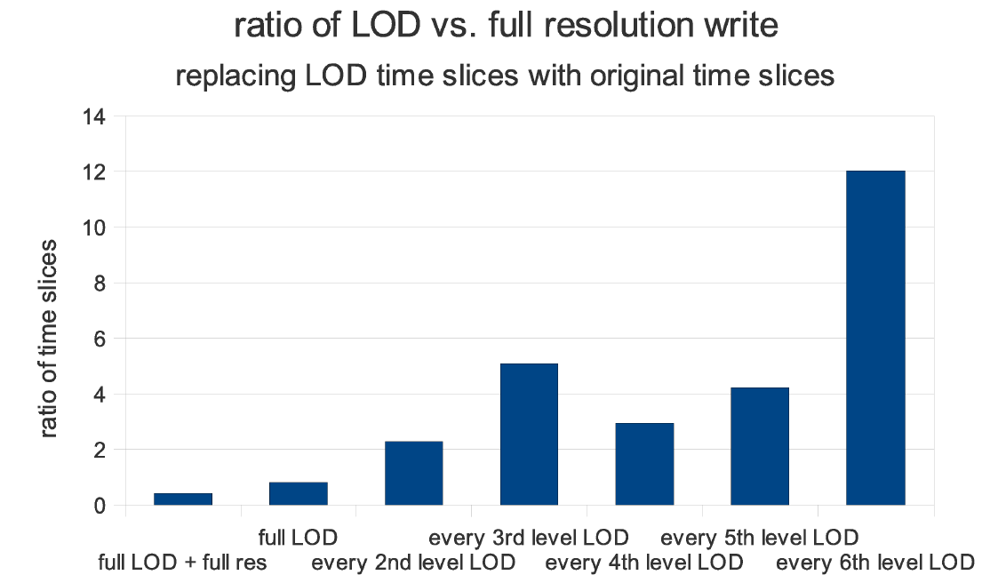
Trading Full Resolution Data for Sample Data Allows for Simulation Fine-Grain I/O
Our in-situ sampling method allows the simulation to adaptively control I/O expenditure
Increase the number of time slices, retain high spatial resolution data, and fine-grain manipulation of I/O utilization
The ratio of time slices that can be stored in the same
time that it takes to write non-LOD full resolution data.
For example, 100 time slices can be converted to 200-1200
low-resolution sample slices and 20 full resolution slices.

Slide 18
Future Research for Data Sampling Methods at Exascale Scientific Computing
Exploring other methods for sampling
Outlier sampling
Sampling in high-dimensional space
Temporally coherent random sampling
Sampling on structured and unstructured grids
Feature and data mining driven sampling
Evaluating reconstruction methods for sampled data
Tracking and calculating error in analysis tools
Additional scaling knobs: precision, variables…

